Slide 1
Using Corpora - II
Albert Gatt

Slide 2
Corpus search
These notes introduce some practical tools to find patterns:
regular expressions
A general formalism to represent finite-state automata
the corpus query language (CQL/CQP):
developed by the Corpora and Lexicons Group, University of Stuttgart
a language for building complex queries using:
regular expressions
attributes and values

Slide 3
A typographical note
In the following, regular expressions are written between forward slashes (/.../) to distinguish them from normal text.
You do not typically need to enclose them in slashes when using them.

Slide 4
Practice
Today we’ll use two corpora:
The MLRS Corpus of Maltese (v2.0)
The CLEM Corpus of Learner English (v2.0)
Both available on a uni server:
http://mlrs.research.um.edu.mt/CQPweb
(This is probably a good time to sign up if you don’t have an account)

Slide 5
Simple query syntax
Part 1

Slide 6
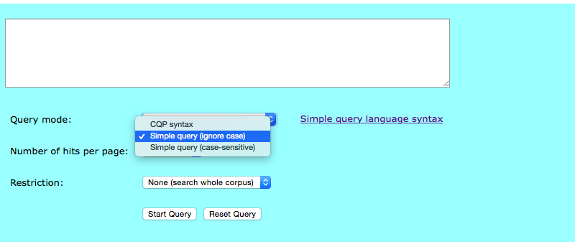
The query interface

Slide 7
Simple queries
Can take the form of words or phrases:
kien
kien qed jiekol
…
But this is a bit limiting.
Simple queries have a (limited) pattern syntax we can exploit.

Slide 8
Levels
We define different levels of annotation.
This depends on the corpus and what info it contains.
The levels can be distinguished in the Simple Query Interface
MLRS:
Primary level: word
Secondary level: pos
CLEM:
Primary level: word
Secondary level: pos
Tertiary annotation: lemma

Slide 9
Simple Query: levels
Primary level:
Convention: just plain typed queries: word or phrase
MLRS: kien
CLEM: he was
Secondary level:
Preceded by an underscore
MLRS: kien_VA
Find instances of “kien” tagged as auxiliary verbs
CLEM: man_NN
Find instances of “man” tagged as nouns
Can also be independent:
MLRS: kien _NN
= instances of kien followed by anything tagged as Noun

Slide 10
Simple query: levels
Tertiary level:
Surrounded by curly brackets
CLEM: {have}
Find instances of the lemma “have”
Returns have, having, had…
CLEM: {man}_NN
Find instances of the lemma “man” tagged as noun
Returns man, men…

Slide 11
Practice
Each corpus links to its POS tagset. You need to have this in front of you!
In CLEM or MLRS, try looking for:
A personal pronoun followed by a verb followed by a determiner followed by a noun
e.g. she ate a bun
E.g. hu qatel in-nemusa
In CLEM, try looking for:
The pronoun it followed by the lemma result tagged as a verb followed by that.

Slide 12
Simple Query Patterns
There is a small number of “wildcard” characters. These can be used on any of the three annotation levels.
? – any character
b?ood → blood, brood
* -- zero or more characters (any)
*able → able, capable, manageable…
+ -- one or more characters (any)
+ata → ravjulata, prinjolata, ċuċata… (but not ata)
??+ -- three or more characters
For alternatives, use square brackets
??+[ata,aġġ] → rappurtata, rappurtaġġ

Slide 13
Try some queries…
Remember:
In MLRS, you have word and pos
In CLEM, you also have lemma
Try using some pattern combinations, for example:
A verb group (auxiliary + main verb, etc)
Specific derivations with a particular prefix/suffix
A word/lemma ending in a specific suffix, tagged as a verb, followed by a pronoun
An adjective, followed by a word/lemma starting with a specific prefix and tagged as a noun
…

Slide 14
An important disclaimer
The symbols used in the simple query language are similar to the ones used for full-fledged regular expressions
However, in real regexes, the meaning is sometimes slightly different.

Slide 15
Regular expressions
Part 2

Slide 16
Regular expressions
A regular expression is a pattern that matches some sequence in a text. It is a mixture of:
characters or strings of text
special characters
groups or ranges
e.g. “match a string starting with the letter S and ending in ane”

Slide 17
The simplest regex
The simplest regex is simply a string which specifies exactly which tokens or phrases you want.
These are all regexes:
the tall dark lady
dog
the

Slide 18
Beyond that
But the whole point of regexes is that we can make much more general searches, specifying patterns.

Slide 19
Delimiting regexes
Special characters for start and end:
/^man/ => any sequence which begins with “man”: man, manned, manning...
/man$/ => any sequence ending with “man”: doberman, policeman...
/^man$/=> any sequence consisting of “man” only

Slide 20
Groups of characters and choices
/[wh]ood/
matches wood or hood
[…] signifies a choice of characters
/[^wh]ood/
matches mood, food, but not wood or hood
[^…] signifies any character except what’s in the brackets

Slide 21
Practice
Write a regular expression to match:
The word beginning with l or m followed by aid
This should match maid or laid
[lm]aid
The word beginning with r or s or b or t followed by at
This should match rat, bat, tat or sat
[rbst]at

Slide 22
Ranges
Some sets of characters can be expressed as ranges:
/[a-z]/
any alphabetic, lower-case character
/[0-9]/
any digit between 0 and 9
/[a-zA-Z]/
any alphabetic, upper- or lower-case character
/[a-zA-Z0-9]/
any alphabetic, upper- or lower-case character, and any digit

Slide 23
Practice
Type a regular expression to match:
a date between 1800 and 1899
18[0-9][0-9]
the number 2 followed by x or y
2[xy]
A four-letter word beginning with i in lowercase
i[a-z][a-z][a-z]

Slide 24
Disjunction and wildcards
/ba./
matches bat, bad, …
/./ means “any single alphanumeric character”
Compare to the simple query language character “?”
/gupp(y|ies)/
guppy OR guppies
/(x|y)/ means “either X or Y”
important to use (round) parentheses!

Slide 25
Practice
Rewrite this regex using the (.) wildcard
A four-letter word beginning with i in lowercase
i[a-z][a-z][a-z]
i...
Does it match exactly the same things?
Why?

Slide 26
Quantifiers (I)
/colou?r/
matches color or colour
/govern(ment)?/
matches govern or government
/?/ means zero or one of the preceding character or group

Slide 27
Practice
Write a regex to match:
color or colour
colou?r
sand or sandy
sandy?

Slide 28
Quantifiers (II)
/ba+/
matches ba, baa, baaa…
/(inkiss )+/
matches inkiss, inkiss inkiss
(note the whitespace in the regex)
/+/ means “one or more of the preceding character or group”

Slide 29
Practice
Write a regex to match:
A word starting with ba followed by one or more of characters.
ba.+

Slide 30
Quantifiers (III)
/ba*/
matches b, ba, baa, baaa
/*/ means “zero or more of the preceding character or group”
/(ba ){1,3}/
matches ba, ba ba or ba ba ba
{n, m} means “between n and m of the preceding character or group”
/(ba ){2}/
matches ba ba
{n} means “exactly n of the preceding character or group”

Slide 31
Summary
Symbol | Meaning | Example | Matches...
^ | Start of string | /^wo/ | woman, wombat
$ | End of string | /man$/ | woman, man, doberman
[...] | Any of the characters in this range or set | [wh]ood | Wood, hood
(...) | Defines a group | (suit|port)able | suitable, portable
| | A disjunction (“or”)
. | Any since character | ..man | woman, human
? | One or none of the preceding | colou?r | color, colour
+ | One or more of the preceding | (go)+ | go, gogo
* | Zero or more of the preceding | goo*d | good, god, goood
{n,m} | Between n and m of the preceding | go{1,2}d | good, god
{n} | Exactly n of the preceding

Slide 32
Practice
Write a regex to match:
A word starting with ba followed by one or more of characters.
ba.+
Now rewrite this to match ba followed by exactly one character.
ba.{1}
Re-write, to match b followed by between two and four a’s (e.g. Baa, baaa etc)
ba{2,4}

Slide 33
The corpus query language
Part 3

Slide 34
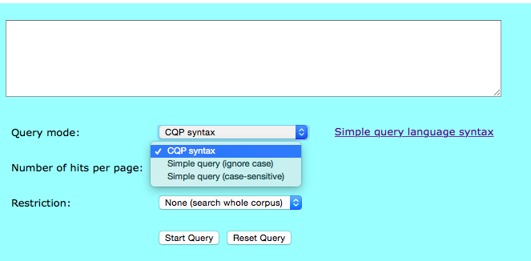
Switch to the CQL interface
Under Query type, select CQP Syntax
Note: CQP syntax on the MLRS/CLEM interface is identical to the CQL syntax in SketchEngine.

Slide 35
CQL syntax
So far, we’ve used regexes to match strings (words, phrases).
We often want to combine searches for words and grammatical patterns.
CQL queries consist of regular expressions.
But we can specify patterns of words, lemmas and pos tags.
NB: What we can do depends on the levels of annotation in the corpus

Slide 36
Structure of a CQL query
[attribute=“...”]
What we want to search for. Can be word, lemma or pos
The actual pattern it should match.

Slide 37
Structure of a CQL query
Examples:
[word=“it.+”]
Matches a single word, beginning with it followed by one or more characters
[pos=“V.*”]
Matches any word that is tagged with a label beginning with “V” (so any verb)
[lemma=“man.+”]
Matches all tokens that belong to a lemma that begins with “man”

Slide 38
Structure of a CQL query
[attribute=“...”]
What we want to search for. Can be word, lemma or pos
The actual pattern it should match.
Each expression in square brackets matches one word.
We can have multiple expressions in square brackets to match a sequence.

Slide 39
CQL Syntax (I)
Regex over word:
[word=“it”] [word=“resulted”] [word=“in”]
matches only it resulted in
Regex over word with special characters:
[word=“it”] [word=“result.*”] [word=“in”]
matches it resulted/results in
Regex over lemma:
[word=“it”] [lemma=“result”] [word=“that”]
matches any form of result (regex over lemma)

Slide 40
CQL Syntax II
We can combine word, lemma and pos queries for any single word.
Word and tag constraints:
[word=“it”] [lemma=“result” & pos=“V.*]
Matches only it followed by a morphological variant of the lemma result whose tag begins with V (i.e. a verb)

Slide 41
Practice
Write a CQL query to match:
Any word beginning with lad
[word=“lad.*”]
The word strong followed by any noun
NB: remember that noun tags start with “N”
[word=“strong”] [tag=“N.+”]

Slide 42
Practice
The word strong followed by any noun
[word=“strong”] [pos=“N.+”]
Rewrite this to search for the lemma strong tagged as adjective.
NB: Adjective tags in CLEM start with JJ; in MLRS with MJ
[lemma=“strong” & pos=“JJ.*”][pos=“N.+”]
The lemma eat in its verb (V) forms
[lemma=“eat” & pos=“V.*”]

Slide 43
CQL syntax III
The empty square brackets signify “any match”
Using complex quantifiers to match things over a span:
[word=“confus.*” & pos=“V.*”] []{0,2} [word=“by”]
“verb beginning with confus tagged as verb, followed by the word by, with between zero and two intervening words”
confused by (the problem)
confused John by (saying that)
confused John Smith by (saying that)

Slide 44
Practice
Search for the verb knock/ħabbat (in any of its forms), followed by the noun door/bieb, with between zero and three intervening words:
[lemma=“knock” & pos=“V.*”][]{0,3}[word=“door” & pos=“N.*”]

Slide 45
Counting stuff (again)
Part 4

Slide 46
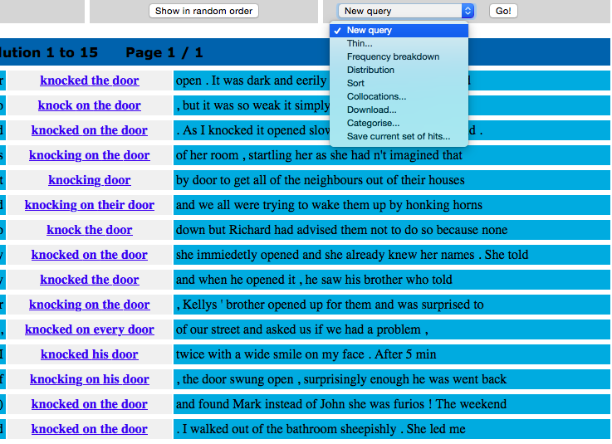
We can count occurrences of these complex phrases
Pretty much the same functionality as we saw last time in SketchEngine is available on this server.
It’s just located in a different place.

Slide 47
A final task
Choose two adjectives which are semantically similar.
Search for them in the corpus (MT or EN), looking for occurrences where they’re followed by a noun.
Run a frequency query on the results.
Generate collocations for them.

