Slide 1
LIN3021 Formal Semantics Lecture 2
Albert Gatt

Slide 2
Aims
Our aim today will be to:
Revisit the principle of Compositionality and try to put it on a concrete footing.
Explore the relationship between syntax and semantics in constructing the meaning of a phrase.
Revisit some formal machinery to help us achieve this.
The main linguistic phenomenon we’ll focus on today is predication

Slide 3
From worlds to models
(a reminder of some things covered in LIN1032)

Slide 4
A bit of notation
In what follows, we’ll be using:
Italics for linguistic expressions
Double brackets to denote the meaning of these expressions:

Slide 5
Propositions as functions
What we’ve said so far about propositions could be formalised as follows:
A proposition is a function from possible worlds to truth values.
In other words, understanding a proposition means being able to check, for any conceivable possible world, whether the proposition is true in that world or not.

Slide 6
Propositions as functions (II)
This situation could be modelled like this:
In other words, we can view a proposition as a function from possible worlds to truth values.
Proposition
T
F

Slide 7
Model theory
The kind of semantics we’ll be doing is often called model-theoretic.
That’s because we assume that interpretation is carried out relative to a model of the world. A model is:
A structured domain of the relevant entities which allows us to interpret all the expressions of our meta-language.
For now, think of it as a “small partial model of the world”
A natural language expression will be translated into the (logical) meta-language and interpreted according to the model.

Slide 8
Models and formal systems
Models are used to make precise the semantics of many formal systems (as well as Natural Languages).
Given a formal theory, a model specifies the minimal structure (abstract or concrete) needed in order to interpret all the primitive statements in the theory.
(In formal systems, we also require that the model is such that all the true statements of the theory come out true in the model.)

Slide 9
Models and natural language
Components of a model:
a universe of individuals U
an interpretation function I which assigns semantic values to our constants.
the truth values {T,F} as usual (for propositions)
Formally: M = <U,I>
“Model M is made up of U and I”

Slide 10
Constructing a world
Suppose our example world contains exactly 4 individuals.
U = {Isabel Osmond, Emma Bovary, Alexander Portnoy, Beowulf}

Slide 11
Assigning referents to constants
To each individual constant, there corresponds some individual in the world, as determined by the interpretation function I:
[[a]]^{M} = Isabel Osmond
[[b]]^{M} = Emma Bovary
[[c]]^{M} = Alexander Portnoy
[[d]]^{M} = Beowulf

Slide 12
Predicates
We also have a fixed set of predicates in our meta-language. These correspond to natural language expressions.
Their interpretation (extension) needs to be fixed for our model too:
1-place predicates are sets of individuals
[[P]]^{M} ⊆ U
2-place predicates are sets of ordered pairs (relations)
[[Q]]^{M} ⊆ U x U
3-place predicates are sets of triples (3-place relations):
[[R]]^{M} ⊆ U x U x U
… and so on

Slide 13
Assigning extensions to predicates
Suppose we have 2 1-place predicates in our language: tall and clever
Let us fix their extension like this:
[[tall]]^{M} = {Emma Bovary, Beowulf}
[[clever]]^{M} = {Alexander Portnoy, Emma Bovary, Isabel Osmond}
Thus, in our world, we know the truth of the following propositions:
[[tall(a)]]^{M} = FALSE (since Isabel isn’t tall)
[[clever(c)]]^{M} = TRUE (since Alexander is clever)

Slide 14
More formally…
A sentence of the form P(t), where P is a predicate and t is an individual term (constant or variable) is true in some model M = <U,I> iff:
the object assigned to t by I is in the extension of P
(i.e. the object that t points to is in the set of things of which P is true)
i.e. t ∈ [[P]]^{M}
How would you extend this to a sentence of the form P(t1, t2), using a 2-place predicate?

Slide 15
For two-place predicates
A sentence of the form P(t1, t2), where P is a predicate and t1, t2 are individual terms (constants or variables) is true in some model M iff:
the ordered pair of the objects assigned to t1 and t2 can be found among the set of ordered pairs assigned to P in that interpretation

Slide 16
Propositions
We evaluate propositions against our model, and determine whether they’re true or false.
If β is a proposition, then [[β]]^{M} is either the value TRUE or the value FALSE, i.e.:
[[β]]^{M} ∈ {TRUE, FALSE}

Slide 17
Complex formulas
Once we have constructed our interpretation (assigning extensions to predicates and values to constants), complex formulas involving connectives can easily be interpreted.
We just compute the truth of a proposition based on the connectives and the truth of the components.
Recall that connectives have truth tables associated with them. For propositions that contain connectives, the truth tables describe the function from worlds to truth values.

Slide 18
Truth tables and models
For a complex proposition (e.g. p→q), our truth table tells us in which worlds this proposition would be true or false, namely:
p→q is true in any world where p is false and q is false, or p is true and q is true, etc

Slide 19
Complex formulas: example
Model:
[[a]]^{M} = I. Osmond
[[b]]^{M} = E. Bovary
[[c]]^{M} = A. Portnoy
[[d]]^{M} = Beowulf
[[tall]]^{M} = {E. Bovary, Beowulf}
[[clever]]^{M} = {A. Portnoy, E. Bovary, I. Osmond}
Formulas:
[[tall(a) Λ clever(b)]]^{M}
“Isabel is tall and Emma is clever”
FALSE
[[clever(a) ν tall(a)]]^{M}
Isabel is tall or clever
TRUE
[[¬tall(a)]]^{M}
Isabel is not tall
TRUE

Slide 20
Compositionality

Slide 21
Frege’s principle
The meaning of an expression is a function of the meaning of its component parts and the manner in which they are combined.
You’ve seen this before. Why is it important?

Slide 22
Productivity and combinatoriality
We could identify the meaning of words with some kind of dictionary. This is much more difficult to do with sentences.
Sentence (and phrase) formation is a productive process, so that the range of possible sentences (resp. phrases) in a language is potentially infinite.
Clearly, in order to comprehend sentences we’ve never heard before, we need some kind of equally productive interpretative process.

Slide 23
Compositional semantics
Our main task is not going to be to figure out the meaning of a particular word, or phrase.
The main task is to figure out how a word of phrase contributes to the meaning of a larger word or phrase.
We are effectively following the advice of philosopher David Lewis (1970):
In order to say what a meaning is, we may first find what a meaning does, and then find something that does that.

Slide 24
Compositional semantics and truth
We’ve said quite a bit about truth conditions already. Here’s another piece of advice, this time from Max Cresswell:
For two sentences α and β, if in some situation α is true and β is false, then α and β must have different meanings.
If we combine this with Lewis’s advice, we arrive at the conclusion that if two distinct expressions give rise to different truth conditions, all other things being equal, then they must have different meanings.
Keep this in mind – we’ll come back to it later.

Slide 25
An initial case study
Predication and reference

Slide 26
Predication
Consider the following sentence: Paul sleeps
Note that it consists of a subject NP (Paul) and a predicate (sleeps). There are two things we need to consider here:
The meaning of names like Paul
The status of predicates like sleeps
We’re going to think of predicates as ‘incomplete propositions’, that is, propositions that have some missing information. Once this information is supplied, they give us a complete proposition.

Slide 27
Names and reference
Let’s think of names as referring to individuals. Then:
[[Paul]] = some individual called Paul (in the world/model under consideration)
under some theories, a name means something like a description
(e.g. [[Paul]] = the guy I met yesterday)
we’ll just assume that there is a direct link between the name and the individual.
[[Paul]] =

Slide 28
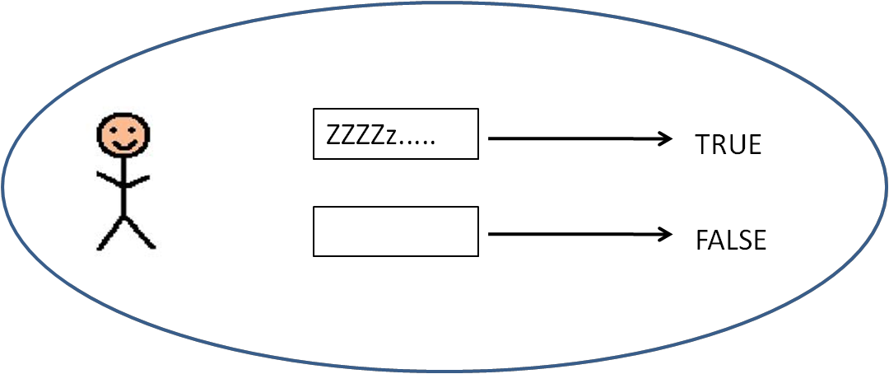
Predicates and saturation
What contribution does sleeps make to the sentence Paul sleeps?
Let’s think of the proposition [[Paul sleeps]] as follows:
if the model contains a situation where Paul is indeed asleep, we have a true sentence; else we have a false sentence
We can represent the proposition graphically as follows:
Intuitively, this picture is a composite of the meanings [[Paul]] and [[sleeps]].

Slide 29
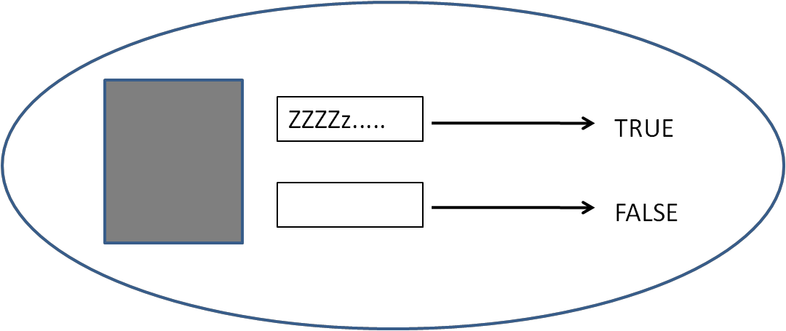
Predicates and saturation
To represent the contribution of the predicate, we can remove the contribution of Paul, leaving whatever it is that sleeps means.
The ‘hole’ is meant to represent the missing reference. Essentially, this says: if you plug something into sleeps, and it’s the right type of object, you have a proposition.
So predicates are unsaturated propositions.
Equivalently, in predicate logic, we call them open propositions or propositional functions.

Slide 30
Predicates and saturation
When a property (sleeps) is predicated of an individual (Paul), we are saturating the predicate. Therefore, predication is saturation.
Formally, we typically represent predicates using the language of predicate logic: sleep(x )
The variable here corresponds to the unsaturated ‘hole’ in our graphic example.
Combining the predicate with the individual that is referred to by Paul (that is, [[Paul]]), we get:
sleep(p) (using p to stand for the individual [[Paul]]
Here’s a something to think about:
Our graphic represents the unsaturated predicate a bit like a function: given the input of the right type, it becomes a proposition.
But a proposition is a function which returns a truth value (in a specific world/situation)
So predicates can be thought of as functions from entities to propositions.

Slide 31
The syntax-semantics correspondence
We’ve seen how predicates can combine with referring expressions like names, to form complete propositions.
In order to give a completely compositional account, we need to bring syntax into the picture
S
NP
VP
N
Paul
V
sleeps

Slide 32
The syntax-semantics correspondence
There are at least two ways in which we can operationalise the principle of compositionality:
rule by rule theories: Assume that for each syntactic rule, there must be a corresponding semantic rule. Syntax and semantics work hand in hand.
interpretive theories: semantics applies to the output of syntax. Syntax and semantics need not work completely in lockstep.
The main difference between the two is that rule by rule theories require that every syntactic building block has a corresponding semantic operation. In interpretive theories, we don’t require this.

Slide 33
An illustration
Rule by rule
Interpretive
(From the lexicon) [[Paul]]=p
(From the lexicon) [[sleep]]=sleep(x )
Assign Paul category N; [[N]] = p
Assign sleeps category V; [[V]]=sleep(x )
[[NP]] = [[N]] (no other daughters)
[[VP]] = [[V]] (no other daughters)
[[S]] = [[NP]] + [[VP]]
(From the lexicon) [[Paul]]=p
(From the lexicon) [[sleep]]=sleep(x )
[[N]] = p
[[V]] = sleep(x )
[[NP]] = [[N]] (no other daughters)
[[VP]] = [[V]] (no other daughters)
[[S]] = [[NP]] + [[VP]]

Slide 34
Implications of the distinction
Consider the question: Who did Paul kill?
Suppose we adopt a generative framework for our syntactic analysis. This would assume that the question had the following underlying form:
who_{i} did Paul kill t_{i}
which essentially views who as a placeholder for something which was originally in the object position.
A rule-by-rule theory would need to state a rule corresponding to the movement of who.
An interpretive theory wouldn’t: it would just need to identify the link between who and the verb object position.

Slide 35
The two approaches in context
The rule-to-rule framework was explicitly proposed by Montague, who went on to formalise several fragments of English.
Montague attempted to state precise semantic rules for every syntactic rule.
Interpretive frameworks are more typical of theories influenced by Chomsky’s Government and Binding theory (and later frameworks). Under this view, semantic interpretation takes place after syntax, at the level of LF (‘logical form’).

Slide 36
Simplifying the semantic rules
So far, we’ve stated semantic rules directly in terms of the syntax (using categories like N and VP).
We’d like to simplify our rules as much as possible. Here are some generalisations:
If a node x has a single daughter y, then [[x]]=[[y]];
If a node x has two daughters y and z, and [[y]] is an individual and [[z]] is a property, then saturate the meaning of z with the meaning of y and assign the resulting meaning to x;
Note: The second rule above implicitly refers to the semantic type of the meanings we’re talking about (are they individuals? are they properties?). This does away with the need to specify syntactic categories (N, V etc). More on this later!

Slide 37
Some implications

Slide 38
Why bother with syntax and semantics?
Recall the two pieces of advice we started out with:
In order to say what a meaning is, we may first find what a meaning does, and then find something that does that.
For two sentences α and β, if in some situation α is true and β is false, then α and β must have different meanings.
Now, consider the following example fragments (from ):
almost half full
almost half empty
Do they mean the same thing?

Slide 39
Half full and half empty
We might consider half full and half empty to be synonymous (recall the possible-worlds definition of synonymy).
But combined with almost, things look slightly different: the sentences don’t have the same truth conditions. So by Cresswell’s principle, the sentences have different meanings.
Suppose we analyse these as:
almost + DEGREE ADJ
Since almost is common to both, then by Lewis’s advice, the difference in meaning must reside in half full and half empty.

Slide 40
Half full and half empty
Now, consider two possible syntactic structures for these expressions:
If we adopt the first structure, then we’ll have to conclude that half full and half empty mean different things (perhaps as a result of combining full and empty with the degree adjective).
If we adopt the second structure, then all we need is for full and empty to have different meanings (the rest is constant).
AdjP
AdjP
almost
AdjP
DegP
ADJ
DEGREE
ADJ
almost
DEGREE

Slide 41
Other kinds of predicates

Slide 42
Other predicates
So far, we’ve considered one kind of predicate, namely, intransitive verbs (e.g. sleep).
Let’s consider a few others:
adjectives: Paul is human
predicate nominals: Paul is a man
relative clauses: Paul is who I’m telling you about
transitive verbs: Mary killed Paul

Slide 43
Adjectives and predicate nominals
Paul is tall
Paul is a man
Questions:
What does the word is mean here?
What about the word a?

Slide 44
Adjectives and predicate nomimals
Compare:
Pawlu twil
Pawlu raġel
In many languages (such as Maltese), the copula (be) is omitted.
Does this suggest that is is meaningless (has a purely syntactic function) or is deleted at the semantic level?

Slide 45
The meaning of be
We can think of is as a kind of ‘super-property’, a property that is saturated by another property.
Under this view, we can think of the predicate adjective or nominal on a par with the intransitive verb sleep, except that (in English) they need to be slotted into another property:
[[tall]] = tall(x)
[[man]] = man(x)

Slide 46
The meaning of a
Observe that a has roughly (but not completely) the same distribution as other determiners:
the/a/every/some dog bit me
But not always:
John is a (*the/some/every) man
For now, let’s think of a as having more or less no function in these examples.

Slide 47
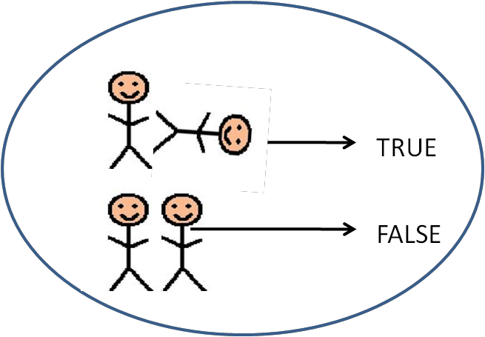
Transitive verbs
The difference between instransitive verbs like sleep and transitive ones like kill is that the latter need more than one argument:
sleep(x)
kill(x,y)

Slide 48
Relative clauses
In a sentence such as John is who Mary killed
the phrase who Mary killed is also a predicate
(i.e. an unsaturated proposition, that yields a complete proposition when combining with John)
We need to deal with the internal structure of this complex predicate.

Slide 49
Relative clauses: a rough estimation
[[who Mary killed]] = the proposition that Mary killed someone
underlined part represents whatever’s missing and needs to saturate the proposition.
We start with Mary killed e: the placeholder e_{i} temporarily saturates kill
We add who
who indicates that the logical object of kill is no longer in place
this can be interpreted as an instruction to (re-)unsaturate kill, before combining it with John
who
Mary
killed
e_{i}
Again, we’re assuming that who has moved to the front of the sentence.
The underlying proposition is Mary killed e.

Slide 50
An interim summary
Names refer. In model-theoretic terms, names denote individuals in the world.
Predicates (adjectives, verbs, nominals) are properties. They are saturated by terms denoting individuals to yield propositions.
A compositional analysis looks at the role of each in the syntactic context in which it occurs. Different manners of combination can yield different interpretations.

