Slide 1
LIN3022 Natural Language Processing
Lecture 3
Albert Gatt

Slide 2
In this lecture
Eliza, Turing Machines and the Turing Test
Overview of finite-state methods
  This will serve as preparation for our discussion of computational morphology
Acknowledgement:
  Many slides from a lecture by Jim Martin

Slide 3
The turing test
Part 1

Slide 4
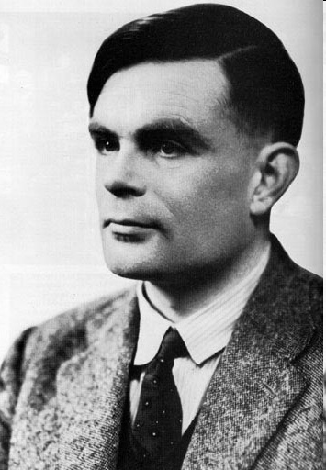
Alan Turing
Turing (1912-1954)
Mathematician
Famous for:
  groundbreaking work in statistics;
  code-breaking (at Bletchley Park, in WWII);
  developing the first formal definition of “computation”

Slide 5
The notion of “computability”
The Entscheidungsproblem (“decision problem”):
  Mathematics deals with truths that are certain, i.e., can be proven.
  A mathematical statement (e.g. 2+2=4) needs to be proven. But sometimes, a proof is difficult to find.
  Question (due to David Hilbert): is there some way of deciding, for any mathematical statement, whether that statement can be proven?
    NB. We’re not asking whether a proof can always be found, but whether there is some way of finding out whether a proof can be found.
Turing: a statement is decidable iff there exists a definite, precise, mechanical way of computing it.
  This is what led Turing to develop an abstract model of a “computing machine”.

Slide 6
The Turing Machine
The Turing Machine consists of:
  A tape divided into squares (assumed to be infinitely long)
  A “scanning head” that can consider one and only one square at a time
  A set of symbols that can be printed on the squares
  A set of rules specifying exactly what the machine can do next, given the position it’s in and the symbol it’s reading. E.g.:
  If the current state is A and the cell under the head has “0” then rewrite this as “1”, move the head right, and change the current state to B.
The point is that, at any time t+1, the state of the machine is completely and unambiguously determined by:
  The previous state at time t
  The symbol on the square being read at time t

Slide 7
Things to note
The rules, however “boring” are:
  unambiguous
  leave no choices open
At any time, we have a complete account of the state of the game and know exactly where to go next.
(This is the formal basis on which digital computers are built).

Slide 8
The Turing Machine
Turing used his machine model to determine which mathematical statements can be decided mechanically.
A side-effect of this work is that we ended up with the first, precise definition of what it means to compute!
We can think of a computer program as a realisation of a Turing Machine to solve a particular task (e.g. adding numbers together).

Slide 9
Turing Machines
Note that Turing Machines are in fact a class of machines.
  There is an infinity of variations on the tape game.
  Similarly, there is an infinity of different ways of initialising a TM, and formulating different rules for it.

Slide 10
The Universal Turing Machine
Turing also proved that there is one kind of abstract machine which is capable of imitating any other machine.
  Since Turing Machines define the class of what is computable, the UTM can compute anything which is computable.

Slide 11

Universal Turing Machines
A Turing Machine M can be designed which:
  takes some input x
  produces some output M(x)
A Universal Turing Machine U:
  takes as input x
  takes as input the description (“program”) of M
  produces M(x) as output

Slide 12
The intuition in modern terms
Turing Machine:
  an algorithm (well-defined procedure) to solve a particular problem (often implemented in a program)
    adding numbers
    word processing
    digitally manipulating photographs
Universal Turing Machine:
  a hardware platform that can accommodate any program

Slide 13
The Church-Turing Thesis
(Note: a thesis, not a theorem!)
Based on the work of Turing and Alonzo Church.
States that any process that can be described in physical terms in this universe can be done by a Turing Machine.
In other words, the TM is the most general and most powerful model of computation available.

Slide 14
Turing on minds and machines
In 1950, Turing published Computing Machinery and Intelligence, a paper in Mind.
This contained the proposal that human cognitive processes could be viewed in terms of “computations” (manipulations of symbols).
This became the basis for “Artificial Intelligence”.

Slide 15
Artificial Intelligence
Term coined by J. McCarthy in 1955.
During a conference in Dartmouth the following year, McCarthy said:
“Every aspect of learning or any other feature of intelligence can in principle be so precisely described that a machine can be made to simulate it.”
This was probably a little optimistic…
In any case, how do we know whether a system is “intelligent”?

Slide 16


The Turing Test (Turing 1950)
Human Judge
(A computer, with an “intelligent”
“chat” program)
Turing argued that, if the human judge can’t decide which is the computer and which the person, then we have no reason to deny that the computer has humanlike intelligence.
(A computer, with an “intelligent”
person using it to chat)

Slide 17
The Turing Test today
Many contemporary NLP evaluations actually compare an NLP system to what a human would do in a similar situation.
  E.g. compare the output of a weather forecaster to what a human forecaster does.
  This is related to the Turing test (though isn’t quite the same).
The Loebner Prize
  organised every year since 1995
  competitors submit “chat bots”
  $100,000 for the first program to pass the Turing Test

Slide 18
Implications of the Turing Test
The Turing Test is based on a view of intelligence which is behaviorally-oriented.
  an intelligent system = a system which is perceived to be intelligent
Is this enough?
From an NLP point of view, when can we say that a system “knows” a language?

Slide 19
A couple of discussion points
Is language processing “intelligent” behaviour?
  I.e., is understanding language/producing it on a par with, say:
    thinking and reasoning about new problems
    seeing and recognising objects
    …
Is it enough for an NLP system to be indistinguishable from a human being doing the same task?
For example, if Google Translate can do Maltese-Russian translation reasonably well, does it mean it “knows” Russian?

Slide 20
Finite state Models and algorithms
Part 2

Slide 21
Models and Algorithms
By models we mean the formalisms that are used to capture the various kinds of linguistic knowledge we need.
  Today, we look at finite-state models
Algorithms are then used to manipulate the knowledge representations needed to tackle the task at hand.
  We look at some algorithms that use finite-state models
Many useful NLP algorithms are transducers
  take one kind of structure as input and output another.

Slide 22
Regular Expressions and Text Searching
Regular expressions are a compact textual representation of a set of strings representing a language
  In the simplest case, regular expressions describe regular languages
Best known application:
  Searching for strings in text (e.g. in a file)
  Many text editors use regex search
  Many programming languages include regexes (Perl is a particularly well-known example)

Slide 23
A note and a reminder
Regular expressions were covered in Computational Linguistics & Corpus Linguistics
Some notes on regexes from the corpus linguistics course have been placed online on the LIN3022 page.
Check out J&M Chapter 2 for more on regexes

Slide 24
Example
Find all the instances of the word “the” in a text.
  /the/
    Matches: atheist, they, there, thespian, the, …
  /[tT]he/
    Matches: atheist, They, they, thespian, the, The…
  /\b[tT]he\b/
    Matches: the, The only
    The \b means “word boundary”

Slide 25
Errors
The process of refinement was intended to fix our regex so that:
  We omit strings that we should not have matched (thespian, atheist,)
    False positives (Type I)
  We include strings that we should have matched (The)
    False negatives (Type II)

Slide 26
Errors in NLP
Reducing the error rate for an application often involves:
  Increasing accuracy, or precision, (minimizing false positives)
  Increasing coverage, or recall, (minimizing false negatives).
These are also criteria used to evaluate the final version of a system.

Slide 27
Back to regular languages
A regular expression describes a language (a set of strings)
Such languages can be represented in three equivalent ways.
  Regular expressions
    Compact textual strings
      Perfect for specifying patterns in programs or command-lines
  Finite state automata
    Graphs
  Regular grammars
    Rules

Slide 28
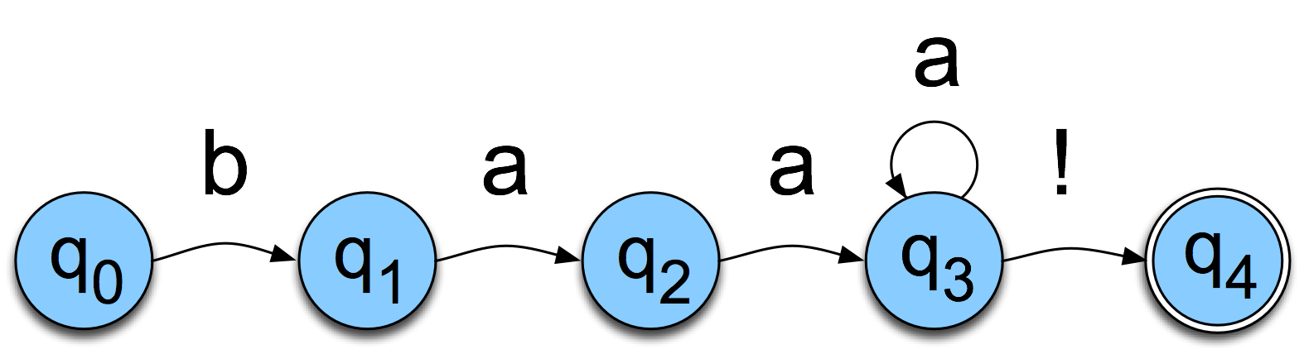
FSAs as Graphs
We’ll focus on sheep talk…
  /baa+!/
    Note the convention:
      Regex delimited by forward slashes
    Other things to note:
      + is a quantifier (one or more of the symbol immediately on the left)
  A graph in this sense is simply:
    A set of nodes
    A set of edges connecting them
    Edges can have labels

Slide 29
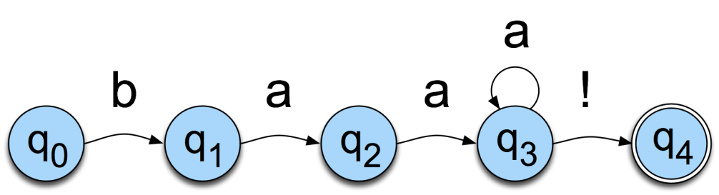
Sheep FSA
We can say the following things about this machine
  It has 5 states
  b, a, and ! are in its alphabet
  q₀ is the start state
  q₄ is an accept state
  It has 5 transitions

Slide 30
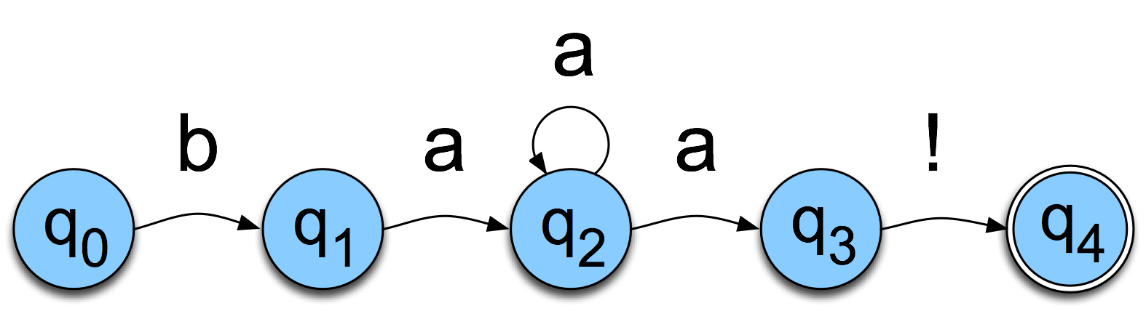
But Note
There are other machines that correspond to this same language
More on this one later

Slide 31
More Formally
You can specify an FSA by enumerating the following things.
  The set of states: Q
  A finite alphabet: Σ
  A start state
  A set of accept/final states
  A transition function
    Tells us which state(s) we can go to next, based on which state we’re in now, and what symbol we’ve seen last

Slide 32
About Alphabets
For our purposes alphabet means a finite set of symbols in the input.
These symbols can be anything
  Letters of the alphabet
  Whole words
  Morphemes
  …

Slide 33
Yet Another View
The guts of an FSA can ultimately be represented as tables
 | b | a | ! | e
0 | 1
1 |  | 2
2 |  | 2,3
3 |  |  | 4
4
If you’re in state 1 and you’re looking at an a, go to state 2

Slide 34
Recognition
Three equivalent definitions of recognition:
  the process of determining if a string should be accepted by a machine
  the process of determining if a string is in the language we’re defining with the machine
  The process of determining if a regular expression matches a string

Slide 35
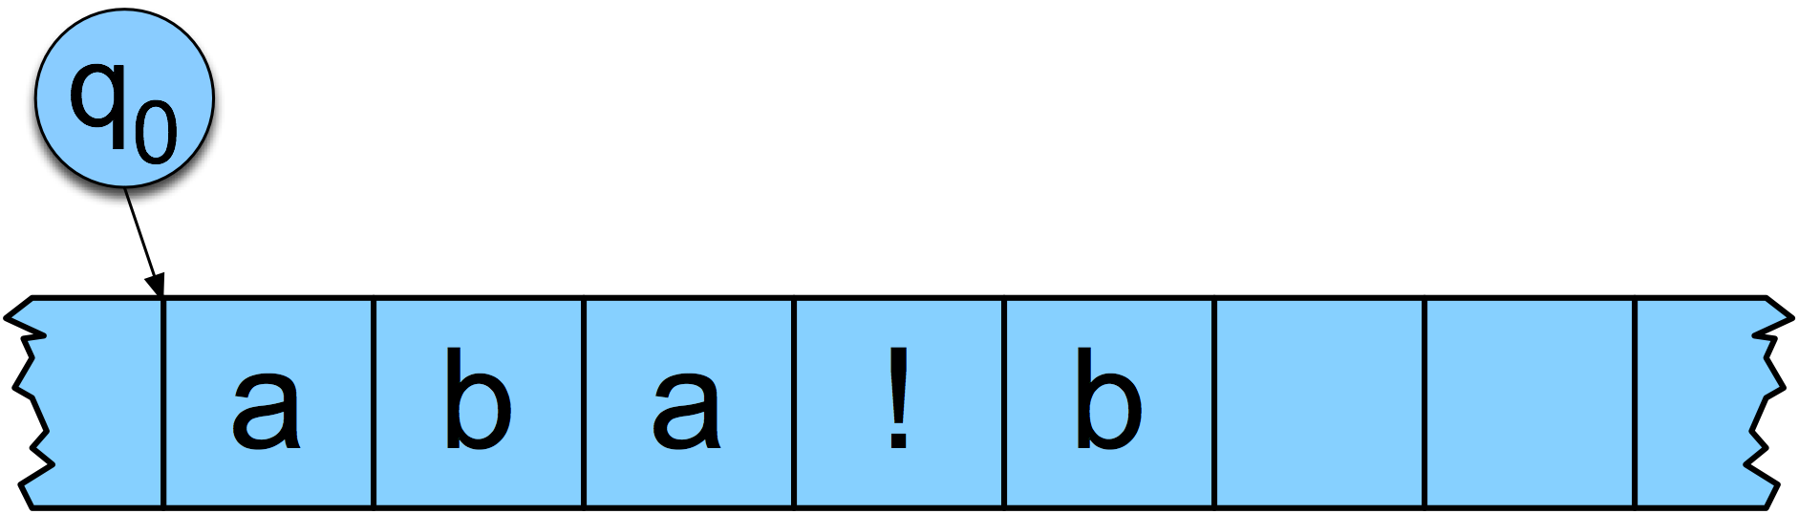
Recognition
Remember Turing?
We can represent the recognition process using a tape.
The cells on the tape consist of the symbol sequence that form the “input” we’re trying to recognise.

Slide 36
Recognition: basic algorithm
Start in the start state
Examine the current input
Consult the table to identify the next state
Go to the new state and update the tape pointer.
…Until you run out of tape.
This is the basic procedure followed by a Deterministic FSA.

Slide 37
Key Points
Deterministic means that at each point in processing there is always one unique thing to do (no choices).
Our algorithm is a simple table-driven interpreter
Any unambiguous regular language can be processed by this algorithm.
  To change the machine, you simply change the table.

Slide 38
Key Points
So what happens when we search for/match strings in a text editor?
  The editor translates the regular expression into an FSA (a table) and
  It passes the table and the string to an interpreter that implement this algorithm.

Slide 39
Recognition as Search
You can view this algorithm as a kind of state-space search
States are pairings of tape positions and state numbers
Operators are compiled into the table
Goal state is a pairing with the end of tape position and a final accept state

Slide 40
So what’s the difference between these two?

Slide 41
Determinism
This automaton is deterministic
If we’re in any state, and we see a given input, there’s only one place to go next (or else we fail).

Slide 42
Non-Determinism
This automaton is non-deterministic
If we’re in state 2, and we see an “a”, we can go back to state 2, or move to state 3.

Slide 43
Determinism vs. Non-Determinism

Slide 44
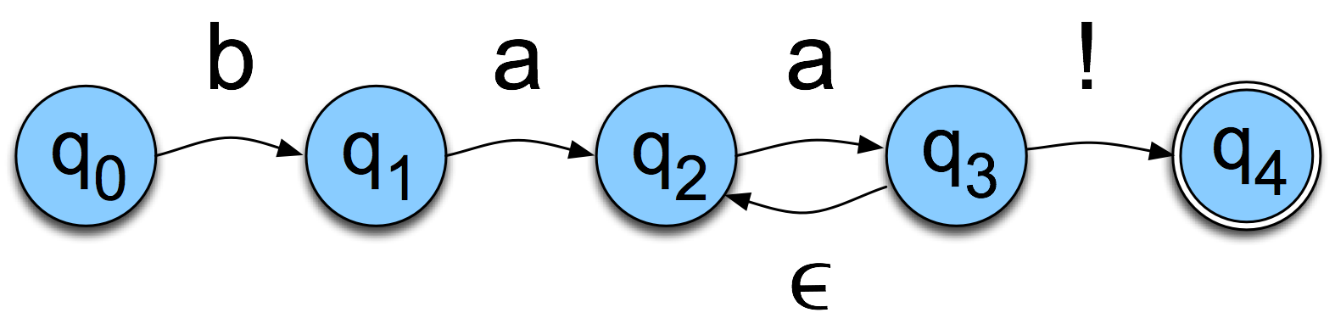
Non-Determinism cont.
Yet another technique
  Epsilon transitions
  Key point: these transitions do not examine or advance the tape during recognition

Slide 45
Equivalence
Non-deterministic machines can always be converted to deterministic ones.
So non-deterministic and deterministic FSAs are essentially equivalent in terms of the languages that they can characterise.

Slide 46
ND Recognition
Two basic approaches (used in all major implementations of regular expressions)
  Either take a ND machine and convert it to a D machine and then do recognition with that.
  Or explicitly manage the process of recognition as a state-space search (leaving the machine as is).

Slide 47
Non-Deterministic Recognition: Search
In a ND FSA there exists at least one path through the machine for a string that is in the language defined by the machine.
But not all paths directed through the machine for an accept string lead to an accept state.
No paths through the machine lead to an accept state for a string not in the language.

Slide 48
Non-Deterministic Recognition
So success in non-deterministic recognition occurs when a path is found through the machine that ends in an accept state.
Failure occurs when all of the possible paths for a given string lead to failure.

Slide 49
Example
b
a
a
a
!
\
q₀
q₁
q₂
q₂
q₃
q₄

Slide 50
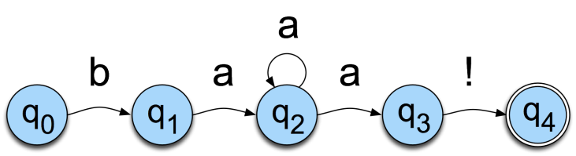
Example

Slide 51
Example

Slide 52
Example

Slide 53
Example

Slide 54
Example

Slide 55
Example

Slide 56
Example

Slide 57
Example

Slide 58
Key Points
States in the search space are pairings of tape positions and states in the machine.
By keeping track of as yet unexplored states, a recognizer can systematically explore all the paths through the machine given an input.

Slide 59
Why Bother?
Non-determinism doesn’t get us more formal power and it causes headaches so why bother?
  More natural (understandable) solutions
  Not always obvious to users whether or not the regex that they’ve produced is non-deterministic or not
    Better to not make them worry about it

Slide 60
An early use of Regular Expressions/FSAs
Weizenbaum’s ELIZA
  Basically works with a cascade of regular expressions
  Match parts of a user’s input,
  Replace the matched part with something else
  Write it out as output

Slide 61
ELIZA examples
s/.* all .*/In what way\?/
  “Replace a string containing “all” with “In what way?”
s/.* always .*/Can you think of a specific example?/
  Replace a string containing “always” with “Can you think of a specific example”

Slide 62
An ELIZA Exchange
User: Men are all alike.
System: In what way?
User: They’re always bugging us about something or other
System: Can you think of a specific example?

Slide 63
Important points for today
FSAs (regexes) characterise a class of languages
We’ve looked at deterministic and non-deterministic FSAs.
We’ve looked at the notion of state-space search.
  This is an important algorithmic paradigm
  Many types of models afford algorithmic solutions that can be cast in this mould

