Slide 1
LIN3022 Natural Language Processing Lecture 10
Albert Gatt

Slide 2
In this lecture
We introduce the task of Natural Language Generation (NLG)
Architecture of NLG systems
Specific NLG tasks

Slide 3
Part 1
Natural Language Generation: Overview

Slide 4
What is NLG?
Subfield of AI and Computational Linguistics that is concerned with systems to produce understandable texts (in English or other languages)
typically from non-linguistic input
(but not always)

Slide 5
NLG in relation to the rest of NLP
Meaning
Natural Language Understanding
(includes parsing)
Natural Language Generation
Text
Text
Speech Recognition
Speech Synthesis
Speech
Speech
Source: E. Reiter & R. Dale (1999). EACL Tutorial

Slide 6
Some examples of NLG applications
Automatic generation of weather reports.
Input: data in the form of numbers (Numerical Weather Prediction models)
Output: short text representing a weather forecast

Slide 7
Weather report system: FoG
Function:
Produces textual weather reports in English and French
Input:
Graphical/numerical weather depiction
User:
Environment Canada (Canadian Weather Service)
Developer:
CoGenTex
Status:
Fielded, in operational use since 1992
Source: E. Reiter & R. Dale (1999). EACL Tutorial

Slide 8
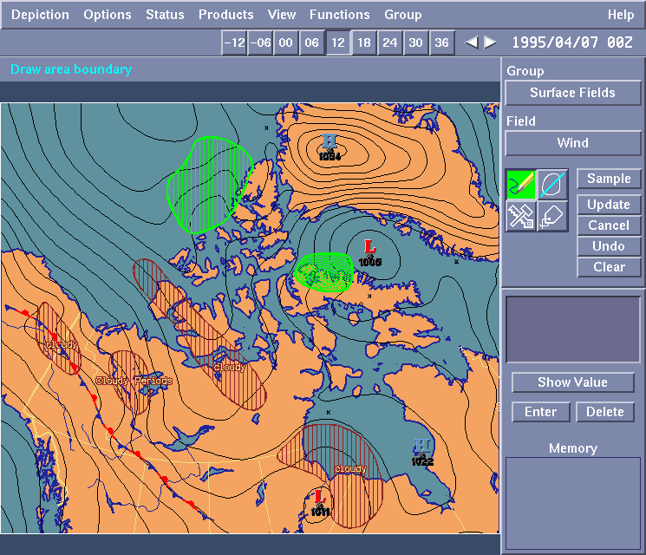
FoG: Input
Source: E. Reiter & R. Dale (1999). EACL Tutorial

Slide 9
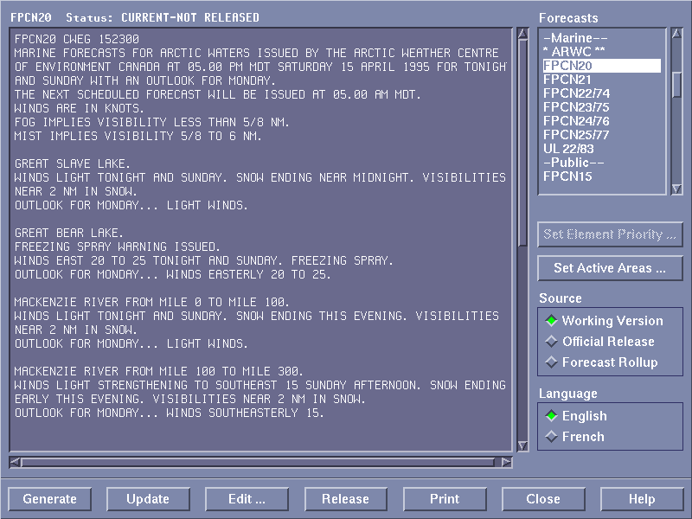
FoG: Output
Source: E. Reiter & R. Dale (1999). EACL Tutorial

Slide 10
Weather Report System: SUMTIME
Function:
Produces textual weather reports in English for offshore oil rigs
Input:
Numerical weather depiction
User:
Offshore rig workers in Scotland
Developer:
Department of Computing Science, University of Aberdeen

Slide 11
Weather report system: SUMTIME
S 8-13 increasing 18-23 by morning, then easing 8-13 by midnight.
S 8-13 increasing 13-18 by early morning, then backing NNE 18-23 by morning, and veering S 13-18 by midday, then easing 8-13 by midnight.
SUMTIME: http://cgi.csd.abdn.ac.uk/~ssripada/cgi_bin/startSMT.cgi

Slide 12
Other examples of NLG systems
ModelExplainer:
system to generate descriptions of technical diagrams for software development
STOP:
generates smoking cessation letters based on a user-input questionnaire
http://www.csd.abdn.ac.uk/research/stop/

Slide 13
The STOP System
Function:
Produces a personalised smoking-cessation leaflet
Input:
Questionnaire about smoking attitudes, beliefs, history
User:
NHS (British Health Service)
Developer:
University of Aberdeen
Source: E. Reiter & R. Dale (1999). EACL Tutorial

Slide 14
STOP: Input
Source: E. Reiter & R. Dale (1999). EACL Tutorial

Slide 15
STOP: Output
Dear Ms Cameron
Thank you for taking the trouble to return the smoking questionnaire that we sent you. It appears from your answers that although you're not planning to stop smoking in the near future, you would like to stop if it was easy. You think it would be difficult to stop because smoking helps you cope with stress, it is something to do when you are bored, and smoking stops you putting on weight. However, you have reasons to be confident of success if you did try to stop, and there are ways of coping with the difficulties.
Source: E. Reiter & R. Dale (1999). EACL Tutorial

Slide 16
Other examples: story generation
STORYBOOK (Callaway & Lester 2002):
input = story plan: sequential list of operators specifying underlying structure of a narrative
(actor-property exist-being woodman001)
(refinement and-along-with woodman001 wife001)
(refinement belonging-to wife001 woodman001)
(specification exist-being process-step-type once-upon-a-time)
output:
Once upon a time there was a woodman and his wife.

Slide 17
NLG: application area vs. task
These examples involve “end-to-end” NLG systems
starting point is some non-linguistic input
NLG plays a role as part of other tasks:
summarisation from multiple documents
Machine Translation: MT systems may have a generation step following analysis of source language
dialogue systems

Slide 18
NLG in dialogue systems
Dialogue fragment:
System1: Welcome.... What airport would you like to fly out of?
User2: I need to go to Dallas.
System3: Flying to Dallas. What departure airport was that?
User4: from Newark on September the 1st.
What should the system say next?
Plan for next utterance
(after analysis of User4)
implicit-confirm(orig-city:NEWARK)
implicit-confirm(dest-city:DALLAS)
implicit-confirm(month:9)
implicit-confirm(day-number:1)
request(depart-time)
Output next uttterance:
What time would you like to travel on September the 1st to Dallas from Newark?
Walker et al. (2001). SPoT: A trainable sentence planner. Proc. NAACL

Slide 19
Types of input to an NLG system
Raw data:
some systems start from raw data (e.g. weather report systems)
needs to be pre-processed to remove noise, identify the interesting aspects to communicate
Knowledge base:
e.g. database of available flights
e.g. ontology with medical facts and relationships
User model:
constrains output to fit user’s needs
e.g. in a medical system: is the user a doctor or a patient?

Slide 20
Types of input to an NLG system
Content plan:
representation of what to communicate
typically some canonical (“logical”) representation
e.g.: confirm a user’s destination while asking for preferred time of travel (SPoT)
e.g.: complete story plan (STORYBOOK)
NB: some systems take this as starting point, others do the planning themselves
Discourse (dialogue) history:
record of what’s been said
useful, e.g. for generating pronouns etc

Slide 21
Part II
NLG the simple way: template-based generation

Slide 22
Templates
A template is a simple data structure, which contains some empty slots which can be filled with information of specific types.
In the simplest kind of NLG, there is a ready-made template which expresses a particular message.
Empty slots (“variables”) are replaced by specific information.

Slide 23
An everyday template application
Many word processors support some form of Mail Merge capacity for creating multiple versions of a letter, to be sent to different people.
This involves writing a letter and defining certain slots.
Client name entered automatically from a database
Dear XXXX,
Please find enclosed your electricity bill, which needs to be paid by March 25th, 2010.
Should you require any further assistance, please contact your nearest office in YYYY.
Town name entered depending on client location.

Slide 24
Using templates
The previous example is extremely simple.
Typically, template-based systems have an inventory of types of messages.
There are templates corresponding to each type of message.
Templates have slots and the system fills them in with specific info.

Slide 25
Another example (highly simplified!)
Template:
You would like to book FLIGHT from ORIGIN to DESTINATION. Please confirm.
Values:
FLIGHT = KM101
ORIGIN = Valletta
DESTINATION = Sri Lanka

Slide 26
Templates: dis/advantages
Advantages:
Very quick to develop, no specialised knowledge needed
Typically, templates are based on the domain (e.g. flight bookings), so quality of output will be high in a specific application.
Problems:
Templates are difficult to generalise from one application to another.
Tend to be highly redundant. Many templates to produce different messages using the same linguistic structure.
Can become tedious: no variation in output.
Any new output must be tailored by hand.

Slide 27
Part III
Beyond templates: architectures for NLG systems

Slide 28
The architecture of NLG Systems
In end-to-end NLG, the system needs to at least:
decide what to say given the input data
decide how to say it
typically, huge number of possibilities
render the outcome as a linguistic string
(if doing speech) run it through a text-to-speech system

Slide 29
The architecture of NLG systems
Communicative goal
A pipeline architecture
represents a “consensus” of what NLG systems actually do
very modular
not all implemented systems conform 100% to this architecture
Document Planner
document plan
Microplanner
(text planner)
text specification
Surface Realiser
text

Slide 30
Concrete example
BabyTalk systems (Portet et al 2009)
summarise data about a patient in a Neonatal Intensive Care Unit
main purpose: generate a summary that can be used by a doctor/nurse to make a clinical decision
F. Portet et al (2009). Automatic generation of textual summaries from neonatal intensive care data. Artificfial Intelligence

Slide 31
A micro example
Input data: unstructured raw numeric signal from patient’s heart rate monitor (ECG)
There were 3 successive bradycardias down to 69.

Slide 32
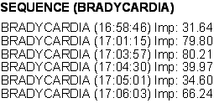
A micro example: pre-NLG steps
(1) Signal Analysis (pre-NLG)
Identify interesting patterns in the data.
Remove noise.
(2) Data interpretation (pre-NLG)
Estimate the importance of events
Perform linking & abstraction

Slide 33
Document planning
Main task is to:
select content
order it
Typical output is a document plan
tree whose leaves are messages
nonterminals indicate rhetorical relations between messages (Mann & Thompson 1988)
e.g. justify, part-of, cause, sequence…

Slide 34
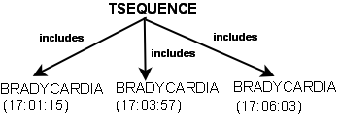
A micro example: Document planning
(1) Signal Analysis (pre-NLG)
Identify interesting patterns in the data.
Remove noise.
(2) Data interpretation (pre-NLG)
Estimate the importance of events
Perform linking & abstraction
(3) Document planning
Select content based on importance
Structure document using rhetorical relations
Communicative goals (here: assert something)

Slide 35
A micro example: Microplanning
Lexicalisation
Many ways to express the same thing
Many ways to express a relationship
e.g. SEQUENCE(x,y,z)
x happened, then y, then z
x happened, followed by y and z
x,y,z happened
there was a sequence of x,y,z
Many systems make use of a lexical database.

Slide 36
A micro example: Microplanning
Aggregation:
given 2 or more messages, identify ways in which they could be merged into one, more concise message
e.g. be(HR, stable) + be(HR, normal)
(No aggregation) HR is currently stable. HR is within the normal range.
(conjunction) HR is currently stable and HR is within the normal range.
(adjunction) HR is currently stable within the normal range.

Slide 37
A micro example: Microplanning
Referring expressions:
Given an entity, identify the best way to refer to it
e.g. BRADYCARDIA
bradycardia
it
the previous one
Depends on discourse context! (Pronouns only make sense if entity has been referred to before)

Slide 38
A micro example
(4) Microplanning
Map events to semantic representation
lexicalise: bradycardia vs sudden drop in HR
aggregate multiple messages (3 bradycardias = one sequence)
decide on how to refer (bradycardia vs it)

Slide 39
A micro example: Realisation
Subtasks:
map the output of microplanning to a syntactic structure
needs to identify the best form, given the input representation
typically many alternatives
which is the best one?
apply inflectional morphology (plural, past tense etc)
linearise as text string

Slide 40
A micro example
(4) Microplanning
Map events to semantic representation
lexicalise: bradycardia vs sudden drop in HR
aggregate multiple messages (3 bradycardias = one sequence)
decide on how to refer (bradycardia vs it)
choose sentence form (there were…)
s
(5) Realisation
map semantic representations to syntactic structures
apply word formation rules
PRO
VP (+past)
V
NP (+pl)
PP
there
be
three successive
bradycardias
down to 69

Slide 41
NLG: The complete architecture
Content Determination
Document Structuring
Aggregation
Lexicalisation
Referring Expression Generation
Linguistic Realisation
Structure Realisation
Document Planning
Micro-planning
Surface Realisation

Slide 42
Rules vs statistics
Many NLG systems are rule-based
Growing trend to use statistical methods.
Main aims:
increase linguistic coverage (e.g. of a realiser) “cheaply”
develop techniques for fast building of a complete system

Slide 43
Part 4
Document planning overview

Slide 44
Document Planning
Goals:
to determine what information to communicate
to determine how to structure this information to make a coherent text

Slide 45
Content determination
Two Common Approaches:
Use a collection of target texts to identify the message types you want to generate.
Methods based on reasoning about discourse coherence and the purpose of the text

Slide 46
Method 1 example in weather domain
Routine messages
MonthlyRainFallMsg, MonthlyTemperatureMsg, RainSoFarMsg, MonthlyRainyDaysMsg
Assumption: every weather report must contain these messages.

Slide 47
Method 1 example in weather domain
A MonthlyRainfallMsg:
((message-id msg091) (message-type monthlyrainfall) (period ((month 04) (year 1996))) (absolute-or-relative relative-to-average) (relative-difference ((magnitude ((unit millimeters) (number 4))) (direction +))))
NB: This represents content only! There is nothing linguistic here. (So it’s not a template in the simple sense we discussed before.)
Source: E. Reiter & R. Dale (1999). EACL Tutorial

Slide 48
Document Structuring via Schemas
Once content is determined, it needs to be structured into a document.
One common method is to use schemas (McKeown 1985)
Schemas
texts often follow conventionalised patterns
these patterns can be captured by means of ‘text grammars’ that both dictate content and ensure coherent structure
the patterns specify how a particular document plan can be constructed using smaller schemas or atomic messages
can specify many degrees of variability and optionality

Slide 49
Document Planning example in weather report system
A Simple Schema:
WeatherSummary →
MonthlyTempMsg
MonthlyRainfallMsg
RainyDaysMsg
RainSoFarMsg
The schema specifies the order of the messages, whose content is determined by the rules seen before.
Source: E. Reiter & R. Dale (1999). EACL Tutorial

Slide 50
Document Planning example in weather report system
A More Complex Set of Schemata:
WeatherSummary →
TemperatureInformation RainfallInformation
TemperatureInformation →
MonthlyTempMsg [ExtremeTempInfo] [TempSpellsInfo]
RainfallInformation →
MonthlyRainfallMsg [RainyDaysInfo] [RainSpellsInfo]
RainyDaysInfo →
RainyDaysMsg [RainSoFarMsg]
...
Things in square brackets are optional.
E.g. only mention ExtremeTempInfo if it is available.
Source: E. Reiter & R. Dale (1999). EACL Tutorial

Slide 51
Schemas: Pros and Cons
Advantages of schemas:
Computationally efficient (easy to build a doc)
Can be designed to specifically reflect genre conventions (e.g. weather reports have specific constraints).
Can be quite easily defined based on a corpus analysis.
Disadvantages
Limited flexibility: require predetermination of possible structures
Limited portability: likely to be domain-specific. A schema for weather reports won’t be usable for story generation.

Slide 52
Beyond schemas and message types
Contemporary NLG systems often perform reasoning about the input data:
Rather than use predefined messages/schemas, they try to build a document on the fly, based on the available input.
This still requires rules and domain knowledge, but the outcomes are much more flexible.

Slide 53
Document planning using reasoning
(1) Signal Analysis (pre-NLG)
Uses rules to process raw input to identify interesting patterns
(2) Data interpretation (pre-NLG)
Uses rules to decide what’s important.
(3) Document planning
Uses rules to:
Choose the content
Decide what should go with what.
No predefined document schema!
Documents will differ depending on input.

Slide 54
Part 5
Structuring texts using Rhetorical Structure Theory

Slide 55
Rhetorical Structure Theory
RST (Mann and Thompson 1988) is a theory of text structure
Not about what texts are about but
How bits of the underlying content of a text are structured so as to hang together in a coherent way.
The main claim of RST:
Parts of a text are related to eachother in predetermined ways.
There is a finite set of such relations.
Relations hold between two spans of text
Nucleus
Satellite

Slide 56
A small example
You should visit the new exhibition. It’s excellent. It got very good reviews. It’s completely free.
ENABLEMENT
MOTIVATION
EVIDENCE
You should ...
It’s excellent...
It got ...
It’s completely ...

Slide 57
An RST relation definition
MOTIVATION
Nucleus represents an action which the hearer is meant to do at some point in future.
You should go to the exhibition
Satellite represents something which is meant to make the hearer want to carry out the nucleus action.
It’s excellent. It got a good review.
Note: Satellite need not be a single clause. In our example, the satellite has 2 clauses. They themselves are related to eachother by the EVIDENCE relation.
Effect: to increase the hearer’s desire to perform the nucleus action.

Slide 58
RST relations more generally
An RST relation is defined in terms of the
Nucleus + constraints on the nucleus
(e.g. Nucleus of motivation is some action to be performed by H)
Satellite + constraints on satellite
Desired effect.
Other examples of RST relations:
CAUSE: the nucleus is the result; the satellite is the cause
ELABORATION: the satellite gives more information about the nucleus
Some relations are multi-nuclear
Do not relate a nucleus and satellite, but two or more nuclei (i.e. 2 pieces of information of the same status).
Example: SEQUENCE
John walked into the room. He turned on the light.

Slide 59
Some more on RST
RST relations are neutral with respect to their realisation.
E.g. You can express EVIDENCE n lots of different ways.
It’s excellent. It got very good reviews.
You can see that it’s excellent from its great reviews.
It’s excellence is evidenced by the good reviews it got.
It must be excellent since it got good reviews.
EVIDENCE
It’s excellent...
It got ...

Slide 60
RST and NLG
RST has proved very useful for structuring text in NLG.
A Document Planner can structure content based on the relations between different messages.
The relations then serve as input to the microplanner, which can decide on how it wants to express them.

Slide 61
RST and NLG example: SEQUENCE
Doc structure rule
Output doc structure
A SEQUENCE can hold between 2 or more elements if:
They are of the same kind
They occur one after the other

Slide 62
RST and NLG example: CAUSE
Doc structure rule
Example doc structure
A CAUSE can hold between two elements if:
One element (Satellite) occurred before the other.
The other element (Nucleus) is known to be a possible effect of the Satellite.
MORPHINE-ADMIN (16:55)
NB: This is based on domain knowledge that morphine can affect heart rate.

Slide 63
Summary
We’ve taken a tour of the task of Natural Language Generation.
Main focus: architecture of NLG systems
Applications of NLG
We focused more closely on document planning.
Next week: some more on microplanning & realisation

