Slide 1
LIN3022 Natural Language Processing
Lecture 5
Albert Gatt

Slide 2
In today’s lecture
We take a look at n-gram language models
Simple, probabilistic models of linguistic sequences

Slide 3
Reminder from lecture 4
Intuition:
P(A|B) is a ratio of the chances that both A and B happen, by the chances of B happening alone.
E.g. P(ADJ|DET) = P(DET+ADJ) / P(DET)

Slide 4
Part 1
Assumptions and definitions

Slide 5
Teaser
What’s the next word in:
Please turn your homework ...
in?
out?
over?
ancillary?

Slide 6
Example task
The word or letter prediction task (Shannon game)
Given:
a sequence of words (or letters) -- the history
a choice of next word (or letters)
Predict:
the most likely next word (or letter)

Slide 7
Letter-based Language Models
Shannon’s Game
Guess the next letter:

Slide 8
Letter-based Language Models
Shannon’s Game
Guess the next letter:
W

Slide 9
Letter-based Language Models
Shannon’s Game
Guess the next letter:
Wh

Slide 10
Letter-based Language Models
Shannon’s Game
Guess the next letter:
Wha

Slide 11
Letter-based Language Models
Shannon’s Game
Guess the next letter:
What

Slide 12
Letter-based Language Models
Shannon’s Game
Guess the next letter:
What d

Slide 13
Letter-based Language Models
Shannon’s Game
Guess the next letter:
What do

Slide 14
Letter-based Language Models
Shannon’s Game
Guess the next letter:
What do you think the next letter is?

Slide 15
Letter-based Language Models
Shannon’s Game
Guess the next letter:
What do you think the next letter is?
Guess the next word:

Slide 16
Letter-based Language Models
Shannon’s Game
Guess the next letter:
What do you think the next letter is?
Guess the next word:
What

Slide 17
Letter-based Language Models
Shannon’s Game
Guess the next letter:
What do you think the next letter is?
Guess the next word:
What do

Slide 18
Letter-based Language Models
Shannon’s Game
Guess the next letter:
What do you think the next letter is?
Guess the next word:
What do you

Slide 19
Letter-based Language Models
Shannon’s Game
Guess the next letter:
What do you think the next letter is?
Guess the next word:
What do you think

Slide 20
Letter-based Language Models
Shannon’s Game
Guess the next letter:
What do you think the next letter is?
Guess the next word:
What do you think the

Slide 21
Letter-based Language Models
Shannon’s Game
Guess the next letter:
What do you think the next letter is?
Guess the next word:
What do you think the next

Slide 22
Letter-based Language Models
Shannon’s Game
Guess the next letter:
What do you think the next letter is?
Guess the next word:
What do you think the next word

Slide 23
Letter-based Language Models
Shannon’s Game
Guess the next letter:
What do you think the next letter is?
Guess the next word:
What do you think the next word is?

Slide 24
Applications of the Shannon game
Identifying spelling errors:
Basic idea: some letter sequences are more likely than others.
Zero-order approximation
Every letter is equally likely. E.g. In English:
P(e) = P(f) = ... = P(z) = 1/26
Assumes that all letters occur independently of the other and have equal frequency.
xfoml rxkhrjffjuj zlpwcwkcy ffjeyvkcqsghyd

Slide 25
Applications of the Shannon game
Identifying spelling errors:
Basic idea: some letter sequences are more likely than others.
First-order approximation
Every letter has a probability dependent on its frequency (in some corpus).
Still assumes independence of letters from eachother. E.g. In English:
ocro hli rgwr nmielwis eu ll nbnesebya th eei alhenhtppa oobttva nah

Slide 26
Applications of the Shannon game
Identifying spelling errors:
Basic idea: some letter sequences are more likely than others.
Second-order approximation
Every letter has a probability dependent on the previous letter. E.g. In English:
on ie antsoutinys are t inctore st bes deamy achin d ilonasive tucoowe at teasonare fuzo tizin andy tobe seace ctisbe

Slide 27
Applications of the Shannon game
Identifying spelling errors:
Basic idea: some letter sequences are more likely than others.
Third-order approximation
Every letter has a probability dependent on the previous two letter. E.g. In English:
in no ist lat whey cratict froure birs grocid pondenome of demonstures of the reptagin is regoactiona of cre

Slide 28
Applications of the Shannon Game
Language identification:
Sequences of characters (or syllables) have different frequencies/probabilities in different languages.
Higher frequency trigrams for different languages:
English: THE, ING, ENT, ION
German: EIN, ICH, DEN, DER
French: ENT, QUE, LES, ION
Italian: CHE, ERE, ZIO, DEL
Spanish: QUE, EST, ARA, ADO
Languages in the same family tend to be more similar to each other than to languages in different families.

Slide 29
Applications of the Shannon game with words
Automatic speech recognition :
ASR systems get a noisy input signal and need to decode it to identify the words it corresponds to.
There could be many possible sequences of words corresponding to the input signal.
Input: “He ate two apples”
He eight too apples
He ate too apples
He eight to apples
He ate two apples
Which is the most probable sequence?

Slide 30
Applications of the Shannon Game with words
Context-sensitive spelling correction:
Many spelling errors are real words
He walked for miles in the dessert. (resp. desert)
Identifying such errors requires a global estimate of the probability of a sentence.

Slide 31
N-gram models
These are models that predict the next (n-th) word from a sequence of n-1 words.
Simple example with bigrams and corpus frequencies:
<S> he 25
he ate 12
he eight 1
ate to 23
ate too 26
ate two 15
eight to 3
two apples 9
to apples 0
...
Can use these to compute the probability of he eight to apples vs he ate two apples etc

Slide 32
The Markov Assumption
Markov models:
probabilistic models which predict the likelihood of a future unit based on limited history
in language modelling, this pans out as the local history assumption:
the probability of w_{n} depends on a limited number of prior words
utility of the assumption:
we can rely on a small n for our n-gram models (bigram, trigram)
long n-grams become exceedingly sparse

Slide 33
The structure of an n-gram model
The task can be re-stated in conditional probabilistic terms:
E.g. P(apples|he ate two)
Limiting n under the Markov Assumption means:
greater chance of finding more than one occurrence of the sequence w₁…w_{n-1}
more robust statistical estimations

Slide 34
Structure of n-gram models (II)
If we construct a model where all histories with the same n-1 words are considered one class, we have an (n-1)^{th} order Markov Model
Note terminology:
n-gram model = (n-1)^{th} order Markov Model

Slide 35
Structure of n-gram models (III)
A unigram model = 0th order Markov Model
Abigram model = 1st order Markov Model
A trigram model = 2nd order Markov Model

Slide 36
Size of n-gram models
In a corpus of vocabulary size N, the assumption is that any combination of n words is a potential n-gram.
For a bigram model: N² possible n-grams in principle
For a trigram model: N³ possible n-grams.
…

Slide 37
Size (continued)
Each n-gram in our model is a parameter used to estimate probability of the next possible word.
too many parameters make the model unwieldy
too many parameters lead to data sparseness: most of them will have c = 0 or 1
Most models stick to unigrams, bigrams or trigrams.
estimation can also combine different order models

Slide 38
Further considerations
When building a model, we tend to take into account the start-of-sentence symbol:
the girl swallowed a large green caterpillar
<s> the
the girl
…
Also typical to map all tokens with c < k to <UNK>:
usually, tokens with frequency 1 or 2 are just considered “unknown” or “unseen”
this reduces the parameter space

Slide 39
Adequacy of different order models
Manning/Schutze `99 report results for n-gram models of a corpus of the novels of Austen.
Task: use n-gram model to predict the probability of a sentence in the test data.
Models:
unigram: essentially zero-context markov model, uses only the probability of individual words
bigram
trigram
4-gram

Slide 40
Example test case
Training Corpus: five Jane Austen novels
Corpus size = 617,091 words
Vocabulary size = 14,585 unique types
Task: predict the next word of the trigram
“inferior to ________”
from test data, Persuasion: “[In person, she was] inferior to both [sisters.]”

Slide 41
Selecting an n Vocabulary (V) = 20,000 words
n | No. of possible unique n-grams
2 (bigrams) | 400,000,000
3 (trigrams) | 8,000,000,000,000
4 (4-grams) | 1.6 x 1017

Slide 42
Adequacy of unigrams
Problems with unigram models:
not entirely hopeless because most sentences contain a majority of highly common words
ignores syntax completely:
P(In person she was inferior)
= P(In) * P(person) * ... * P(inferior)
= P(inferior was she person in)

Slide 43
Adequacy of bigrams
Bigrams:
improve situation dramatically
some unexpected results:
p(she|person) decreases compared to the unigram model. Though she is very common, it is uncommon after person

Slide 44
Adequacy of trigrams
Trigram models will do brilliantly when they’re useful.
They capture a surprising amount of contextual variation in text.
Biggest limitation:
most new trigrams in test data will not have been seen in training data.
Problem carries over to 4-grams, and is much worse!

Slide 45
Reliability vs. Discrimination
larger n: more information about the context of the specific instance (greater discrimination)
smaller n: more instances in training data, better statistical estimates (more reliability)

Slide 46
Genre and text type
Language models are very sensitive to the type of text they are trained on.
If all your texts are about restaurants, you’ll have a hard time predicting the sentences in Jane Austen!

Slide 47
An illustration
Suppose we are using a bigram model to compute the probability of different English sentences.
We’ll use and example from J&M from a corpus of queries about restaurants.
We’ll try to compute the probability of I want English food.

Slide 48
An illustration
First, we compute all bigram counts.
Each cell is the frequency of the word in the row followed by the word in the column

Slide 49
An illustration
Next, we convert the counts to probabilities.

Slide 50
An illustration
Finally, we compute the probability of the sentence.
P(<s> i want english food </s>)
= P(i|<s>) * P(want|i) * P(english|want) * P(food|english) * P(</S>|food)
= .25 * .33 * .0011 * .5 * .68
= .000031
Notice: the probabilities of all bigrams are multiplied to give the probability of the whole sentence.

Slide 51
Maximum Likelihood estimation
The example we’ve seen works with Maximum Likelihood Estimation (MLE).
We compute the maximum likelihood of a bigram by:
Counting the number of occurrences of the bigram in the corpus.
Normalising the count so that it is between 0 and 1.
E.g. To compute P(y|x)
Count all occurrences of (x,y) in the corpus
Divide by the total count of all bigrams beginning with x
This gives us the relative frequency of the bigram (x,y)

Slide 52
Maximum Likelihood Estimation
# times that bigram (x,y) occurs
# times that x occurs, followed by any word.
Intuition:
We are computing the probability of a bigram (x,y) as a fraction of the times there is some bigram (x,...).
This gives us the probability of y, given x.

Slide 53
Part 2
Trouble with MLE

Slide 54
Limitations of MLE
MLE builds the model that maximises the probability of the training data.
Unseen events in the training data are assigned zero probability.
Since n-gram models tend to be sparse, this is a real problem.
Consequences:
seen events are given more probability mass than they have
unseen events are given zero mass

Slide 55
Seen/unseen
A
A’
Probability mass
of events not in
training data
The problem with MLE is that it distributes A’ among members of A.
Probability mass of events in
training data

Slide 56
The solution
Solution is to correct MLE estimation using a smoothing technique.
Basic intuition:
If the probability of something is zero, that doesn’t mean it doesn’t exist.
It could be that we don’t have enough data.
Ideally, we want some way of correcting our observed probabilities:
Reduce our non-zero probabilities
Leave some probability to distribute among the “zero” probabilities.

Slide 57
Rationale behind smoothing
Sample frequencies
seen events with probability P
unseen events (including “grammatical” zeroes”) with probability 0
Real population frequencies
seen events
(including the unseen events in our sample)
+ smoothing
to approximate
results in
Lower probabilities for seen events (discounting). Left over probability mass distributed over unseens.

Slide 58
Smoothing techniques
There are many techniques to perform smoothing.
We will only look at the most basic class of methods.

Slide 59
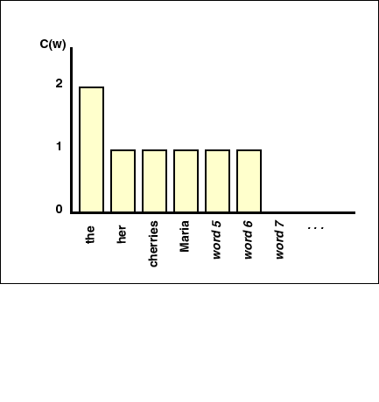
Instances in the Training Corpus: “inferior to ________”
C(w)

Slide 60
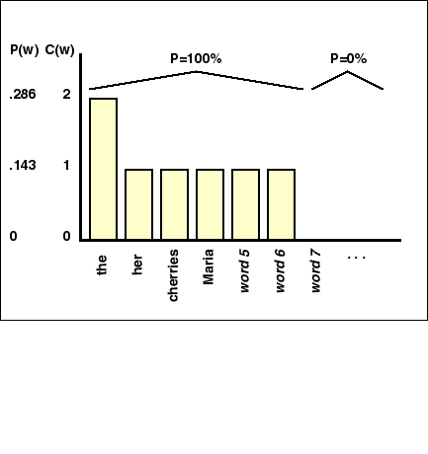
Maximum Likelihood Estimate
F(w)
Unknowns are assigned 0% probability mass

Slide 61
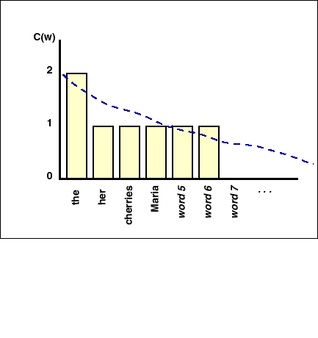
Actual Probability Distribution
F(w)
These are non-zero probabilities in the real distribution

Slide 62
Laplace’s Law
An example with unigrams.
N = the total count of all n-grams observed
For unigrams, N = the corpus size
V = the number of unique n-grams (the “vocabulary”).
For unigrams, V = the number of types.
Our standard probability estimate for a unigram w is:

Slide 63
Laplace’s Law
We adjust our probability estimate as follows:
Augment the count by a constant amount λ
This gives the adjusted count
Most common value for λ is 1
Divide the adjusted count by N + V

Slide 64
LaPlace’s Law (Add-one smoothing)
F(w)

Slide 65
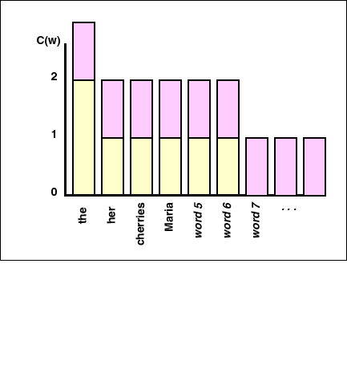
LaPlace’s Law (Add-one smoothing)
F(w)

Slide 66
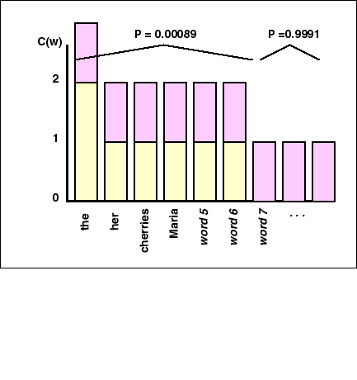
LaPlace’s Law
NB. This method ends up assigning most prob. mass to unseens
F(w)

Slide 67
Objections to Lidstone’s Law
Need an a priori way to determine λ.
Setting it to 1 is arbitrary and unmotivated.
Predicts all unseen events to be equally likely
Not much used these days. More sophisticated models exist:
Good-Turing Frequency Estimation
Witten-Bell discounting
…

Slide 68
Part 3
Final words on language models

Slide 69
Summary
We’ve seen that language models rely on the Markov assumption:
The probability of an event (e.g. a word) depends on what came before it (to a limited degree)
LMs are used throughout NLP, for any task where we need to compute the likelihood of a phrase or sentence.

Slide 70
Limitations of n-gram models
Essentially, n-gram models view language as sequences.
Only pay attention to contiguous sequences.
Can’t really handle long-distance dependencies properly. This was one of Chomsky’s objections to models based on Markov assumptions.

