Slide 1
LIN3022 Natural Language Processing Lecture 11
Albert Gatt

Slide 2
In this lecture
We consider the task of Machine Translation
Some history
Rule-based approaches
Contemporary statistical approachs

Slide 3
Part 1
The Challenge of MT

Slide 4
Lost in translation (excerpt from script)
[Scene: Bob is shooting an advert in Japan]
The Director (with blue contact lenses) utters a long stream of sentences in Japanese.
TRANSLATOR: He wants you to turn, look in camera and say the lines.
BOB: That's all he said?
TRANSLATOR: Yes, turn to camera.

Slide 5
Literary: Chinese to English
Chinese vs English
Very different word order
No tense/aspect marking in Chinese
Notice lots of adverbials in English
...
Cultural conventions on literary prose differ.
Metaphor, etc...

Slide 6
Non-literary: English to French
Still challenging:
Word order differences etc
But easier than literary translation...

Slide 7
What computational MT is good for
Non-literary (factual etc) prose.
Typical contemporary uses:
Producing a rough translation when this suffices (e.g. Running a web page through Google translate)
Computer-aided Human Translation (CAHT): Facilitating human translation by post-editing an automatic draft
Carrying out Fully-Automatic, High-Quality Translation (FAHQT) in small, well-defined sublanguages
e.g. Weather forecasts, software manuals etc

Slide 8
Why it’s hard: typological differences
Morphology:
Isolating vs polysynthetic (and the gradations in between)
Agglutinative vs fusion morphology
Syntax:
Word order
Argument structure & linking differences
Prepositions vs postpositions
Premodification vs postmodification
....

Slide 9
Why it’s hard: lexical differences
Languages exhibit different degrees of polysemy, homonymy etc.
Homonyms:
English bass (fish, instrument)
Spanish lubina (fish) or bajo (instrument)
Polysemy:
English know a person, know a fact
French connaitre vs savoir
English ceiling (inside) vs roof (outside)
Maltese saqaf
English corner
Maltese kantuniera (outside), rokna (inside)

Slide 10
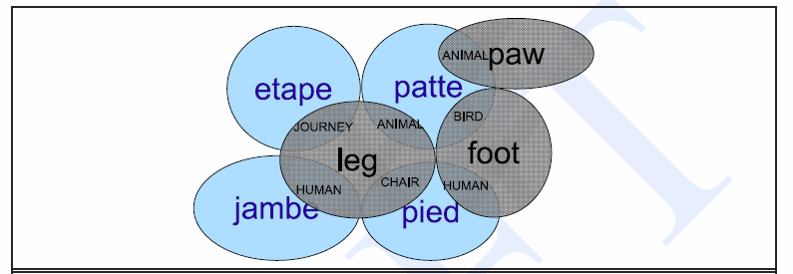
Lexemes map in many-to-many fashion
One word in L1 → several different words in L2
Several words in L2 → one word in L1
L1 may have lexical gaps (e.g no English word for Japanese oyakoko meaning ‘filial piety’)

Slide 11
Part 2
A brief history of MT

Slide 12
The Babel problem
Governments and companies have had to deal with the problem of multilinguality for decades
EU Commission employs hundreds of translators
US Defence Department needs continuous translation of documents in scores of different languages
For businesses, translation is a key to competitiveness
In everyday life, (partial) access to documents in a foreign language may be beneficial

Slide 13
Automatic Machine Translation: history
One of the oldest applications of Language Engineering
interest in MT goes back at least to the 1950s, during WWII
Theorists such as Shannon and Weaver proposed to use statistical techniques.
approach abandoned; computers weren’t powerful enough to process the huge amounts of data required
Georgetown experiment (1954): jointly developed by IBM and Georgetown University: successful translation of >60 Russian sentences into English
authors claimed that MT would be a solved problem in a few years
prospect of automatic translation very attractive from a defence point of view (Cold War)
government funding began in earnest

Slide 14
Automatic Machine Translation: history
ALPAC Report 1966:
Automatic Language Processing Advisory Committee (a team of 7 scientists)
commissioned by the US Government
evaluated efforts in Language Engineering, especially MT
concluded that MT was slower than human translation, and less accurate
recommended investment in machine aids to translation, rather than automatic MT systems

Slide 15
Automatic Machine Translation: history
1980’s: MT research took off again
usually relied on rule-based technologies
Basic strategy:
Natural Language Understanding: translate source language into a language-independent semantic representation
Natural Language Generation: translate semantic representation into target language
Problem: highly restricted, due to the huge effort required in encoding rules
rules need to encode a lot of knowledge

Slide 16
The underlying model in knowledge-based MT
Language as the “surface manifestation” of an underlying meaning.
Translation as the rendering into a target language of the same underlying meaning
Natural Language utterance
(in source language)
Natural Language utterance
(in source language)
Deep semantics
(language-independent)
Deep semantics
(language-independent)
Natural Language utterance
(in target language)

Slide 17
The Knowledge Bottleneck
Codifying all human knowledge relevant to “understand” an utterance seems like an impossible task.
The Cyc Project: founded by Doug Lenat
Aim: codify human knowledge in all areas (common sense reasoning, mathematics, physics….)
ongoing since 1984
First public release (2001)
ca. 6,000 concepts; 60,000 facts
Latest public release of the knowledge base: 2006
hundreds of thousands of terms
millions of assertions relating terms to eachother
still incomplete
no objective criterion for determining coverage, correctness

Slide 18
Automatic Machine Translation: history
1990s – present: growing interest in the use of very large, parallel corpora for translation
many systems radically departed from the traditional “rule-based” methodology
proposals include completely statistical systems (no linguistic knowledge at all)
Current efforts: usually hybrid, combining linguistic knowledge and statistical techniques

Slide 19
MT Today
Many systems are deployed in real-world applications
SYSTRAN: one of the oldest companies in the MT business
supplier to the EU Commission and US Government
Partly undeliers the online Babelfish (Altavista) and Google Translate
Many statistical MT systems.

Slide 20
Part 3
Doing MT: classical approaches

Slide 21
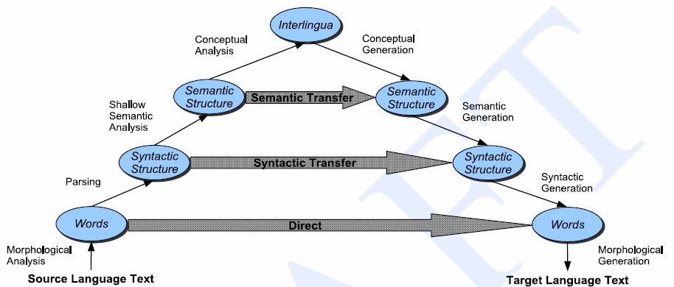
The Vauqois Triangle
Increasing
depth of
analysis

Slide 22
Direct translation
Incrementally transform source sentence into target sentence.
Main knowledge source: a large, bilingual dictionary
Each entry in the dictionary is viewed as a “program” (set of instructions) for going from source expression to target expression.
Proceed through the source text word by word. For each word/phrase do:
Perform shallow morphological analysis
Look up corresponding target word/phrase
Final step:
Reorder target language sentence
Perform morphological generation

Slide 23
Direct Translation: example
Input: Maria didn’t slap the green witch
Morphology: Maria DO-PAST not slap the green witch
Lexical transfer: Maria PAST no dar una bofetada a la verde bruja
NB: dar una bofetada assumed to be dictionary entry for slap
Local reordering: Maria no dar una bofetada a la bruja verde
Morphology: Maria no dió una bofetada a la bruja verde

Slide 24
Direct translation: Problems
This approach performs no parsing of the input and has little or no knowledge of grammar.
Difficult to deal with word order variation and issues related to ordering dependencies over long distances:
E.g. In German, adverbials can vary position fairly flexibly
E.g. In Chinese, goal PP (send X to Y) often occur before the verb.

Slide 25
Direct Translation: Problems
Different word order languages
Maltese OVS: Il-mużika jħobb Pawlu
def-music like-3SgM Paul
(order used for emphasis on music)
Direct translation into English would be:
The music likes Paul.
More appropriate:
It’s music that Paul likes.
But to do this, we would need to syntactically analyse the input, to identify the roles of Paul and the music and to identify the topicalisation.

Slide 26
Syntactic Transfer approaches
Systems based on the transfer model:
Apply contrastive knowledge of languages
Analyse/Parse the source language input
Transfer the constituents to the target language
Generate the syntactically correct sentence
NB: may not need to solve all parsing problems.
E.g. PP-attachment ambiguity in the source often translates into PP-attachment ambiguity in the target:
Jack saw the girl with the glasses
Jack à vu la fille avec les lunettes

Slide 27
Syntactic transfer
Additional knowledge source:
Morphology as in direct MT;
Syntactic transfer rules to go from source to target syntax
E.g. Adjective-noun reordering.
NP
N
Adj
NP
ADJ
N
Maltese, Italian, Spanish
kelb kbir
cane grande
English
large dog

Slide 28
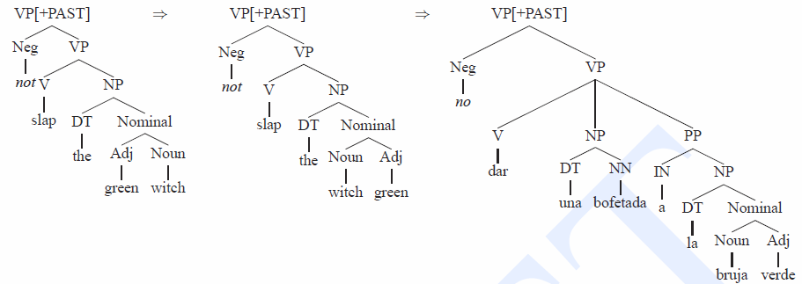
Syntactic transfer
The original English-Spanish example:
After application of transfer rules
After bilingual dictionary lookup

Slide 29
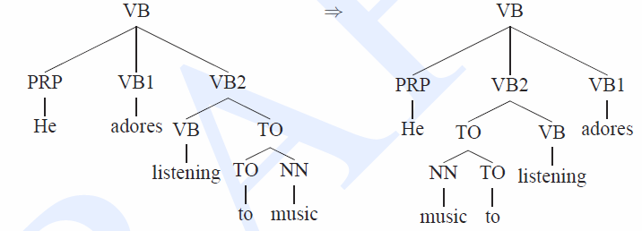
Syntactic transfer
Dealing with word order variation (e.g. English SVO → Japanese SOV)
Example transfer rules:
VP → V NP := VP → NP V
PP → P NP := PP → NP P

Slide 30
Syntactic transfer: other components
These systems also need:
Lexical transfer rules (based on a bilingual dictionary)
Include phrases
In some cases, semantic transfer rules as well
E.g. Chinese thematic role GOAL tends to be pre-verbal
English: I went to the store
Chinese: I to the store went
Note: this kind of re-ordering needs sensitivity to semantic info.

Slide 31
Direct + transfer combinations
Commercial MT systems often combine direct and transfer approaches.
Example: Systran (first documented, 1992, still in use!)
Shallow analysis
Morphology
POS ttagging
Chunking of NPs, PPs etc
Transfer
Translation of idioms
Word Sense disambiguation
Preposition assignment
Synthesis
Lexical translation (dictionary-based)
Reordering
Morphological generation

Slide 32
Interlingua
Transfer models require a distinct set of rules for each language pair.
Not feasible if we have a many-to-many translation problem
E.g. Translating between all pairs of the EU’s 27 official languages
Rather than direct transformation from source to target, interlingua-based approaches go :
from source to a “language-neutral” meaning representation (the interlingua)
From interlingua to target language

Slide 33
Interlingua
An interlingua should:
Represent all sentences that mean the same thing in the same way.
Regardless of the original language
Common approach:
Simple, event-based representation
(Others possible, including use of logic etc)

Slide 34
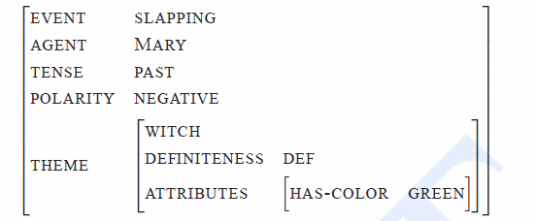
Event-based interlingua example
Mary did not slap the green witch
NB: requires deep semantic analysis for:
Identification of thematic roles (AGENT, THEME etc)
Polarity identification
Definiteness, attributes etc
E.g. In this example, we need to identify that green is a colour, rather than something else (e.g. “naive”)

Slide 35
Interlingua: Pros
No syntactic transformation rules necessary
All languages are “generated” from the common interlingua
No specific English-Spanish, Spanish-Italian etc rules.
No lexical transfer rules
French connaitre vs savoir arise from different interlingua semantic representations.
The same solution can apply to other languages that make the distinction.

Slide 36
Interlingua: Cons
Large burden on deep semantic analysis.
Problematic in “open domain translation” – a lot of semantics involves “world knowledge”
Interlingua is assumed to be language neutral.
But is this realistic? Do we ever have a language-neutral semantics?
Example:
Chinese/Japanese will require concepts for ELDER-BROTHER and YOUNGER-BROTHER
English doesn’t
If intelingua is “universal”, then analysing and generating English will have to make use of these concepts, involving a lot of extra work:
Brother disambiguated into ELDER or YOUNGER
ELDER or YOUNGER both mapped to brother

Slide 37
Part 4
Statistical MT: overview

Slide 38
Alignment
In order to be of any use for MT, parallel corpora must be:
very large
aligned, usually at sentence and word level
Uses of aligned corpora:
example-based MT
statistical MT
cross-lingual information retrieval
…

Slide 39
Automatic alignment
Automatic tools for alignment are now common. Typically use:
statistical heuristics (sentence 1 in corpus A is probably a translation of sentence 2 in corpus B)
linguistic rules
a combination of both

Slide 40
Automatic sentence alignment
Simple quantitative measures can give surprisingly good results, e.g.:
using sentence length: long sentences in corpus A are likely to be translations of long sentences in corpus B
based on the observation that relative sentence length remains roughly constant in translation
Alternative is to use linguistically motivated methods:
pairing of lexical units
pairing of sentences based on functional dependencies (relations between lexical units)

Slide 41
Automatic sentence alignment
Results from McEnery and Oakes 1996, using statistical heuristics:
Languages | Domain | No. pars | %correct
En-Pl | fiction | 89 | 100
En-Fr | telecom | 100 | 98
En-Sp | telecom | 222 | 93.2
En-De | Economics | 36 | 75
Ch-En | News | 171 | 54.5

Slide 42
Automatic sentence alignment
A lot depends on the languages compared
we can expect sentences in some languages to be more similar

Slide 43
Automatic word alignment
Source: Brown et al. 1993. A statistical approach to machine translation.
Computational Linguistics, 16(2): 79—85

Slide 44
Automatic word alignment
Simple technique: compare the similarity between two words
can use the Dice coefficient
score of 1 means “identical”
using this technique, yields quite good results
again, probably dependent on whether languages are historically related
other techniques rely on positional information

Slide 45
Aligning multiword expressions
McEnery et al 1996:
attempt to align nominal compounds in English and Spanish
combine rules and statistical heuristics
use the dice coefficient to compare compounds extracted
over 80% accuracy for compounds with a Dice score over .85

Slide 46
Statistical MT
Brown et al (1990):
argued that the time was ripe for a return to the statistical paradigm in MT (abandoned in the 1950’s)
Given a sentence S in the source language, and a sentence T in the target language:
what is the probability that S is a translation of T?
if we know this for many candidate translations, then we can choose the sentence T which is most probable, given S

Slide 47
Statistical MT
Brown et al focused on English-French translation
“for simple sentences it is reasonable to think of the French translation of an English sentence as being generated from the English sentence word by word”
i.e. every English word maps to a French word with some probability, with no intervening semantics

Slide 48
Statistical MT: alignment
For more complicated sentences:
suppose English S is made up of several words w1, w2…, wn
given an alignment model, each word in S maps to one or more words in French
probabilities differ for each mapping
some words in English won’t map to anything in French
some words may map to more than one word in French

Slide 49
Automatic word alignment
Source: Brown et al. 1993. A statistical approach to machine translation.
Computational Linguistics, 16(2): 79—85

Slide 50
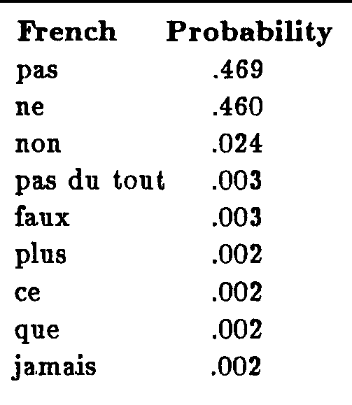
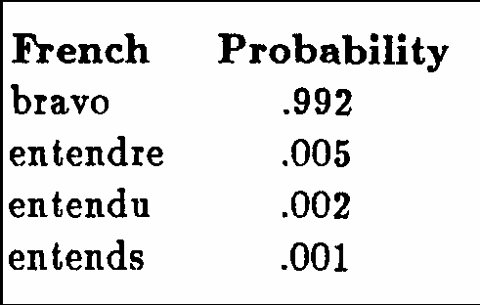
Brown et al’s alignment probabilities
English “hear”
English “not”
NB: probabilities are learned automatically from aligned corpora using statistical heuristics

Slide 51
Statistical MT: distortion
Brown et al (1990):
observation: words in English will tend to align with words in French in the same sentence position
e.g. English word at the beginning of a sentence maps to French word at the end of sentence
but not always the case: sometimes, the position of the French word is quite far from that of the English
this is called distortion
captured using probabilities: what is the likelihood that word w in English maps to a word w’ in French which is in a different position?

Slide 52
Statistical MT: search
Brown et al’s alignment model is then used to translate new sentences:
given an English sentence S:
search for the most likely French mappings for words in S
check whether there is distortion (and move the French words accordingly)
output the French sentence

Slide 53
Some observations
Highly domain-dependent!
e.g. most probable translation for hear is Bravo!
reason: aligned corpus used was Canadian parliamentary transcripts, where Hear hear! was often translated as bravo!
model had no notion of context: assumption was that every word in a sentence was independent of every other word

Slide 54
Example-based translation
again uses parallel aligned corpora
Simplest method:
given sentence S in source language
try and find S in the parallel corpus, and retrieve the aligned translation sentence
More elaborate methods exist:
e.g. parsed bilingual corpora, aligned at the dependency level

Slide 55
Contemporary approaches
Most corpus-based MT approaches recognise the limitations of using corpora alone
Many hybrid approaches now developing
e.g. use statistical approaches, combined with grammatical rules

Slide 56
Summary
MT is one of the fastest-growing applications in Language Engineering
Millions invested in research every year.
Still far from perfect
Contemporary approaches rely strongly on aligned corpora, but are now becoming more hybrid

