Slide 1
LIN3022 Natural Language Processing Lecture 8
Albert Gatt

Slide 2
In this lecture
We begin to look at the task of syntactic parsing
Overview of grammar formalisms (especially CFGs)
Overview of parsing algorithms

Slide 3
The task
Example input sentence:
Book that flight.
What does a parser need to do?
Recognise the sentence as a legal sentence of English.
(i.e. That the sentence is allowed by the grammar)
Identify the correct underlying structure for that sentence.
More precisely, identify all the allowable structures for the sentence.

Slide 4
Why parsing is useful
Several NLP applications use parsing as a first step.
Grammar checking
If a sentence typed by an author has no parse, then it is either ungrammatical or probably hard to read.
Question answering:
E.g. What laws have been passed during Obama’s presidency?
Requires knowledge that:
Subject is what laws (i.e. this is a question about legislation)
Adjunct is during Obama’s presidency
...
Machine translation
Many MT algorithms work by mapping from input to target language.
Parsing the input makes it easier to consider syntactic differences between languages.

Slide 5
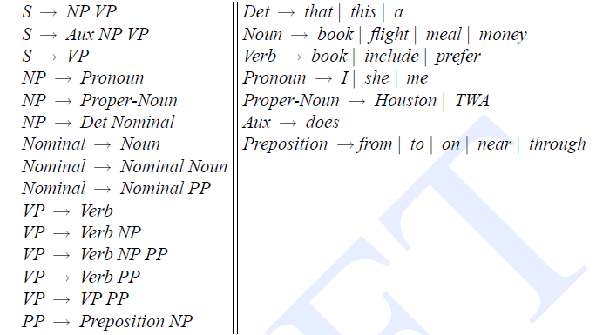
A simple context-free grammar
Jurafsky & Martin 2009, p. 462

Slide 6
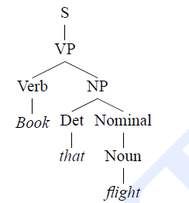
The parse
Things to note
The parse tree has one root node (S).
Every path through the tree represents a sequence of rule applications.
The tree has 3 leaf nodes. This is a constraint imposed by the input sentence.

Slide 7
Grammar vs parse
A grammar specifies the space of possible structures in a language.
Remember our discussion of FS models for morphology. The FSA defines the space of possible words in the language.
But a grammar does not tell us how an input sentence is to be parsed.
Therefore, we need to consider algorithms to search through the space of possibilities and return the right structure.

Slide 8
Part 1
Context-free grammars

Slide 9
Parsing with CFGs
Many parsing algorithms use the CFG formalism.
We therefore need to consider:
The definition of CFGs
Their scope.

Slide 10
CFG definition
A CFG is a 4-tuple: (N,Σ,P,S):
N = a set of non-terminal symbols (e.g. NP, VP)
Σ = a set of terminals (e.g. words)
N and Σ are disjoint (no element of N is also an element of Σ)
P = a set of productions of the form A→β where:
A is a non-terminal (a member of N)
β is any string of terminals and non-terminals
S = a designated start symbol (usually, “sentence”)

Slide 11
A CFG example in more detail
S → NP VP
S → Aux NP VP
NP → Det Nom
NP → Proper-Noun
Det → that | the | a
…
Some of these rules are “lexical”
The grammar defines a space of possible structures (e.g. Two possible types of sentence)
A parsing algorithm needs to search through that space for a structure which:
Covers the whole of the input string.
Starts with root node S.

Slide 12
Where does a CFG come from?
CFGs can of course be written by hand. However:
Wide-coverage grammars are very laborious to write.
There is no guarantee that we have covered all the (realistic) rules of a language.
For this reason, many parsers employ grammars which are automatically extracted from a treebank.
A corpus of naturally occurring text;
Each sentence in the corpus manually parsed.
If the corpus is large enough, we have some guarantee that a broad range of phenomena will be covered.

Slide 13
The Penn Treebank
Created at the University of Pennsylvania. Widely used for many parsing tasks.
Manually parsed corpus with texts from:
Brown corpus (general Americal English)
Switchboard corpus (telephone conversations)
Wall Street Journal (news, finance)
ATIS (Air Traffic Information System)
Quite neutral as regards the syntactic theory used.
Parses conform to the CFG formalism.

Slide 14
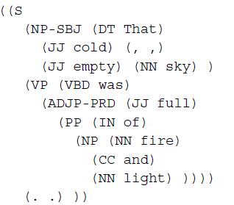
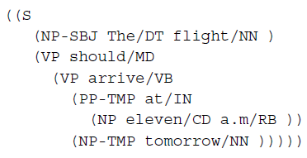
Penn Treebank example
Brown extract
ATIS extract
Jurafsky & Martin 2009, p. 439

Slide 15
Some things to note
Quite flat structures.
Some grammatical function information marked (SBJ, PRD)

Slide 16
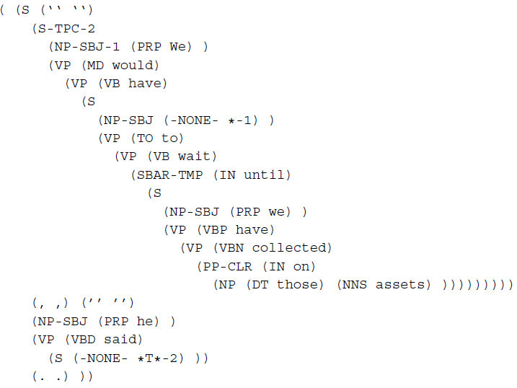
Marking up syntactic movement
Marks object of “said” as preceding sentence.

Slide 17
Top-down parsing
One way to think of parsing is as a goal-directed search:
Start from the root node S (the goal).
Recursively expand S until every part of the input is covered.

Slide 18
Bottom-up parsing
Another way to think of parsing is as a bottom-up or data-directed search:
Start from the individual words.
Recursively find the rules that will cover increasingly large parts of the input until:
all words are covered and
S is reached.

Slide 19
Part 2
Top-down parsing

Slide 20
Top-down parsing
A top-down parser searches for a parse tree by trying to build from the root S down to the leaves.
Basic procedure:
Assume that the input can be derived from S
Find all the possible expansions of S in the grammar (the set of possible “expectations”)
For each expansion, use the right hand side of the rule to create a new set of expectations.
...
Continue until at least one expansion matches the part-of-speech categories of the input words.
Reject all non-matching expansions.

Slide 21
Top-down: Book that flight
Assume that the input can be derived from S

Slide 22
Top-down: Book that flight
Assume that the input can be derived from S.
Find all the possible expansions of S in the grammar.

Slide 23
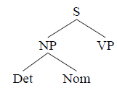
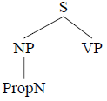
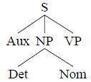
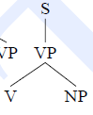
Top-down: Book that flight
Assume that the input can be derived from S.
Find all the possible expansions of S in the grammar.
For each expansion, use the right hand side of the rule to create a new set of expectations.

Slide 24
Top-down: Book that flight
Assume that the input can be derived from S.
Find all the possible expansions of S in the grammar.
For each expansion, use the right hand side of the rule to create a new set of expectations.
Reject all non-matching parses

Slide 25
Some important terminology
We can think of this as a search through ever-deeper levels.
Each level of the search is called a ply.
First ply
Second ply
Third ply

Slide 26
Part 3
Bottom-up parsing

Slide 27
Bottom-up parsing
The earliest parsing algorithm proposed was bottom-up.
Very common technique for parsing artificial languages (especially programming languages, which need to be parsed in order for a computer to “understand” a program and follow its instructions).

Slide 28
Bottom-up parsing
The basic procedure:
Start from the words, and find terminal rules in the grammar that have each individual word as RHS.
(e.g. Det → that)
Continue recursively applying grammar rules one at a time until the S node is reached.
At each ply, throw away any partial trees that cannot be further expanded.

Slide 29
Bottom-up: Book that flight
Start from the words

Slide 30
Bottom-up: Book that flight
Start from the words
find terminal rules in the grammar that have each individual word as RHS
Ambiguity results in bifurcation of search space.

Slide 31
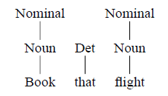
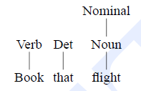
Bottom-up: Book that flight
Start from the words
find terminal rules in the grammar that have each individual word as RHS
Ambiguity results in bifurcation of search space.
Recursively build structure by applying grammar rules whose RHS matches input.

Slide 32
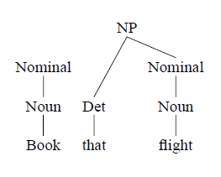
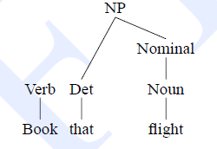
Bottom-up: Book that flight
Start from the words
find terminal rules in the grammar that have each individual word as RHS
Ambiguity results in bifurcation of search space.
Recursively build structure by applying grammar rules whose RHS matches input.

Slide 33
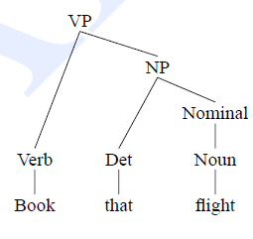
Bottom-up: Book that flight
Start from the words
find terminal rules in the grammar that have each individual word as RHS
Ambiguity results in bifurcation of search space.
Recursively build structure by applying grammar rules whose RHS matches input.
Prune non-matching trees.
Continue until S is reached.

Slide 34
Top-down vs bottom-up
Top-down
Bottom-up
Never considers derivations that do not end up at root S.
Wastes a lot of time with trees that are inconsistent with the input.
Generates many subtrees that will never lead to an S.
Only considers trees that cover some part of the input.

Slide 35
Part 4
The problem of ambiguity (again)

Slide 36
Syntactic ambiguity
Broadly, a sentence is ambiguous if it has more than one parse.
Local ambiguity: a sentence can be unambiguous (have only one correct parse), but manifest local ambiguity in one or more of its subtrees.
Book that flight
Unambiguous, but a local ambiguity arises with book (N or V)
Global ambiguity: a sentence can have more than one correct parse.

Slide 37
Global ambiguity
Ambiguity is pervasive, but we often don’t notice it, because we default to a “most likely” parse using:
Semantic knowledge;
Pragmatic and real-world knowledge;
Statistical probabilities.
Example (with apologies to Groucho Marx):
I shot an elephant in my pyjamas.

Slide 38
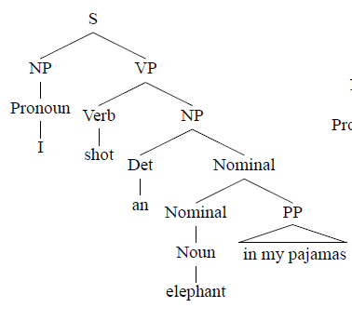
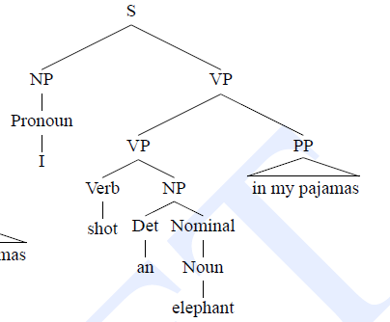
Of elephants and pyjamas

Slide 39
Two common types of ambiguity
Attachment ambiguity:
A phrase can attach to more than one head.
I [shot [the elephant] [in my pyjamas]]
I [shot [the elephant in my pyjamas]]
Coordination ambiguity:
A coordinate phrase is ambiguous in relation to its modifiers.
[old men] and [shoes]
[old [men and shoes]]
An example of PP attachment ambiguity (very common)

Slide 40
Syntactic disambiguation
In the absence of statistical, semantic and pragmatic knowledge, it is difficult to perform disambiguation.
On the other hand, returning all possible parses of a sentence can be very inefficient.
Large grammar → bigger search space → more possibilities → more ambiguity
No of possible parses grows exponentially with a large grammar

Slide 41
Beyond simple algorithms
Next week, we’ll start looking at some solutions to these problems:
Dynamic programming algorithms
Algorithms that don’t search exhaustively through a space of possibilities, but resolve a problem by breaking it down into partial solutions.
Using corpus-derived probabilities to identify the best parse.

