Slide 1
LIN3022 Natural Language Processing
Lecture 4
Albert Gatt

Slide 2
Spell checking and edit distance
Part 1

Slide 3
Sequence Comparison
Once we have the kind of sequences we want, what kinds of simple things can we do?
Compare sequences (determine similarity)
  How close are a given pair of strings to each other?
Alignment
  What’s the best way to align the various bits and pieces of two sequences
Edit distance
  Minimum edit distance

Slide 4
Spelling Correction
How do I fix “graffe”?
  Search through all words in my lexicon
    graf
    craft
    grail
    giraffe
  Pick the one that’s closest to graffe
  What does “closest” mean?
  We need a distance metric.
  The simplest one: edit distance

Slide 5
Edit Distance
The minimum edit distance between two strings is the minimum number of editing operations…
  Insertion
  Deletion
  Substitution
…needed to transform one string into the other

Slide 6
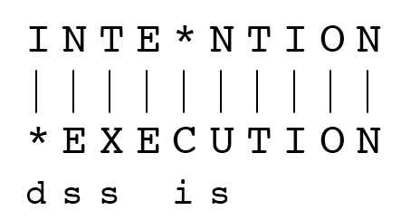
Minimum Edit Distance
If each operation has cost of 1
Distance between these is 5
If substitutions cost 2 (Levenshtein)
Distance between these is 8

Slide 7
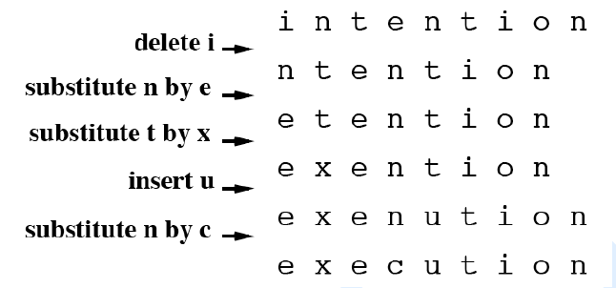
Min Edit Example

Slide 8
Min Edit As Search
We can view edit distance as a search for a path (a sequence of edits) that gets us from the start string to the final string
  Initial state is the word we’re transforming
  Operators are insert, delete, substitute
  Goal state is the word we’re trying to get to
  Path cost is what we’re trying to minimize: the number of edits

Slide 9
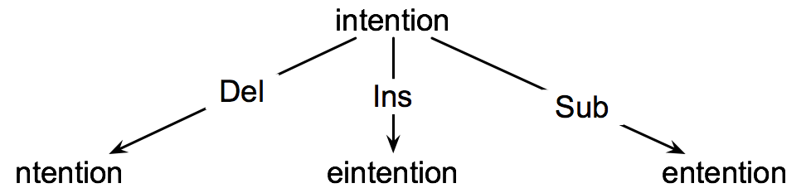
Min Edit as Search

Slide 10
Min Edit As Search
But that generates a huge search space
  Imagine checking every single possible path from the source word to the destination word.
  We’d have a combinatorial explosion.
Also, there will be lots of ways to get from source to destination.
  But we’re only interested in the shortest one.
  So there’s no need to keep track of the them all.

Slide 11
Defining Min Edit Distance
For two strings:
  S₁ of len n
  S₂ of len m
  distance(i,j) or D(i,j)
    means the edit distance of S₁[1..i] and S₂[1..j]
    i.e., the minimum number of edit operations need to transform the first i characters of S₁ into the first j characters of S₂
    The edit distance of S₁, S₂ is D(n,m)
We compute D(n,m) by computing D(i,j) for all i (0 < i < n) and j (0 < j < m)

Slide 12
Defining Min Edit Distance
Base conditions:
  D(i,0) = i
    (transforming a string of length i to a zero-length string involves i deletions)
  D(0,j) = j
    (transforming a zero length string to a string of length j involves j insertions)
  Recurrence Relation:
  D(i-1,j) + 1 (insertion)
  D(i,j) = min D(i,j-1) + 1 (deletion)
  D(i-1,j-1) + 2; if S₁(i) ≠ S₂(j) (substitution)
  0; if S₁(i) = S₂(j) (equality)

Slide 13
Dynamic Programming
A tabular computation of D(n,m)
Bottom-up
  We compute D(i,j) for small i,j
  And compute increase D(i,j) based on previously computed smaller values
The essence of dynamic programming:
  Break up the problem into small pieces
  Solve the problem for the small bits.
  Add the solutions up.

Slide 14
Initial steps
Let n be the length of the target, m be the length of the source
Create a matrix (table) with n+1 columns and m+1 rows.
Initialise row 0, col 0 to D(0,0) = 0

Slide 15
The Edit Distance Table
N | 9
O | 8
I | 7
T | 6
N | 5
E | 4
T | 3
N | 2
I | 1
# | 0 | 1 | 2 | 3 | 4 | 5 | 6 | 7 | 8 | 9
 | # | E | X | E | C | U | T | I | O | N
Notes:
15

Slide 16
Next steps
For each column for i = 1 to n do:
  D(i,0) = D(i-1,0) + insert-cost(i)
    The cost at col i, row 0 is the cost of the previous column at this row + whatever the cost of inserting i is.
For each column for j = 1 to m do:
  D(0,j) = D(0,j-1) + delete-cost(j)
    The cost at col 0, row j is the cost at this row for the previous column + whatever the cost of deleting j is.

Slide 17
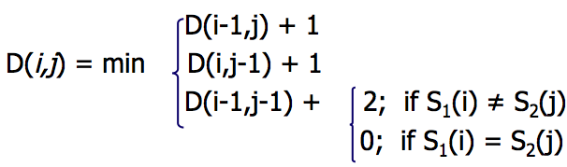
N | 9
O | 8
I | 7
T | 6
N | 5
E | 4
T | 3
N | 2
I | 1
# | 0 | 1 | 2 | 3 | 4 | 5 | 6 | 7 | 8 | 9
 | # | E | X | E | C | U | T | I | O | N
Notes:
17

Slide 18
Next steps
For each column i from 1 to n do:
  For each row j from 1 to m do:
  set D(i,j) to be the minimum of:
      The distance between the previous col and this row + the cost of inserting the current character in the target
      The distance between the previous col and the previous row + the cost of substituting the current character in the source with that in the target
      The distance between the current col and the previous row + the cost of deleting the current character from the source.

Slide 19
N | 9
O | 8
I | 7
T | 6
N | 5
E | 4
T | 3
N | 2
I | 1 | 2
# | 0 | 1 | 2 | 3 | 4 | 5 | 6 | 7 | 8 | 9
 | # | E | X | E | C | U | T | I | O | N
Compare i=1 to j = 1
Take the minimum of:
D(1-1,1)+1 = D(#,I)+1= 2 (ins)
D(1,1-1)+1 = D(E,#)+1 = 2 (del)
D(i-1,j-1) + 2 = D(#,#) + 2 = 2 (subst)
Min is 2
Notes:
19

Slide 20
N | 9
O | 8
I | 7
T | 6
N | 5
E | 4
T | 3
N | 2 | 3
I | 1 | 2
# | 0 | 1 | 2 | 3 | 4 | 5 | 6 | 7 | 8 | 9
 | # | E | X | E | C | U | T | I | O | N
Step 2: compare i=1 to j = 2
Take the minimum of:
D(1-1,2)+1 = D(#,N)+1 = 3 (ins)
D(1,1-1)+1 = D(E,I) + 1 = 3 (del)
D(i-1,j-1) + 2 = D(#,I) + 2 = 4 (subst)
Min is 3
Notes:
20

Slide 21
N | 9 | 8 | 9 | 10 | 11 | 12 | 11 | 10 | 9 | 8
O | 8 | 7 | 8 | 9 | 10 | 11 | 10 | 9 | 8 | 9
I | 7 | 6 | 7 | 8 | 9 | 10 | 9 | 8 | 9 | 10
T | 6 | 5 | 6 | 7 | 8 | 9 | 8 | 9 | 10 | 11
N | 5 | 4 | 5 | 6 | 7 | 8 | 9 | 10 | 11 | 10
E | 4 | 3 | 4 | 5 | 6 | 7 | 8 | 9 | 10 | 9
T | 3 | 4 | 5 | 6 | 7 | 8 | 7 | 8 | 9 | 8
N | 2 | 3 | 4 | 5 | 6 | 7 | 8 | 7 | 8 | 7
I | 1 | 2 | 3 | 4 | 5 | 6 | 7 | 6 | 7 | 8
# | 0 | 1 | 2 | 3 | 4 | 5 | 6 | 7 | 8 | 9
 | # | E | X | E | C | U | T | I | O | N
Notes:
21

Slide 22
Min Edit Distance
Note that the result isn’t all that informative
  For a pair of strings we get back a single number
    The min number of edits to get from here to there
Like telling someone how far away their destination is, without giving them directions.

Slide 23
Alignment
An alignment is a 1 to 1 pairing of each element in a sequence with a corresponding element in the other sequence or with a gap...

Slide 24
Paths/Alignments
Keep a back pointer
  Every time we fill a cell add a pointer back to the cell that was used to create it (the min cell that led to it)
  To get the sequence of operations follow the backpointer from the final cell
  That’s the same as the alignment.
Notes:
24

Slide 25
Backtrace
N | 9 | 8 | 9 | 10 | 11 | 12 | 11 | 10 | 9 | 8
O | 8 | 7 | 8 | 9 | 10 | 11 | 10 | 9 | 8 | 9
I | 7 | 6 | 7 | 8 | 9 | 10 | 9 | 8 | 9 | 10
T | 6 | 5 | 6 | 7 | 8 | 9 | 8 | 9 | 10 | 11
N | 5 | 4 | 5 | 6 | 7 | 8 | 9 | 10 | 11 | 10
E | 4 | 3 | 4 | 5 | 6 | 7 | 8 | 9 | 10 | 9
T | 3 | 4 | 5 | 6 | 7 | 8 | 7 | 8 | 9 | 8
N | 2 | 3 | 4 | 5 | 6 | 7 | 8 | 7 | 8 | 7
I | 1 | 2 | 3 | 4 | 5 | 6 | 7 | 6 | 7 | 8
# | 0 | 1 | 2 | 3 | 4 | 5 | 6 | 7 | 8 | 9
 | # | E | X | E | C | U | T | I | O | N
Notes:
25

Slide 26
Uses for spellchecking
Given a lexicon, and an input word to check, Min Edit gives us a way of finding an alternative which is the closest to the input word.
If user types graffe, the closest word might be giraffe (edit cost of 1 insertion).

Slide 27
An aside about contextual spell checking
Part 2

Slide 28
The simplest kind of spellchecker
Lexicon
[...]
graph
giraffe
gaffe
geometry
[...]
gaffe
(1 deletion)
Input: graffe
giraffe
(one insertion)
The candidates offered to the user are just based on edit distance.
The idea is that we minimise the distance from the solution to the user’s input.
But sometimes we have ties.

Slide 29
A slight variation
Lexicon
[...]
graph
giraffe
gaffe
geometry
[...]
Gaffe
(1 deletion)
C(gaffe) = 200
Input: graffe
giraffe
(one insertion)
C(giraffe) = 380
The candidates offered to the user still based on edit distance to minimise the distance from the solution to the user’s input.
But if we have frequencies (or, better, probabilities), we can also nudge the user’s choice in a more likely direction.

Slide 30
An even nicer variation
There are lots of spelling errors that aren’t “typos”:
  Actual words, just not the intended words.
  Sometimes called “brainos”
How do we determine whether something is indeed a braino?

Slide 31
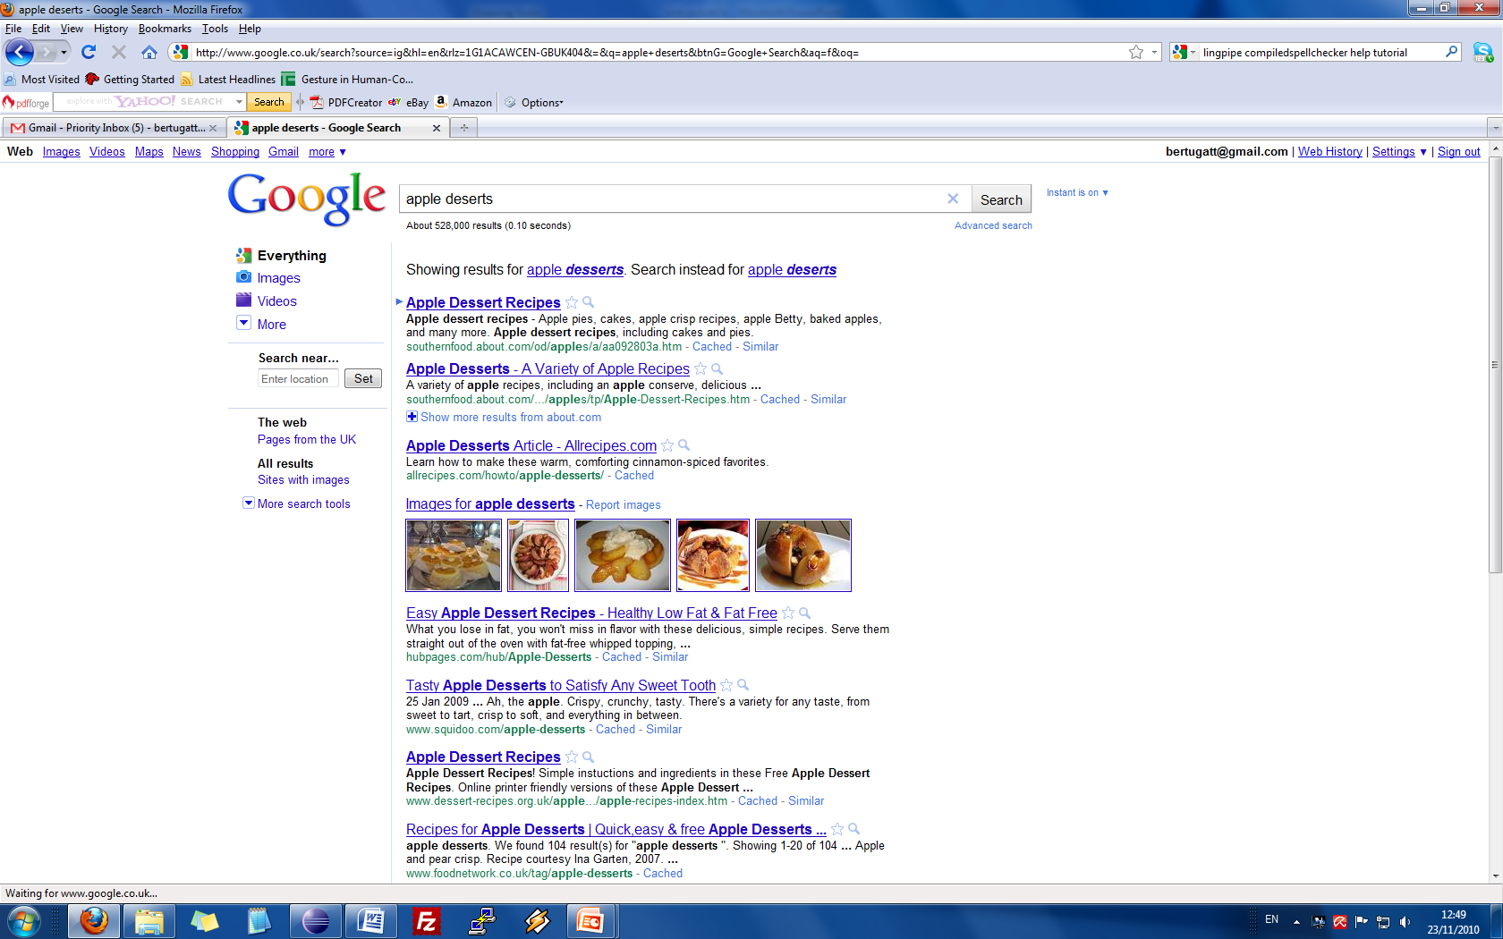
Contextual spelling correction

Slide 32
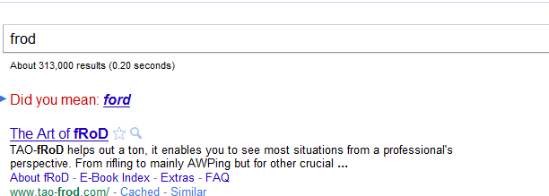
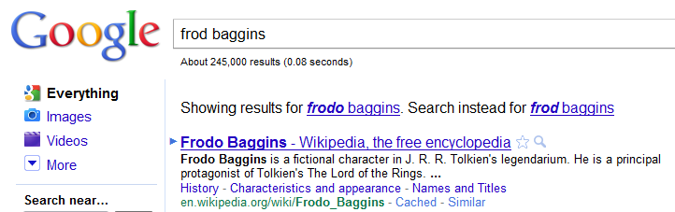
Anka l-iżbalji veri jiddependu mill-kuntest

Slide 33
How it works
This kind of speller needs a probabilistic language model.
  Needs to provide the probability of a sequence of characters.
  Language is modelled as a series of transitions bertween characters.

Slide 34
Frod or Frodo?
F->r->o->d->o->_->B->a->g->g-i->n->s
versus
F->r->o->d->_->B->a->g->g-i->n->s
Think of each arrow as being “decorated” with the probability of going from the previous to the following character.
We expect the first sequence to be more probable than the second

Slide 35
Which means the model now works like this
Lexicon
[...]
graph
giraffe
gaffe
geometry
[...]
Gaffe
(1 deletion)
C(gaffe) = 200
Input: I made a graffe last week in class
giraffe
(one insertion)
C(giraffe) = 380
We identify the closest existing words to the input word, but also combine character transition probabilities, to give us the more likely solution irrespective of its overall frequency.

Slide 36
Which means the model now works like this
Lexicon
[...]
graph
giraffe
gaffe
geometry
[...]
Dessert
(1 insertion)
Input: I made apple desert for lunch
We identify the closest existing words to the input word, but also combine character transition probabilities, to give us the more likely solution irrespective of its overall frequency.
This could also work with input words which aren’t typos, but make no sense in context.

Slide 37
Introduction to language models more generally
Part 3

Slide 38
Teaser
What’s the next word in:
  Please turn your homework ...
  in?
  out?
  over?
  ancillary?

Slide 39
Example task
The word or letter prediction task (Shannon game)
Given:
  a sequence of words (or letters) -- the history
  a choice of next word (or letters)
Predict:
  the most likely next word (or letter)

Slide 40
Letter-based Language Models
Shannon’s Game
Guess the next letter:

Slide 41
Letter-based Language Models
Shannon’s Game
Guess the next letter:
W

Slide 42
Letter-based Language Models
Shannon’s Game
Guess the next letter:
Wh

Slide 43
Letter-based Language Models
Shannon’s Game
Guess the next letter:
Wha

Slide 44
Letter-based Language Models
Shannon’s Game
Guess the next letter:
What

Slide 45
Letter-based Language Models
Shannon’s Game
Guess the next letter:
What d

Slide 46
Letter-based Language Models
Shannon’s Game
Guess the next letter:
What do

Slide 47
Letter-based Language Models
Shannon’s Game
Guess the next letter:
What do you think the next letter is?

Slide 48
Letter-based Language Models
Shannon’s Game
Guess the next letter:
What do you think the next letter is?
Guess the next word:

Slide 49
Letter-based Language Models
Shannon’s Game
Guess the next letter:
What do you think the next letter is?
Guess the next word:
What

Slide 50
Letter-based Language Models
Shannon’s Game
Guess the next letter:
What do you think the next letter is?
Guess the next word:
What do

Slide 51
Letter-based Language Models
Shannon’s Game
Guess the next letter:
What do you think the next letter is?
Guess the next word:
What do you

Slide 52
Letter-based Language Models
Shannon’s Game
Guess the next letter:
What do you think the next letter is?
Guess the next word:
What do you think

Slide 53
Letter-based Language Models
Shannon’s Game
Guess the next letter:
What do you think the next letter is?
Guess the next word:
What do you think the

Slide 54
Letter-based Language Models
Shannon’s Game
Guess the next letter:
What do you think the next letter is?
Guess the next word:
What do you think the next

Slide 55
Letter-based Language Models
Shannon’s Game
Guess the next letter:
What do you think the next letter is?
Guess the next word:
What do you think the next word

Slide 56
Letter-based Language Models
Shannon’s Game
Guess the next letter:
What do you think the next letter is?
Guess the next word:
What do you think the next word is?

Slide 57
Applications of the Shannon game
Identifying spelling errors:
  Basic idea: some letter sequences are more likely than others.
Zero-order approximation
  Every letter is equally likely. E.g. In English:
    P(e) = P(f) = ... = P(z) = 1/26
  Assumes that all letters occur independently of the other and have equal frequency.
        xfoml rxkhrjffjuj zlpwcwkcy ffjeyvkcqsghyd

Slide 58
Applications of the Shannon game
Identifying spelling errors:
  Basic idea: some letter sequences are more likely than others.
First-order approximation
  Every letter has a probability dependent on its frequency (in some corpus).
  Still assumes independence of letters from eachother. E.g. In English:
      ocro hli rgwr nmielwis eu ll nbnesebya th eei alhenhtppa oobttva nah

Slide 59
Applications of the Shannon game
Identifying spelling errors:
  Basic idea: some letter sequences are more likely than others.
Second-order approximation
  Every letter has a probability dependent on the previous letter. E.g. In English:
    on ie antsoutinys are t inctore st bes deamy achin d ilonasive tucoowe at teasonare fuzo tizin andy tobe seace ctisbe

Slide 60
Applications of the Shannon game
Identifying spelling errors:
  Basic idea: some letter sequences are more likely than others.
Third-order approximation
  Every letter has a probability dependent on the previous two letter. E.g. In English:
    in no ist lat whey cratict froure birs grocid pondenome of demonstures of the reptagin is regoactiona of cre

Slide 61
Applications of the Shannon Game
Language identification:
  Sequences of characters (or syllables) have different frequencies/probabilities in different languages.
Higher frequency trigrams for different languages:
  English: THE, ING, ENT, ION
  German: EIN, ICH, DEN, DER
  French: ENT, QUE, LES, ION
  Italian: CHE, ERE, ZIO, DEL
  Spanish: QUE, EST, ARA, ADO
Languages in the same family tend to be more similar to each other than to languages in different families.

Slide 62
Applications of the Shannon game with words
Automatic speech recognition :
  ASR systems get a noisy input signal and need to decode it to identify the words it corresponds to.
  There could be many possible sequences of words corresponding to the input signal.
Input: “He ate two apples”
  He eight too apples
  He ate too apples
  He eight to apples
  He ate two apples
Which is the most probable sequence?

Slide 63
Applications of the Shannon Game with words
Context-sensitive spelling correction:
  Many spelling errors are real words
    He walked for miles in the dessert. (resp. desert)
  Identifying such errors requires a global estimate of the probability of a sentence.

Slide 64
N-gram models
These are models that predict the next (n-th) word (or character) from a sequence of n-1 words (or characters).
Simple example with bigrams and corpus frequencies:
  <S> he 25
  he ate 12
  he eight 1
  ate to 23
  ate too 26
  ate two 15
  eight to 3
  two apples 9
  to apples 0
  ...
Can use these to compute the probability of he eight to apples vs he ate two apples etc

Slide 65
N-gram models
We’ll talk about n-gram models and markov assumptions in more detail next week...

