Slide 1
LIN1180/LIN5082 Semantics Lecture 1
Albert Gatt

Slide 2
Logistics…
Course tutor:
Albert Gatt
albert.gatt@um.edu.mt
Course assessment is by assignment:
This year, this will take the form of a number of short questions. They will be made available in due course.

Slide 3
Course website
http://staff.um.edu.mt/albert.gatt/home/teaching/semantics.html
Visit this website regularly!

Slide 4
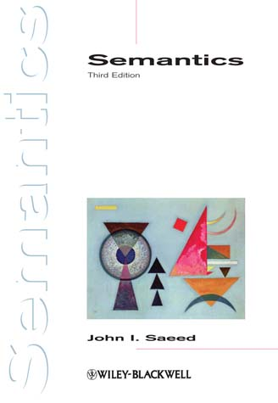
Textbook and readings
Course text
This course will largely follow this book:
Saeed, J. (2003). Semantics. Oxford: Blackwell
Many other texts suggested on the website.
Several readings to be made available along the way.

Slide 5
What you can expect from me
Web page will always be up to date
Readings assigned per lecture
relevant sections from the textbook
other readings, usually available online
Downloadable lecture notes in powerpoint format (available after the lecture)

Slide 6
What is expected of you
Check the website regularly for updates!
Keep up by reading what is required.
Core readings are indicated on the website. You should read these before the lecture.
Additional readings are also indicated. You should read these after the lecture.
Hand in your work on time.
Participate in lectures!!!

Slide 7
Questions…
?

Slide 8
Part 1
What is semantics?

Slide 9
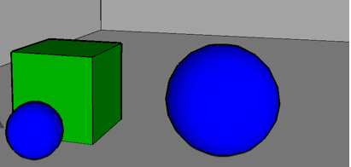
Some things we know
These sentences describe the same situation:
The small blue circle is in front of the square.
The square is behind the small blue circle.
We are also capable of verifying that both sentences are true in this particular situation.
This is because we know what the world must be like in order for these sentences to be true.

Slide 10
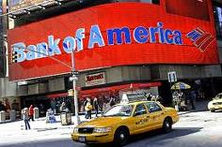

Some things we know
We know that the following sentence can mean more than one thing (it is ambiguous):
She drove past the bank.
This seems to be related to our knowledge of what bank denotes.

Slide 11
Some things we know
We also know that sentence two follows from sentence 1 (technically: sentence 1 entails sentence 2)
John murdered the president.
The president is dead.
In this particular case, it seems to be related to the meaning of murder.

Slide 12
Semantics
Usually defined as that part of Linguistics that deals with meaning
word meaning
sentence meaning
The remainder of this lecture will try to outline:
Why this is of interest to the linguist
What problems arise with this enterprise

Slide 13
Grammar
Grammar (in the linguist’s sense) is a characterisation of the knowledge of a speaker/hearer.
We ask: when a speaker “knows” a language, what does she know exactly?
The linguist’s task is therefore to characterise what it takes for a speaker/hearer to produce and comprehend her language.

Slide 14
Semantics as part of grammar
Semantics is part of a speaker’s (listener’s) linguistic knowledge.
Therefore, semantics is part of grammar.
Speakers have some internalised knowledge such that:
They understand what other people mean
They are able to say what they mean

Slide 15
Knowledge of language is productive
Open any book…
How many of the sentences in it have you seen/heard before?
Some, but certainly not all of them.
But even if the sentences are completely “new”, you are still able to understand them.
To characterise our knowledge of language, we need to characterise this ability people have to decode any new utterance, so long as it conforms to the grammar of their language.

Slide 16
The problem of knowledge
Chomsky (1986) identified this as Plato’s problem:
A lot of what we hear or say is new
How do we manage to understand and produce such an infinite variety of things, even if we’ve never heard them before?
This is the basic motivation for much linguistic work since the 1950’s.

Slide 17
The problem of knowledge
Until the 1960s, the role of semantics in grammar was somewhat obscure.
What can semantics contribute which is not accounted for by other areas?
syntax (phrase structure)
morphology (word structure)
phonology (sound structure)
…

Slide 18
Katz and Fodor (1963)
an early attempt to characterise what is required of a semantic theory
“semantics takes over the explanation of the speaker's ability to produce and understand new sentences at the point where grammar leaves off” (p. 172-3)
K&F argued that syntax and phonology alone cannot give a full account of a speaker’s knowledge of language
e.g. the sentences the man bit the dog and the dog bit the man are structurally identical, but differ in meaning
(NB: K&F assume that syntax has no bearing on meaning as such)

Slide 19
Language and the world
But in characterising knowledge of meaning, we also have the problem of distinguishing linguistic knowledge from world knowledge
E.g. What is the meaning of the word man or ostrich?
Is your knowledge of the meaning independent of your experience of the world?
Are you born with an innate knowledge of such words?

Slide 20
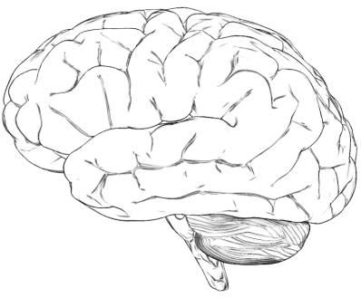

Knowledge of language and the world
semantics
How do we account for the relationship between words and concepts?
How do we decode the meaning of complex sentences?
How is linguistic meaning related to the world?
concepts/
thoughts
things
&
situations

Slide 21
Knowledge of language and the world
How do we account for the relationship between words and concepts?
How do we decode the meaning of complex sentences?
How is linguistic meaning related to the world?
lexical semantics
sentential semantics
lexical semantics
&
sentential semantics

Slide 22
The problem of knowledge
In designing a semantic theory, we need to account for productivity
We know a lot of words (thousands) and their meanings. This is our mental lexicon.
We can create an infinite number of sentences, using grammatical rules of our language.
The meaning of sentences is derived from the meaning of their component words and the way they’re combined.

Slide 23
Compositionality
The guiding principle to explaining the productivity of meaning is the Principle of Compositionality
The meaning of a sentence is a function of the meaning of its component words and the way they’re combined.
Often attributed to the philosopher Gottlob Frege.

Slide 24
Part 2
Semantics in relation to other components of grammar

Slide 25
Meaning and grammar (I)
In some theories, such as Generative grammar, the language faculty is divided into modules:
This view emphasises distinct roles played by different components.
There is a separate component for meaning, completely unrelated to syntax or phonology.
phonology
syntax
semantics

Slide 26
Is this view tenable?
It seems clear that some grammatical facts must take meaning into account.
Jake opened the door.
The door opened.
The girl kissed Steve.
?Steve kissed.
It looks like the meaning of the verbs affects their syntactic behaviour!
Open is a change of state verb.
Kiss is not a change of state verb.

Slide 27
Meaning and grammar (II)
An alternative view, found for example in Cognitive Grammar, argues that meaning is inseparable from the other components.
In this framework, people often argue also that linguistic knowledge and encyclopaedic knowledge cannot be separated.
phonology
syntax
semantics

Slide 28
Part 3
What should a semantic theory look like?

Slide 29


An example situation
So did you like the food?
You made great black coffee.

Slide 30
Requirements for our theory (I)
What kinds of knowledge do you need to understand a reply such as you made great black coffee:
Word meaning:
black, coffee, great, make
Phrasal and sentence meaning (Compositionality):
black + coffee
(great + black + coffee) + (make + PAST)

Slide 31
Requirements for the theory (II)
You also need to consider contextualised meaning:
The pronoun you means person of unspecified gender whom the speaker is addressing
Only makes sense in a context where there is an interlocutor

Slide 32
A first attempt
The task:
Design a theory that will explain a speaker’s semantic knowledge, i.e.
Word meaning
Sentence meaning
…
The solution (take 1):
Suppose we just claimed that meaning is about knowing “dictionary definitions”

Slide 33
Problem 1: Circularity
Knowing the meaning of a word = knowing the definition
E.g. coffee = a beverage consisting of an infusion of ground coffee beans
We need to know the meaning of the words making up the definition (infusion, coffee beans)!
This involves giving further definitions…
Where would this process stop?
The problem here is trying to define word meaning using other words…

Slide 34
Problem 2: World knowledge vs. Linguistic Knowledge
Suppose you think of coffee as:
black, hot, bitter…
Suppose I think of coffee as:
black, hot, ground from coffee beans, grown in Brazil…
Which of the two conceptions is correct?
Which of these aspects belongs to language, and which are “encyclopaedic knowledge”?
How much do we need to agree on in order to understand each other’s uses of the word?

Slide 35
Problem 3: Individual differences
Suppose we agree that coffee is typically black.
We might not agree precisely on the true meaning of the word black:
How dark must something be to qualify?
When does black become dark brown?
People often differ on the boundaries
This doesn’t seem to stop them understanding each other
Two possible goals of a semantic theory:
to identify aspects of meaning independent of individual variation
to account for how speakers manage to understand each other even where there is such variation

Slide 36
Interim summary
Thinking of meaning as “definition” is problematic because:
Definitions are linguistic, and so their components will themselves need definition.
Therefore, we need to try to formulate our account of meaning without recourse to words.
People won’t necessarily agree on definitions.

Slide 37
The need for a metalanguage
To meet these problems, we need to characterise linguistic meaning independently of words:
This involves using a semantic metalanguage
A way of “translating” meaning into a form that is language-neutral.
We might assume that speakers have a stock of concepts in their heads
E.g. the meaning of coffee is the concept COFFEE
The concept is not tied to its “English” usage. A Maltese speaker has the same concept when she uses kafé
Such concepts might be argued to exist in a speaker’s mental lexicon

Slide 38
Problem 4: Context
The phrase you made great black coffee seems to acquire new shades of meaning in different contexts:
You’re a hopeless cook, but at least, the coffee was OK…
You completely failed to impress me…
Are such context-dependent effects part of semantics?

Slide 39
Semantics vs. pragmatics
Many linguists make a distinction between
Literal/conventionalised meaning
“core meaning”, independent of context
This belongs to semantics proper
Speaker meaning & context
What a speaker means when they say something, over and above the literal meaning.
This and other “contextual” effects belong to pragmatics
NB. The distinction between semantics and pragmatics is not hard and fast
Is the context-dependent meaning of you a matter for semantics or pragmatics?

Slide 40
Summary
Semantics is part of linguistic knowledge
This is productive and systematic
Compositionality of meaning helps us to explain how people can interpret a potentially infinite number of sentences
Theories of linguistic meaning must account for distinctions between:
Linguistic knowledge and world knowledge
Literal meaning vs contextualised or non-literal meaning

Slide 41
Next lecture
Mainly introducing some of the core concepts that semanticists use in their analysis:
Utterances vs sentences vs propositions
Sense and reference

Slide 42
Questions
?

