Slide 1
LIN1180/LIN5082 Semantics Lecture 2
Albert Gatt

Slide 2
Goals of this lecture
To introduce some of the central concepts that semanticists use in their work.
To delve a little deeper into the notions of sense, denotation and reference
These concepts have been central to many arguments about the relationship between language and reality

Slide 3
Part 1
Utterances, sentences, propositions and contexts

Slide 4
An example situation (from last lecture)
To successfully analyse meaning as used by speakers of a language, we need to distinguish various aspects of a communicative situation
So did you like the food?
You made great black coffee.

Slide 5
Levels of abstraction
A further abstraction, ignoring many grammatical components of the sentence
proposition
An abstraction of the grammatical and lexical content of an utterance
sentence
Bound to a specific situation, a specific speaker
utterance

Slide 6
Utterances vs. sentences
Consider the sentence:
John stole the meat pie.
Every time this sentence is spoken, the result is a new utterance of the same sentence.
There can be many utterances of the same sentence.

Slide 7
Utterance
A speaker’s production of a linguistic signal in a specific context of use.
This is inevitably bound to the context:
who it is addressed to
the physical surroundings
disfluencies
etc

Slide 8
Sentence
The abstract grammatical object that an utterance represents.
Roughly, this focuses only on grammar and lexicon.
Reasons to distinguish from utterance:
There can be many utterances of the same sentence.
We can quote somebody else, extracting the sentence that underlies their utterance: She said that John stole the meat pie.
The distinction gives us a way of abstracting aspects of language from their specific context of use

Slide 9
Sentences vs. propositions
A sentence is a linguistic construct. From a linguistic point of view, these are (grammatically) different sentences:
John stole the meat pie.
The meat pie was stolen by John.
A proposition is a logical construct, which abstracts away from grammatical differences.
If we simplify things, we could view the above sentences as expressing the same proposition:
“There is an x, and there is a y: x is a meat pie and y is a person called John, and y stole x”
Logicians would express the above using some form of notation.

Slide 10
Propositions
Example 1:
John made the black coffee.
It’s the black coffee that John made.
Example 2:
John made the black coffee.
Ġanni għamel il-kafè iswed.
In all these examples, the underlying proposition is the same. They all describe the same state of affairs.
These differ in syntactic and information structure. They are different sentences.
These differ entirely in their grammatical and lexical properties: They are different sentences in different languages.

Slide 11
Propositions and metalanguages
Logicians (and semanticists) seek a “language-neutral” way of representing propositions.
One way involves the use of a “formula”
John made the coffee
make(John, coffee)
Notice how this abstracts away from English/Maltese grammar completely
the fact that we use the English words for predicates is just a convention

Slide 12
Part 2
Sense and reference

Slide 13
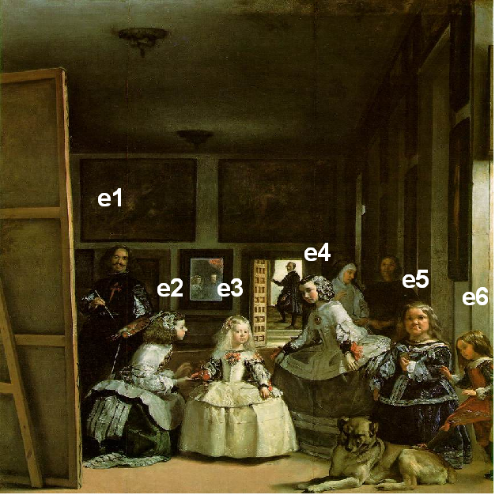
Preliminaries (I)
Imagine you’re standing in front of this painting. Your partner asks:
Which of those figures is the Princess of Spain?
You know that it’s the figure marked “e3”
Diego Velazquez, Las Meninas
(Museo Prado, Madrid)

Slide 14
Preliminaries (II)
There are many ways to reply:
the girl in the white dress
the girl in the middle
the person being tended to by the kneeling maid
Diego Velazquez, Las Meninas
(Museo Prado, Madrid)

Slide 15
Reference
These different expressions mean different things, have different content.
However, they all pick out the same entity in this context (the Princess of Spain).
i.e. they refer to the princess of Spain
In a different context, the girl in the white dress could pick out something different.
Sometimes, it can fail to pick out anything.

Slide 16
Reference
an action on the part of a speaker
it is context-bound
but how do we pull it off?

Slide 17
Sense
the girl in white
the person in the middle
reference partly depends on the “meaning” or sense of expressions like girl or person

Slide 18
Sense
We shall equate the sense of an expression with the CONCEPT (mental representation) associated with the expression.
This is a mentalistic view of the notion of sense. Other views are possible.

Slide 19
The Semiotic Triangle (I)
The sense of an expression is its descriptive meaning or concept.
Effectively, expressions are pairs of sound and meaning.
But what about objects in the world?
CONCEPT
(sense)
means
expression

Slide 20
Denotation
If we understand an expression, i.e. know the concept/sense associated with it…
…then we are able to determine what things (or situations) it can be predicated of
this is the denotation of the expression (the set of things of which the expression is true)

Slide 21
The Semiotic Triangle (II)
CONCEPT
(sense)
means
determines
denotes
expression
objects
The semiotic triangle was first introduced by C.K. Ogden and I.A. Richards (1923), The meaning of meaning.

Slide 22
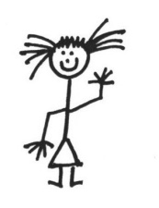
The Semiotic Triangle: Example
CONCEPT
(sense)
GIRL
determines
means
objects in the world
denotes
expression: girl

Slide 23
Denotation vs. Reference
We therefore distinguish between:
the sense of an expression
what the expression denotes
We should also distinguish:
what a person intends to refer to by means of a linguistic expression
in this view, reference is an action carried out by a speaker
It relies on our knowledge of the sense and denotation of an expression.

Slide 24
Reference as speaker intention
Suppose I refer to e1 as “the sculptor”.
This is incorrect.
But you might still understand that I mean to refer to e1.
My intention is sometimes clear even if I use the wrong expression.

Slide 25
Reference vs. Denotation (cont.)
So denotation is a stable relationship between expressions and things:
The word ħuta (“fish”) always denotes a certain kind of thing in the world. It can only apply to a specific set of objects.
This is independent of who uses the word and when.
This is denotation or extension
Reference depends on speakers and contexts:
I can use ħuta to refer to different individual fish in different situations
So in different situations, my use can pick out different referents

Slide 26
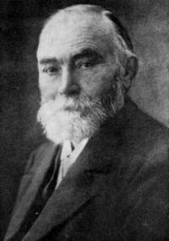
The man himself…
German philosopher and mathematician
Considered to be one of the founding fathers of modern semantic theory and logic.
Formalised the distinction between sense and denotation in an article
Uber Sinn und Bedeutung (1892)
“On sense and denotation”
Gottlob Frege
1848-1925

Slide 27
Two major theories of reference
The Denotational theory:
direct relationship between words and the world
meaning = the relationship between linguistic expressions and things/situations
The Representational theory:
the relationship between words and the world is mediated by our mental model
We will revisit the differences between them later...

Slide 28
The denotational theory
A direct relationship between expressions (words, sentences) and things in the world.
This is a realist view.
things
&
situations
linguistic
expressions

Slide 29
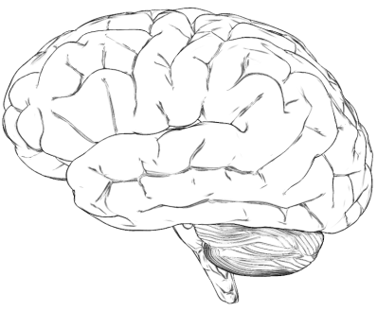
The representational theory
The relationship between expressions (words, sentences) and things in the world is mediated by the mind.
This is a cognitivist view.
mental model
of the world
linguistic
expressions
things
&
situations

Slide 30
Questions
?

