Slide 1
LIN1180/LIN5082 Semantics Lecture 3
Albert Gatt

Slide 2
Overview of last lecture
We’ve introduced the notions of sense, reference and denotation.
Sense = the “conceptual meaning” of an expression
denotation = the set of things an expression can be predicated of, by virtue of its sense
dog = the set of things in the world which are dogs
reference is a speaker’s act
Saying “the dog” involves identifying some specific dog
so there’s an element of pragmatics

Slide 3
Today’s focus
We discuss reference in more detail
Specifically, we ask why should reference be viewed as a speaker’s act?
We focus on these types of referring expressions:
definite reference
indefinite reference
We then take a look at proper names

Slide 4
Part 1
Definite reference

Slide 5
Definite reference
There are many types of definite reference:
proper names
Jake, Clare...
deictic pronouns and determiners:
this man, that girl...
personal pronouns:
he, she...
definite descriptions
the girl ...
All seem to be used to uniquely identify things in the world.
We shall focus first on definite descriptions, i.e. common noun phrases with a definite article.

Slide 6
Definite descriptions
The man gave it to her.
A man gave it to her.
What is the difference between (1) and (2)?
In (1), the intended referential target is a particular entity.
A speaker uses (1) when s/he intends the hearer to be able to uniquely identify the entity.

Slide 7
Is definite reference purely semantic?
Bertrand Russell (1905) analysed the meaning of definite descriptions as involving two necessary conditions:
existence:
a sentence of the form the X VP is true if X exists.
uniqueness:
a sentence of the form the X VP is true if there is one and only one X.

Slide 8
Problems with Russell (I)
How should we analyse a sentence such as:
The present king of France is bald.
there is no king in France
therefore, the subject NP violates the existence condition
Does this imply that the sentence is false?
(compare: France is a kingdom.)
Rather than false, it simply seems to be an unsuccessful communicative act.

Slide 9
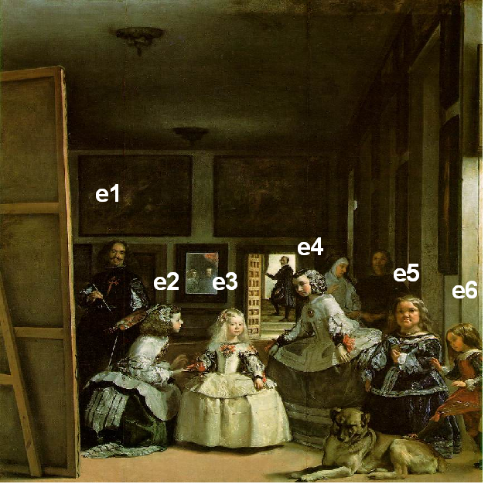
Problems with Russell (II)
Example dialogue:
A: The sculptor in the painting is Velazquez himself.
B: It is indeed, but it’s not a sculptor, it’s a painter.

Slide 10
Problems with Russell (II)
Sometimes you can refer to something incorrectly, and yet still succeed in identifying the referent for your interlocutor.

Slide 11
The pragmatic view
Originates with philosophers such as P.F. Strawson (1950), and John Searle (1969).
Argues that reference as such is not about truth-conditional semantics, but about what speakers do.
I.e. reference the meaning of referential expressions involves a pragmatic component

Slide 12
Back to our original definition…
the intended referential target is a particular entity
NB: we are focussing on intention, in line with our view that reference is a speaker’s act
it is of course constrained by the sense of what the speaker says
the speaker intends the hearer to be able to uniquely identify the entity
speaker assumes that the hearer understands the expression
also that she understands the speaker’s intention
This is essentially Searle’s view.

Slide 13
Some more on Searle’s view
Searle (1969) argued that in using a definite description, the speaker also:
signals to the hearer that they have enough info to identify the entity, given:
the semantic content of what the speaker said
the context (situational, linguistic etc)
(If necessary, the speaker can supply additional info.)

Slide 14
Part II
Indefinite reference

Slide 15
Our motivating example
The man gave it to her.
A man gave it to her.
In (2), the identity of the man in question is not at issue.
(Even if the man is known to the speaker and identifiable.)
The indefinite description signals that the speaker isn’t interested in exactly who, but only that there was a man involved.

Slide 16
Indefinite expressions
Prototypically, these are NPs with an indefinite article (“a”).
But also:
Come up and see me sometime.
Some chappie called the other day.
Certain people are just obnoxious.
This driver she met was kind of cute.

Slide 17
Specific vs. non-specific
To get the door to open, you have to say a word.
Has at least 2 readings:
…you have to say any word that comes to mind. (non-specific)
…you have to say a special word that the speaker may or may not know. (specific)

Slide 18
Definites vs. specific indefinites
Like definite NPs, specific indefinites carry the suggestion that the identity of the entity is relevant.
…you have to say a word
not any word, but a specific word will do the trick
However, with a specific indefinite, the speaker is not signalling to the hearer that identification is essential for the communicative act to be successful.

Slide 19
Markers of specificity
In English, a certain is often used to mark specific indefinites explicitly:
A certain woman is said to have married him in secret.
In Maltese, the determiner wieħed/waħda (“one”). Compare:
Ġie wieħed raġel.
came-3SgM one-MSg man
A (certain) man came.
wieħed used before the noun marks specificity
Ġie raġel wieħed.
came-3SgM man one.MSg
One man came.
wieħed after the noun is a numeral

Slide 20
Grammatical markers of specificity
Evidence that specificity is linguistically relevant comes from languages where it is marked grammatically.
French:
Marie cherche un homme qui peut lui faire l’amour douze fois par jour.
= Mary’s looking for a (specific) man who can make love to her a dozen times a day.
Marie cherche un homme qui puisse lui faire l’amour douze fois par jour.
= Mary’s looking for a (some/any) man who can make love to her a dozen times a day.

Slide 21
Grammatical markers of specificity
Turkish signals specificity via the direct object marker on the noun:
Bir kelime söyledi.
= S/he said a word.
(non-specific: s/he said any word)
Bir kelimeyi söyledi.
= S/he said a word.
(specific: there is a particular word s/he said)

Slide 22
Questions
?

