Slide 1
LIN1180 Semantics Lecture 4
Albert Gatt

Slide 2
Continuation of last week
Reference and proper names

Slide 3
Proper names
These seem to be “purely referential”, establishing a direct relationship to things/people in the world.
What is the meaning of “Barack Obama”?
The name itself seems to carry little meaning.
It is used to identify a specific person.

Slide 4
A thought experiment
Question:
Does your name have any meaning?
I.e. does it have any sense?
Experiment:
There’s a famous writer called Shakespeare.
Everybody knows who he was and what he wrote.

Slide 5
A thought experiment (cont/d)
When people use the name “Shakespeare”, they use it to refer to this guy.
If pressed, they’d tell you things like:
he lived in Stratford upon Avon
he wrote King Lear, Hamlet…

Slide 6
Thought experiment (cont/d)
Suddenly someone makes the discovery that all of Shakespeare’s plays were written by Christopher Marlowe.

Slide 7
Who does the name “Shakespeare” refer to now?

Slide 8
The point of the experiment
A variation of a thought experiment introduced by Saul Kripke (Naming and Necessity, 1980)
Kripke wanted to make the point that:
we may associate a name with a description, such as Shakespeare is the author of Hamlet
but ultimately, the name itself always designates the same thing, even if the descriptions turn out to be false or infelicitous.

Slide 9
How names work
The description theory (Frege/Russell/Searle):
Frege suggested that names are like descriptions:
Barack Obama = “the American who currently holds the office of President of the US”
This emphasises that to know the referent of a name, you have to have some knowledge of that referent.
The causal theory (Kripke):
Names begin with some event of naming (e.g. a christening). But then they fall into common usage.
This emphasises that to know the meaning of a name is the result of this original event or grounding of the name.
But then the name itself doesn’t really “mean” anything, it just “points” to an individual.

Slide 10
?

Slide 11
Goals of this lecture
We revisit:
The contrast between denotational and representational theories of meaning
We look at:
How scientists have studied the mental representation of concepts, the “units of thought”

Slide 12
Part 1
The denotational and representational theories revisited

Slide 13
The denotational theory (I)
Proposes that meaning involves establishing a direct relationship between linguistic expressions and the world
Word meaning:
dog denotes the set of things in the world which are dogs
Sentence/propositional meaning
My dog ate the carpet denotes a situation in which it is the case that a dog, belonging to the speaker, ate the carpet…

Slide 14
The denotational theory (II)
This theory has its roots in the “correspondence theory” of meaning and truth
A sentence is true if and only if it denotes a situation in the world.
Important figures include logician Alfred Tarski, and semanticist Richard Montague. Also the early work of Ludwig Wittgenstein.
It dominates the tradition of formal semantics
Based on a realist or objectivist view: We can obtain objective knowledge of what is “out there”
Makes no commitments regarding psychological reality

Slide 15
Challenges to the denotational theory
In its simplest form, the theory says:
semantics = denotation
proper names denote individuals
common nouns denote sets of things
verbs denote actions…
But some words seem to denote nothing at all!
Words for imaginary things (unicorns), function words (not, with)…
This is usually resolved by saying that expressions have sense, which determines denotation and reference
Expressions may have sense but simply no denotation!
Others may denote the same things, but differ in their sense.

Slide 16
Concepts
The denotational theory tends to be adopted in the tradition of formal semantics
applies the tools of logical analysis to the study of meaning
More cognitively-oriented theories tend to adopt some version of the representational theory
crucially, the study of meaning involves the study of conceptual structure

Slide 17
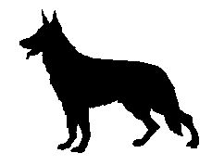
The representational theory (I)
The meaning of linguistic expressions is a mental representation (CONCEPT)
So expressions are meaningful, and denote things, because they are associated with something in our heads.
So the relationship between language and world is indirect or mediated.
kelb

Slide 18
Part 2
Concepts and mental representation

Slide 19
Why do we need concepts?
In effect, Funes not only remembered every leaf on every tree of every wood, but even every one of the times he had perceived or imagined it. […] He knew that at the hour of his death he would scarcely have finished classifying even all the memories of his childhood.
(J.L. Borges, Funes the memorious)

Slide 20
Why concepts?
Without a way of categorising things and situations, human cognition would break down.
Concepts provide:
an organisation of similar experiences under more general categories;
a way of establishing relationships among those categories;
a way of making generalisations about things.

Slide 21
Conceptual structure and language
Presumably, words and constituents map to conceptual elements.
E.g. Jackendoff (2002) proposes a three-level theory of language:
phonological structure (purely linguistic)
syntactic structure (purely linguistic)
conceptual structure (general cognition)
Rules to map from one level to the other.
The rules mapping from linguistic to conceptual structure define an interface between language and other cognitive functions.
Conceptual structure is shared with other cognitive modalities, such as vision.

Slide 22
Other theories
Other theories (contra Jackendoff), propose a level of semantic structure which is “properly” linguistic.
This intervenes between conceptual structure and linguistic structure.

Slide 23
What’s in your head?
Under the representational view, concepts underlie the meanings of words
What could a concept be?

Slide 24
Concepts as images (I)
Do we have a “mental picture” of things?
But not everybody has the same picture…
So how do we understand eachother?
kelb

Slide 25
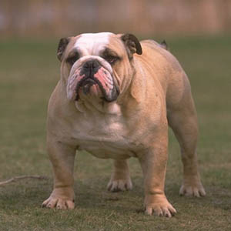
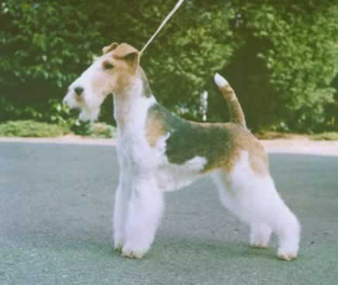
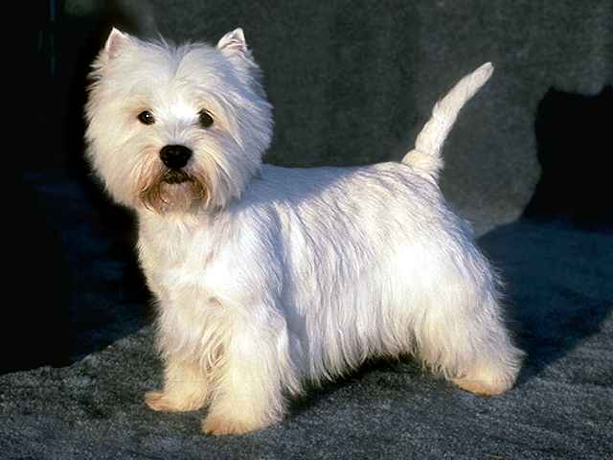
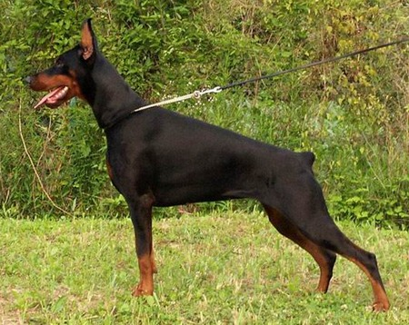
What’s your picture of DOG?
???
kelb

Slide 26
Beyond the image theory
Concepts must be something more abstract than concrete images
This is still a huge topic in current psychological and semantic theory
Let’s look at some possibilities…

Slide 27
Theories of concepts I: the classical view
A concept like GIRL is simply the set of features which distinguish it from other concepts
GIRL = human, not adult, female …
Essentially, to know a concept = to know a list of necessary and sufficient conditions (a kind of definition).
View dating back to Aristotle.
Dominated psychology until the 1960s

Slide 28
Objections to the classical view
Most concepts simply can’t be analysed like this.
What are the necessary and sufficient conditions for the concept GAME? (Wittgenstein, 1953)
Many concepts have fuzzy boundaries.
We often use words without knowing the true nature of things
Do you need to know the chemical make-up of aluminium in order to know the word?
Putnam (1975): We rely on experts a lot of the time, a division of linguistic labour

Slide 29
Questions
?

