Slide 1
Natural Language Generation and Data-To-Text
Albert Gatt
Institute of Linguistics, University of Malta
Tilburg center for Cognition and Communication (TiCC)
Department of Computing Science, University of Aberdeen

Slide 2
Natural Language Generation (NLG)
Natural language generation (NLG) is the process of deliberately constructing a natural language text in order to meet specified communicative goals.
(McDonald 1992)

Slide 3
Aims of these lectures
To introduce the field of NLG
Main sub-tasks
Architectures
To introduce some of the challenges in going from non-linguistic data to relatively long, “narrative” texts
Document planning
Dealing with time
To look at methodological issues in NLG evaluation using different methods:
Evaluating large-scale systems with real users
Evaluating Referring Expression Generation algorithms
As a running example, we’ll often be looking at a recent family of systems developed as part of the BabyTalk Project.

Slide 4
Nlg and choice
Part 1

Slide 5
What is NLG?
Goal:
computer software which produces understandable and appropriate texts in human language
Input:
Some non-linguistic representation of information (structured KB, numerical data…)
The goal that the system has to satisfy (e.g. inform the user)
Output:
documents, reports, explanations, help messages, and other kinds of texts
Knowledge sources required:
Knowledge of language (lexicon, grammar)
Knowledge of the domain (types of entities and events, their properties, etc)
Notes:
7

Slide 6
Uses of NLG (examples)
Informational:
Automatic generation of weather reports
Producing medical summaries from patient histories.
Entertainment:
Automatic generation of stories, jokes etc.
Interaction:
Dialogue agents that help users achieve a task.
Assistive technology:
Aids for people with special communication needs.

Slide 7
What is involved?
Suppose someone produces the following utterance:
→Today the temperature will be 25 degrees on average.
What are the steps required to produce this utterance?

Slide 8
Steps in language production
Today the temperature will be 25 degrees on average.
Communicative goal/intention
Inform the reader
Formulation (conceptualisation)
Deciding what to say
Encoding:
Choice of words
Choice of grammatical construction

Slide 9
Steps in language production
Today the temperature will be 25 degrees on average.
Realising the message
Ensuring syntactic correctness
Applying morphological rules
Mapping to speech output (or writing)

Slide 10
The main task
The main problem for a speaker (and for an NLG system) is choice
Let’s unpack some of the choices.

Slide 11
Choice in language generation
Content determination
Given a communicative intention, the generator needs to decide:
What is relevant
What the addressee knows (or not)
What is easily inferrable (and can therefore be left unsaid)

Slide 12
Choice in language production
Lexicalisation: Choice of words
Humans have a vast lexicon at their disposal. Word choice can be impacted by a host of factors:
The addressee (will he understand a particular word?)
The genre and context (is this appropriate in the context?)
The speaker’s personality.

Slide 13
Choice in language production
Lexicalisation: Choice of words
Today the temperature will be 25 degrees on average.
Today the temperature will be roughly 25 degrees.
Today, the temperature will average around 25 degrees.
Today, it will be warm.

Slide 14
Choice in language production
Realisation: choosing grammatical structures
Partly dependent on the words chosen.
But also on many other factors, including desired style, context etc.
Today the temperature will average 25 degrees.
Today the average temperature will be 25 degrees.
Today it’ll be warm.

Slide 15
How are choices made?
Some choices are simply consequences of the language or grammar (cf. Reiter 2010).
I kicked myself.
*I kicked me.
The choice of pronoun is directly predictable from principles governing the use of reflexives.
Other choices are less straightforward:
I kicked him. Vs. I kicked Pete.
Depends, among other things, on how salient the person called Pete is in the hearer’s memory.

Slide 16
NLG and choice
Like human speakers, NLG systems too are designed to make choices at every level.
Systems differ in their degree of complexity.
It is possible to hardwire “shortcuts” into the system to avoid complex choices.
But full-blown NLG systems can become extremely complex.

Slide 17
Some examples of nlg systems
Part 2

Slide 18
Example System #1: FoG
Function:
Classic system that produces textual weather reports in English and French
Input:
Graphical/numerical weather depiction
User:
Environment Canada (Canadian Weather Service)
Developer:
CoGenTex Inc.
See Goldberg et al (1994)

Slide 19
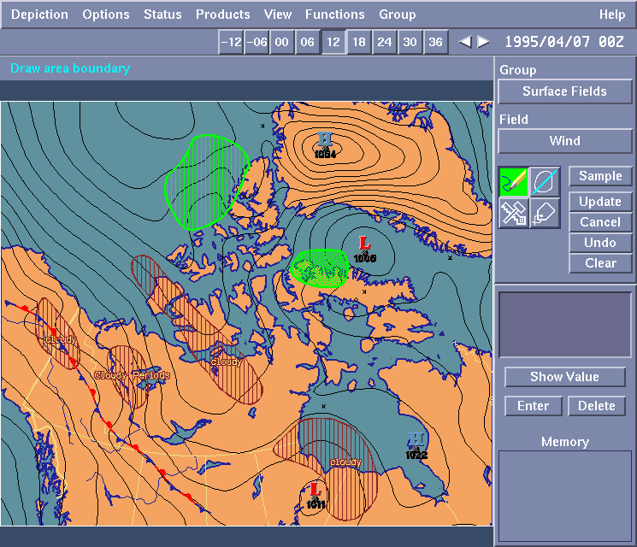
FoG: Input

Slide 20
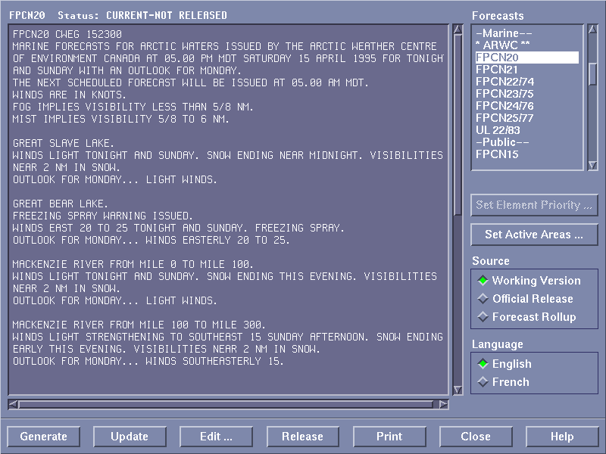
FoG: Output

Slide 21
Example System #2: STOP
Function:
Produces a personalised smoking-cessation leaflet
Input:
Questionnaire about smoking attitudes, beliefs, history
Developer:
University of Aberdeen
See: Reiter et al. (2003)

Slide 22
STOP: Input

Slide 23
STOP: Output
Dear Ms Cameron
Thank you for taking the trouble to return the smoking questionnaire that we sent you. It appears from your answers that although you're not planning to stop smoking in the near future, you would like to stop if it was easy. You think it would be difficult to stop because smoking helps you cope with stress, it is something to do when you are bored, and smoking stops you putting on weight. However, you have reasons to be confident of success if you did try to stop, and there are ways of coping with the difficulties.

Slide 24
Example System #3: STORYBOOOK
Function:
Produces a fairy tale for entertainment purposes
Input:
An abstract story plan
Developer:
Charles Callaway (part of a PhD project)
See: Callaway and Lester (2002)

Slide 25
STORYBOOK: input
(actor-property exist-being woodman001)
(refinement and-along-with woodman001 wife001)
(refinement belonging-to wife001 woodman001)
(specification exist-being
process-step-type
once-upon-a-time)
(...)

Slide 26
STORYBOOK: Output
Once upon a time, there was a woodman and his wife who lived in a pretty cottage on the borders of a great forest. They had one little daughter, a sweet child, who was a favourite with everyone.
She was the joy of her mother’s heart, and to please her, the good woman made her a little scarlet cloak and hood. She looked so pretty in it that everyone called her Little Red Riding Hood.

Slide 27
Nlg tasks and architectures
Part 3

Slide 28
The architecture of NLG systems
There is widespread consensus on what NLG systems do (the tasks).
There’s more variation in how NLG systems are organised (the modules, input and output).
We often speak of a “consensus” architecture which has been adopted in many systems.
But many systems, especially statistical NLG systems, do not conform to this architecture.

Slide 29
NLG core tasks
Lexicalisation:
The choice of content words to appear in the final output text.
Aggregation:
The combination of several structures (e.g., sentences) into a single, more complex, structure.
Rhetorical structuring:
The determination of rhetorical relations and their scope.
Referring expression generation:
Selection of content for referring expressions;
Decision on the form of these expressions (pronoun, definite description).
Ordering:
The choice of linear ordering of the elements of the text.
Segmentation:
The dividing up of information into sentences and paragraphs.
RAGS project (Mellish et al, 2006)
Identified several important tasks which are carried out by many systems.
Based on an exhaustive survey of the state of the art.
But how are these tasks organised?

Slide 30
A consensus architecture?
Reiter (1994) and Reiter and Dale (2000) argued that the various tasks can be grouped in a three-stage pipeline.
Their architecture represents a “consensus” view.
But note that several systems do not conform to it.
This is especially true of statistical NLG systems.

Slide 31
The “consensus” architecture
Communicative goal
A pipeline architecture
highly modular
NB: Diagram does not show knowledge sources!
Domain knowledge
Lexical/grammatical knowledge
Model of the user
...
Document Planner
document plan
Microplanner
text specification
Surface Realiser
text

Slide 32
The “consensus” architecture
Communicative goal
Tasks:
Selecting the messages to be included
Rhetorical structuring
Ordering
Segmentation
Document Planner
document plan
Tasks:
Lexicalisation
Referring Expression Generation
Aggregation
Microplanner
text specification
Surface Realiser
Tasks:
Choosing syntactic structures
Applying morphological rules
Rendering the text as a string
text

Slide 33
NLG vs Automatic Summarisation
Automatic summarisation systems generate summaries of one or more input documents.
Most systems work by:
Analysing the input documents to extract important sentences
Carrying out some transformation on the result to render the text coherent
Synthesising the sentences into a summary

Slide 34
NLG vs Automatic Summarisation
I. Mani (2001). Automatic summarization. Amsterdam: John Benjamins
There are some similarities between NLG and summarisation.
But summarisation systems take text as a starting point.
Extractive summarisers perform quite limited linguistic processing.
Some of the transformation/synthesis tasks done by summarisation systems are the same as those done by NLG systems during microplanning.

Slide 35
Case study: the babytalk systems
Part 4

Slide 36
Extending the architecture
Some NLG systems have to deal with raw, unstructured data.
This means that prior to generating text, the data has to be analysed in order to:
Identify the important things and filter out noise
Map the data to appropriate input representations
Perform some reasoning on these representations

Slide 37
Extending the architecture
Reiter (2007) proposed to extend the “consensus” architecture to deal with preliminary stages of:
Signal analysis: to extract patterns and trends from unstructured input data;
Data interpretation: the perform reasoning on the results

Slide 38
BabyTalk
Context
Neonatal Intensive Care Unit (NICU), where patients:
are typically preterm infants (e.g. 27 weeks)
are monitored continuously
… so data is collected all the time.
Problem
A doctor or nurse needs to process the relevant parts of the data to make clinical decisions.
Typical scenario
Large datasets are investigated using some form of visualisation (graphs, time series, etc).

Slide 39
NICU Environment

Slide 40
Data (I): continuous
Oxygen Saturation (SO)
ECG (HR)
Peripheral Temperature (TP)
Arterial Line
(Blood Pressure)
Transcutaneous Probe
(CO2,O2)
Core Temperature (TC)
Each channel sampled at 1Hz
86,400 samples/channel/patient/day

Slide 41
Data (I): Continuous

Slide 42
Data (II): Sporadic (manual)
Manually entered values
Numeric: results of lab tests, etc
Symbolic: type of respiratory support, drugs…
Currently displayed as a structured entry.

Slide 43
Data (III): Free text
Notes entered periodically by nurses
No structure
“
“
Stable overnight Handling slightly better TPN ordered with extra potassium today Balance = +35mls, UO 2.7ml/kg/hr Ventilation unchanged - good gas overnight Morning bloods sent

Slide 44
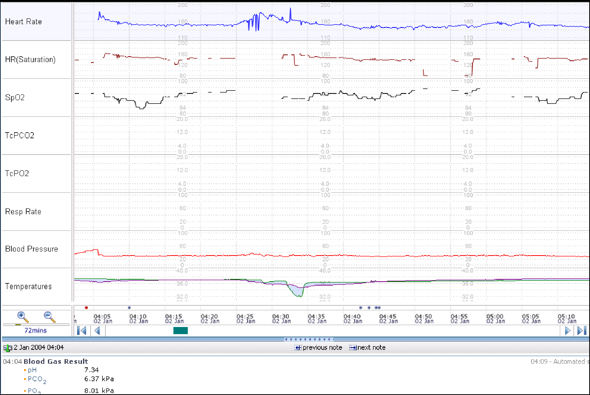
A “shift summary report”

Slide 45
Why isn’t that enough?
Previous research
Nurses and doctors have trouble identifying important patterns in data;
Long-term trends in a patient’s health difficult to detect;
Shift reports consist of “disjointed” items of information.
(McIntosh et al `00; Alberdi et al `01)
Law et al (2005):
Off-ward experiment with doctors and nurses;
45 minutes of patient data, presented visually or in written form;
Preference expressed for visualisations (the standard presentation format);
Better decisions with summaries.

Slide 46
Data to Text
Our question
Can data-to-text NLG be used to summarise patient data in the NICU for decision support?
The answer
We think it can. This claim is based on the development and evaluation of the systems in the BabyTalk project.

Slide 47
BabyTalk Systems
BabyTalk developed systems to summarise patient data.
BT45
Prototype system to summarise 45 minutes’ worth of data from the NICU.
BT-Nurse
Large-scale system to summarise a whole shift (12 hrs) of data to help nurses.
BT-Family/BT-Clan
Summarises patient data for family members and friends who want to know how their loved one is doing.
In the following sessions, we will focus mainly on the challenges with BT-Nurse and BT45

Slide 48
BabyTalk architecture
(1) Signal analysis
(2) Data interpretation
Continuous data
Ontology
+ expert rules
Signal
Processing
Sporadic data
Knowledge Base
Data
Interpretation
Intubation: 12:30:00
Free text
Text
Processing
“Morphine given”
Document
planning
Microplanning + Realisation
(3) Natural Language Generation

Slide 49
Data-to-text architecture
(1) Extracting raw data
Events
interval representation;
at this stage, an unstructured list of all events in the relevant period.
Continuous data
Signal
Processing
Sporadic data
Intubation: 12:30:00
Free text
Text
Processing
“Morphine given
10mg”
Morphine: 15mg (12:31 – 12:31)
Intubation (12:30 – 12:34)
Channel reading (HR): 69 (12:35:20 – 12:35:40)
Channel reading (HR): 66 (12:36:20 – 12:36:40)
Channel reading (HR): 65 (12:53:10 – 12:53:25)

Slide 50
Data-to-text architecture
Events
mapped to ontology concepts;
expert rules to link them;
importance assigned based on expert rules;
Abstractions (e.g. channel readings merged into trends);
some “diagnostic” reasoning
(2) Reasoning
Ontology
+ expert rules
Data
Interpretation
cause

Slide 51
Data-to-text architecture
Events
selected based on importance;
structured into a document plan (tree) with rhetorical links;
sections/paragraphs determined.
(3) Natural Language Generation
Document
planning
CAUSES
MOTIVATES

Slide 52
Data-to-text architecture
Events
rules to map events to argument structure;
lexicalisation;
referring expressions;
temporal planning: tense, time modifiers;
(3) Natural Language Generation
Microplanning
CAUSES
MOTIVATES

Slide 53
The BT architecture: a micro example
Part 5

Slide 54
A micro example
Input data: unstructured raw numeric signal from patient’s heart rate monitor (ECG)
There were 3 successive bradycardias down to 69.

Slide 55
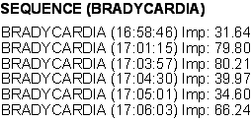
A micro example: pre-NLG steps
(1) Signal Analysis (pre-NLG)
Identify interesting patterns in the data.
Remove noise.
(2) Data interpretation (pre-NLG)
Estimate the importance of events
Perform linking & abstraction

Slide 56
Document planning/Content Selection
Main tasks
Content selection
Information ordering
Typical output is a document plan
tree whose leaves are messages
nonterminals indicate rhetorical relations between messages (Mann & Thompson 1988)
e.g. justify, part-of, cause, sequence…

Slide 57
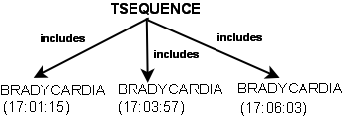
A micro example: Document planning
(1) Signal Analysis (pre-NLG)
Identify interesting patterns in the data.
Remove noise.
(2) Data interpretation (pre-NLG)
Estimate the importance of events
Perform linking & abstraction
(3) Document planning
Select content based on importance
Structure document using rhetorical relations
Communicative goals (here: assert something)

Slide 58
A micro example: Microplanning
Lexicalisation
Many ways to express the same thing
Many ways to express a relationship
e.g. SEQUENCE(x,y,z)
x happened, then y, then z
x happened, followed by y and z
x,y,z happened
there was a sequence of x,y,z
Many systems make use of a lexical database.

Slide 59
A micro example: Microplanning
Aggregation:
given 2 or more messages, identify ways in which they could be merged into one, more concise message
e.g. be(HR, stable) + be(HR, normal)
(No aggregation) HR is currently stable. HR is within the normal range.
(conjunction) HR is currently stable and HR is within the normal range.
(adjunction) HR is currently stable within the normal range.

Slide 60
A micro example: Microplanning
Referring expressions:
Given an entity, identify the best way to refer to it
e.g. BRADYCARDIA
bradycardia
it
the previous one
Depends on discourse context! (Pronouns only make sense if entity has been referred to before)

Slide 61
A micro example
(4) Microplanning
Map events to semantic representation
lexicalise: bradycardia vs sudden drop in HR
aggregate multiple messages (3 bradycardias = one sequence)
decide on how to refer (bradycardia vs it)

Slide 62
A micro example: Realisation
Subtasks:
map the output of microplanning to a syntactic structure
needs to identify the best form, given the input representation
typically many alternatives
which is the best one?
apply inflectional morphology (plural, past tense etc)
linearise as text string

Slide 63
A micro example
(4) Microplanning
Map events to semantic representation
lexicalise: bradycardia vs sudden drop in HR
aggregate multiple messages (3 bradycardias = one sequence)
decide on how to refer (bradycardia vs it)
choose sentence form (there were…)
s
(5) Realisation
map semantic representations to syntactic structures
apply word formation rules
PRO
VP (+past)
V
NP (+pl)
PP
there
be
three successive
bradycardias
down to 69

Slide 64
Challenges
Document planning
How to select appropriate content from such a vast input dataset?
How to structure it according to the users’ expectations?
Microplanning
How to ensure that the (longish) texts generated are coherent?
How to express events in such a way that their temporal and causal sequence is fully clear to the reader?

