Slide 1
Natural Language Generation and Data-To-Text
Albert Gatt
Institute of Linguistics, University of Malta
Tilburg center for Cognition and Communication (TiCC)
Department of Computing Science, University of Aberdeen

Slide 2
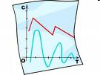
A typical evaluation scenario
How good is my generator?
Do people like the output?
Does it compare well to what people do?
Does it help people achieve a task?
Are these questions completely different, or are they related in some way?

Slide 3
Evaluation in NLG
Evaluation strategies
Evaluate performance of single modules
e.g. realisation
e.g. Generation of Referring Expressions
Evaluate entire system (“end to end evaluation”).
Evaluation methods (Sparck Jones & Galliers `95)
Extrinsic (looking at a system’s utility)
through experiments with human users in relevant settings
“Does the system/module achieve what it is meant to achieve?”
Intrinsic (looking at output quality in its own right)
against corpora
“Is the output like that produced by people in a similar situation?”
by eliciting human judgements
“Do people like the output?”

Slide 4
NLG Evaluation: extrinsic/task-oriented
Method
Evaluation with target users
STOP: how effective are generated letters in motivating people to stop smoking? (Reiter `05)
PEACH: are people’s museum visits enhanced by automatic generation of information on a PDA? (Stock et al `07)
BT-45: do generated summaries help doctors and nurses take clinical decisions? (Portet et al `09)
Widely accepted as the most conclusive sort of NLG evaluation.
Very expensive!
STOP evaluation cost ca. £75,000
BT-45 evaluation cost ca. £20,000 (Reiter/Belz `09)
BT-NURSE evaluation cost even more!

Slide 5
NLG evaluation: intrinsic/human
Method
Show readers a generated text and ask for judgements
JAPE: do children recognise generated jokes as such? Are they funny? (Binsted et al `97)
SumTime: how do readers judge generated vs expert-written forecasts? (Reiter et al `05)
COMIC: which strategy for combining speech and gesture is preferred by human judges? (Foster/Oberlander `07)
STORYBOOK: which components of a story generator contribute to making readers’ judgements more positive? (Callaway/Lester `02)
One of the most widespread methodologies in NLP.
Probably more appropriate for some domains than extrinsic evaluation.

Slide 6
NLG evaluation: intrinsic/automatic
Method
Compare output to a corpus of human-authored reference texts using some evaluation metric.
Not very typical in end-to-end system evaluation (but see Belz and Kow `09; Reiter and Belz `09)
To date, mainly used to evaluate coverage and correctness of realisers (Langkilde-Geary `02; Callaway `03)

Slide 7
Precedents
Intrinsic evaluation in Machine Translation
Heavily dominated by BLEU (Papineni et al `02)
Essentially, intrinsic, corpus-based method;
Often used in NLG evaluations of realisers.
Some doubts have been cast on whether BLEU properly reflects translation quality (Callison-Burch et al `06).
E.g. to what extent does it correlate with human judgements?
Question: which human judgements?
It’s one thing to ask monolinguals to judge a translation, quite another to ask bilinguals.

Slide 8
Precedents
Intrinsic evaluation of automatic summarisation
Methods range from judgements (pyramid method) to automatic intrinsic metrics (ROUGE)
Correlations have been reported between ROUGE and human judgements.
Very low correlations between ROUGE and extrinsic methods (based on relevance) (Dorr et al `05).

Slide 9
Precedents in NLG
Role of corpora
Recent evaluations show that judgements of generated texts don’t correlate well with corpus-based measures (Reiter/Belz `09).
Many have questioned whether corpus texts should be treated as NLG “gold standards” (e.g. Reiter/Sripada `02).
Role of judgements
Experimental results suggest that people’s preferences don’t reflect their task performance:
Law et al `05: compared medical decision making with visualisations vs human-written summaries of patient data.
Doctors & nurses preferred visualisations.
But decision-making was much better with text!

Slide 10
Why this matters
Ultimately, we’re interested in the relationship between these methods.
Do automatic results against corpora tell us anything about the quality of our output?
Do people’s judgements converge with corpus-based results?
Can we predict effectiveness of a text (extrinsic) from corpus-based metrics or judgements?

Slide 11
Extrinsic evaluation of the Babytalk BT-45 prototype systems
Part 1

Slide 12
BabyTalk Evaluation
In BabyTalk, there was a fairly clear target user population.
Aim was also fairly clear: help medics (doctors, nurses) take clinical decisions.
BT-Family had a different aim.
Here, we’ll look at:
Evaluation of BT-45: prototype system which summarises 45 minutes of data.
Evaluation of BT-Nurse: system that summarises 12 hours of data (next part)

Slide 13
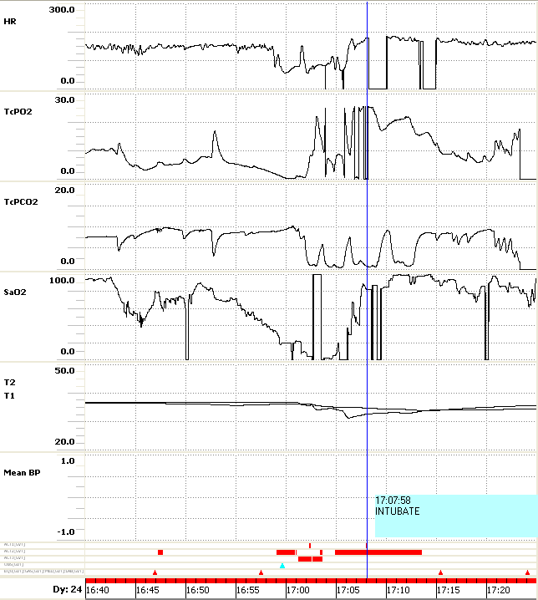
BT-45 Summary
Input data
Output text
[…]
Over the next 24 minutes there were a number of successive desaturations down to 0. Fraction of Inspired Oxygen (FIO2) was raised to 100%. There were 3 successive bradycardias down to 69.
[…]

Slide 14
Prototype evaluation: BT-45
Method
Tested decision-making by medical staff given exposure to some information about a patient;
Experiment conducted off-ward in 2008-9.
Conditions
(G) Data presented as visualisation (the usual way)
(H) Human summary produced by experts
consensus summary of the data by a senior neonatal nurse and a consultant neonatologist
(C) Computer-generated summary by BT-45
completely automatic

Slide 15
Prototype evaluation: BT-45
Participants
35 junior and senior doctors and nurses
Procedure
Participants shown 24 scenarios in one of the conditions;
Asked to select one or more appropriate actions given the summary.
For each scenario, there were 18 actions to choose from.
Scoring
Decision-making score reflects the extent to which a participant made appropriate selections (range: [0,1]).

Slide 16
Performance metrics
18 actions
appropriate
inappropriate
neutral
P-APP
(proportion)
P-INAPP
(proportion)
P
(main score in original study)
-

Slide 17
Prototype Evaluation: Results
0.5
G
G = 0.33 ^{0.14}
H = 0.39 ^{0.11}
C = 0.34 ^{0.14}
H
C
0.4
Biggest difference for Junior Nurses
H best overall
G no better than C
0.3
0.2
0.1
0
Junior Nurse
Senior Nurse
Junior Doctor
Senior Doctor
F. Portet, E. Reiter, A. Gatt, J. Hunter, S. Sripada, Y. Freer, and C. Sykes. (2009). Automatic generation of textual summaries from neonatal intensive care data. Artificial Intelligence 173 (7-8): 789-816
Notes:
Graphics understanding needs experience

Slide 18
Prototype Evaluation: Summary
Generated summaries are at least as good as graphical presentations.
Automatic summarisation shown to be feasible in the neonatal context.
Text may be more effective for some user groups (Junior Nurse).
But what makes human texts better?

Slide 19
BT-45 vs Human
A qualitative comparison
BT-45 texts suffered from a lack of continuity.
BT-45: TcPO2 suddenly decreased to 8.1. [...] TcPO2 suddenly decreased to 9.3.
BT-45 focus is on medically important events. Humans take context into account.
Human: The pO2 and pCO2 both have spikes in the traces [...] There are several episodes of artefact
BT-45: never mentions noise or artefact.
BT-45 doesn’t give long-term overviews. Humans do this all the time.
Human: He is warm centrally.
BT-45: Core Temperature (T1) = 36.4
Humans handle time much better!
Reiter, E., Gatt, A., Portet, F., and van der Meulen, M. (2008). The importance of narrative and other lessons from an evaluation of an NLG system that summarises clinical data. Proc. INLG-08

Slide 20
Question
Is there a relationship between the content of the generated texts and the level of decision making by doctors and nurses?
We tried to answer this in an evaluation that tried to predict decision-making performance from the textual content.
This relied very heavily on the domain knowledge in the system.

Slide 21
Can we quantify this somehow?
Our method
Compare human and BT-45 texts on a number of metrics based on
surface structure
content
discourse/temporal structure
Relevance
In practice
We annotate the human and BT-45 texts, using our ontology.
We compute scores, most of which rely heavily on that ontology.
We see if there is a relationship between the text scores and the decision-making scores in the experiment.
These make heavy use of domain knowledge.

Slide 22
Textual annotation I: Content
Using the ontology, human and BT-45 texts were annotated with the events they express.
Annotation also reflects the functional concept (roughly, body system) that an event in the text is associated to.
there are brief desaturations to the mid 80s;
recovery to baseline is spontaneous
TYPE = DESATURATION
ASSOCIATED-TO = RESPIRATION
TYPE = TREND
SOURCE = Saturation O2
ASSOCIATED-TO = RESPIRATION

Slide 23
Textual annotation II: Structure
At 14:15 hours a heel prick is done.
The HR increases at this point ...
... and for 7 minutes from the start of this procedure there is a lot of artefact...
TREL: at
ARG0: HEEL-PRICK
ARG1: TIMESTAMP
TREL: starts
ARG0: TREND(HR)
ARG1: HEEL-PRICK
TREL: starts
ARG0: HEEL-PRICK
ARG1: ARTEFACT
Temporal relations are based on Allen’s (`84) typology.
Also annotated discourse relations of CAUSE and CONTRAST (Mann & Thompson `88)

Slide 24
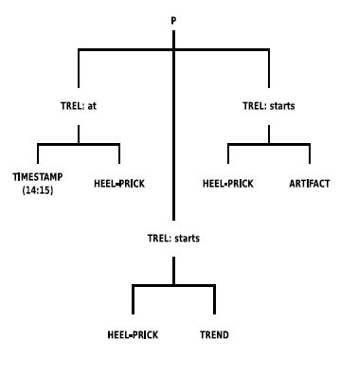
Textual annotation III: deriving trees
At 14:15 hours a heel prick is done.
The HR increases at this point ...
... and for 7 minutes from the start of this procedure there is a lot of artefact...

Slide 25
Evaluation metrics
Surface properties (n-gram overlap)
ROUGE-4
ROUGE-SU (skip bigrams + unigrams)
Content and structure
No. of events mentioned in a text
No. of temporal/discourse relations mentioned in a text
Tree Edit Distance between texts
Knowledge-based relevance measure
REL: extent to which events mentioned in a text are relevant to one or more appropriate action(s).
IRREL: extent to which events are relevant to one or more inappropriate action(s).

Slide 26
Quantifying relevance – I
action 1
w1
w2
action 2
w3
action 3
Main hypothesis
Texts can reference actions to different degrees. This may bias readers towards some actions more than others.
This is reflected by a weight assigned to each action, for each text.
The scores
REL = sum of weights of appropriate actions referenced in the text
IRREL = sum of weights of inappropriate actions referenced in the text

Slide 27
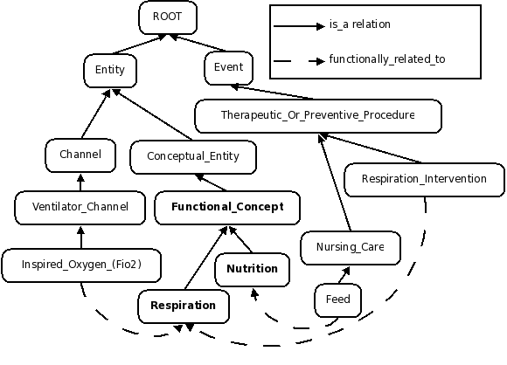
Quantifying relevance - II
“There are 3 episodes of desaturation to 70%”
DESATURATION is functionally linked to RESPIRATION
So are some of the actions
E.g. MANAGE VENTILATION
The DESAT references RESPIRATION-related actions

Slide 28
Quantifying relevance – III
Pruning spurious connections
With the reasoning so far, we can end up with a lot of actions related to each event.
But not all of these are warranted, given the status of a patient.
Solution: use knowledge-based expert rules to prune these connections.
Only assume a connection between an event and the INTUBATE action if the action can indeed be taken.

Slide 29
Quantifying relevance - IV
Estimating prior probabilities
Not all actions that could have been chosen are equally probable.
MANAGE VENTILATION – routine
RESUSCITATE PATIENT – drastic, only in highly critical situations
Actions are weighted by their prior probability, based on a DB of 48K clinical actions (Hunter et al `03)
Event importance
Events are also weighted by their importance.
A resuscitation is much more important than a nappy change.

Slide 30
Results – Surface Properties (I)
Correlation with difference in human performance on H and C texts
No correlations are significant.
 | ROUGE-4 | ROUGE-SU
P | -.19 | .04
P-APP | -.2 | .01
P-INAPP | -.01 | -.1
SP | -.1 | .13

Slide 31
Results – Surface Properties (II)
Correlation with performance on C texts only
No correlations are significant.
 | ROUGE-4 | ROUGE-SU
P | .33 | -.03
P-APP | .38 | -.02
P-INAPP | .2 | .05
SP | -.03 | -.31

Slide 32
Performance metrics for evaluation
18 actions
appropriate
inappropriate
neutral
P-APP
(proportion)
P-INAPP
(proportion)
P
(main score in original study)
-
SP “precision”
(proportion of appropriate actions selected out of the 18 actions)

Slide 33
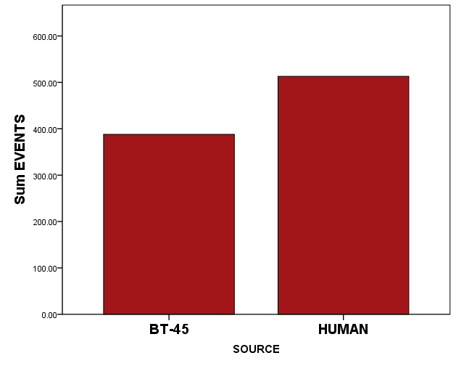
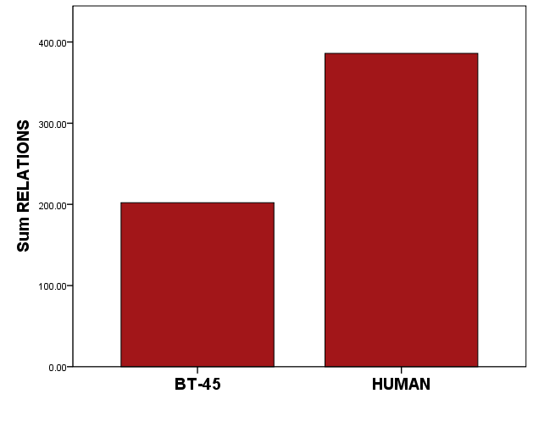
Results – Content and Structure (I)
EVENTS
RELATIONS
t = 2.44, p = .05
t = 3.70, p < .05

Slide 34
Results – Content and Structure (II)
Discourse/temporal relations
For BT-45 texts:
Negative correlation with P-INAP (r = -.49, p < .05)
Positive correlation with SP precision (r = .7, p < .001)
Temporal/discourse relations made texts easier to understand in the case of BT-45.
Events
For BT-45 texts:
Negative correlation with P-APP (r = -.53, p < .05)
Negative correlation with P (r = -.5, p < .05)
Suggests that BT-45 may have mentioned several “irrelevant” events.

Slide 35
Results – Content & Structure (III)
Correlation with performance differences (H-C)
 | EVENTS | RELATIONS | TREE EDIT
P | .43 | .34 | .36
P-APP | .42 | .30 | .33
P-INAPP | -.09 | -.15 | -.14
SP | .02 | 0 | .09
Performance score is positively correlated to the number of events mentioned.
Correlations with relations in the predicted direction.
No significant correlation with Tree Edit
Problem with node duplication method?

Slide 36
Results – Relevance
Correlation: Human texts
All correlations in the predicted direction.
Positive correlations with our precision score, SP.
 | REL | IRREL
P | .14 | -.25
P-APP | .11 | -.22
P-INAPP | -.14 | .1
SP | .60 | -.56

Slide 37
Results – Relevance
Correlation: BT-45 texts
The same overall trends as with H texts.
Suggests that our knowledge-based relevance metrics may be on the right track.
 | REL | IRREL
P | .33 | -.34
P-APP | .24 | -.26
P-INAPP | -.49 | .43
SP | .7 | -.62

Slide 38
Summary
Lack of correlations between “surface” metrics and performance, which echoes similar results by many other authors.
The content and structure of the text correlates with various performance measures.
But we need a better way of comparing underlying text structure directly (graph-based methods?)
Our experiment also gives us a workable definition of the notion of “relevance”, which is found to correlate with precision on a decision-making task.

Slide 39
Conclusions
Unlike many previous evaluation studies, we place more emphasis on domain knowledge:
Enables us to quantify aspects of content, structure and relevance.
These are more systematically related to performance than surface properties.
From a methodological point of view, our results suggest that evaluating NLG systems must factor in the domain knowledge they incorporate.

Slide 40
Evaluating bt-nurse
Part 3

Slide 41
BT-Nurse: Example summary
Respiratory Support
Current Status
Currently, the baby is on CMV in 27 % O2. Vent RR is 55 breaths per minute. Pressures are 20/4 cms H2O. Tidal volume is 1.5.
SaO2 is variable within the acceptable range and there have been some desaturations.
The most recent blood gas was taken at around 07:45. Parameters are acceptable.
Events During the Shift
[...] Another ABG was taken at around 23:00. Blood gas parameters had deteriorated to respiratory acidosis by around 23:00.
[…] The baby was intubated at 00:15 and was put on CMV. […] He was given morphine and suxamethonium.
[…] Between 00:30 and 03:15, SaO2 increased from 88 % to 97 %.
Another ABG was taken at around 00:45. pH was 7.18. CO2 dropped to 7.95 kPa. BE was -4.8 mmol/L.

Slide 42
Evaluating BT-Nurse
Method
Deployed on-ward for three months (1 month pilot + 2 months evaluation) at the Edinburgh Royal Infirmary.
Integrated with cotside patient management system;
Used under supervision (for evaluation purposes);
Generated summaries from real-time, unseen patient data.
Details
54 different nurses; 31 different patients
165 evaluation scenarios
92 with incoming nurses (56%); 73 with outgoing nurses (44%)
System breakdowns: 0%

Slide 43
Deployment of BT-Nurse

Slide 44
Evaluation measures
Nurses asked to express dis/agreement with three statements:
Understandability: "The BT-Nurse summary was easy to understand”
Accuracy: “The BT-Nurse summary is accurate”
Utility: “The BT-Nurse summary would help me...”
“...write a shift summary” [outgoing]
“...plan a shift” [incoming]
Nurses also asked to comment freely on the text.

Slide 45
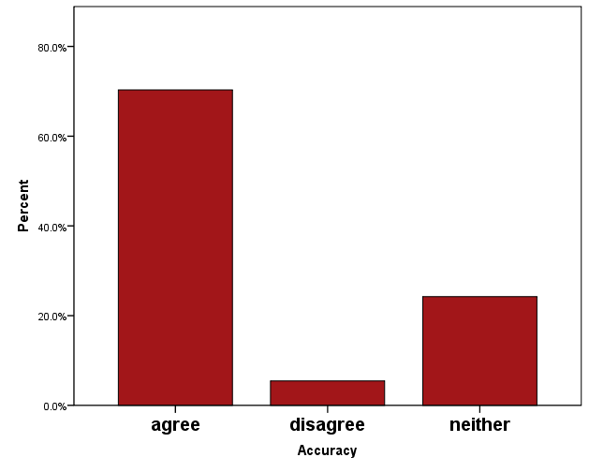
“The summary reflects what actually happened”
Positive trend is statistically significant.
No difference between incoming/outgoing.

Slide 46
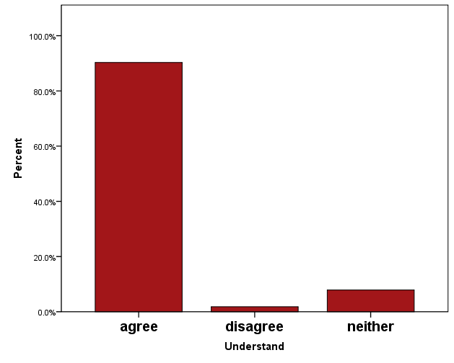
“The summary was easy to understand”
Positive trend is statistically significant.
No difference between incoming/outgoing.

Slide 47
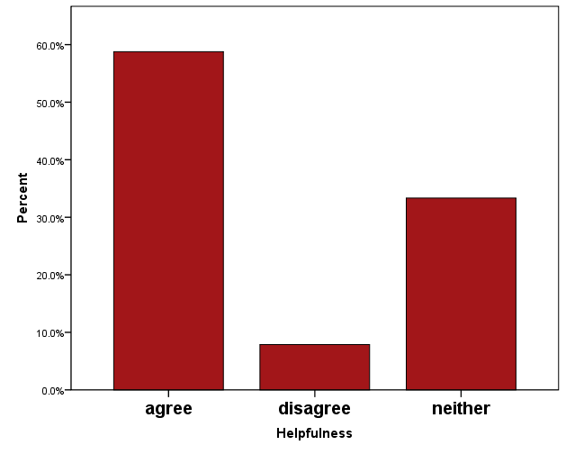
“The summary was helpful”
Positive trend is statistically significant.
No difference between incoming/outgoing.

Slide 48
Comments from users
We obtained comments for 138 scenarios out of 165 (83.6%)
Segmentation
Comments were manually segmented.
237 segments in all
Content categories:
Overall (good/bad/neutral)
Content (good/unnecessary/missing...)
Language (good/poor)
3 independent annotators; good to moderate agreement using Kappa.

Slide 49
Example segmentation
Example
Cardio - 'HR increased from 153 bpm to 154 bpm.' Not significant. Temp gap - ? Acceptable range. Would prefer a number
Segmentation
Content: Cardio - 'HR increased from 153 bpm to 154 bpm.' Not significant.
Category: unnecessary
Language: Temp gap - ? Acceptable range. Would prefer a number
Category: poor

Slide 50
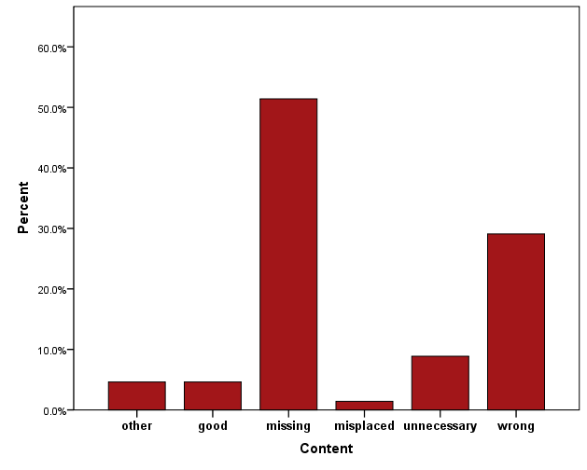
Summary content
185 segments
Mostly about missing or incorrect content.
I cannot see how BT got the figure of 6.91 ml for urine output.
Sometimes directly relevant to BT’s content selection & document planning:
[BT has done a good job of reporting extubation and intubation,] though the listing of the dose of suxamethonium could have been with the note about intubation.

Slide 51
Language
Comments about wording or phrasing:
Changes to vent settings is written in a confusing way.
Sometimes, BT-Nurse gets the pragmatics wrong:
BT says: 'Between 22:30 and 02:30, FiO2 was raised from 40% to 51%'. When I read this phrase it makes me think that the baby spent those whole four hours at 51% oxygen.
11 segments only.
How do we interpret this?
Maybe language only draws attention to itself when it’s really bad (or really good).
The absence of comments might mean that it was ok most of the time.

Slide 52
Summary
Summary
Majority of users find summaries easy to understand, accurate and useful.
Comments suggest that language is OK. Content issues could be resolved with more knowledge engineering.
Methodological pros:
Real setup
Real users
No artificial tasks
A solid test of system robustness
Methodological cons:
Relatively uncontrolled (not an experimental design)
Difficult to answer questions about decision-making accuracy
Need to rely on user comments for evaluation of content selection and language generation.
J. Hunter, Y. Freer, A. Gatt, E. Reiter, S. Sripada, C. Sykes, D. Westwater. BT-Nurse: Computer Generation of Natural Language Shift Summaries from Complex Heterogeneous Medical Data. Submitted to Journal of the American Medical Informatics Association (JAMIA)

Slide 53
Comparative evaluation of referring expression generation
Part 4

Slide 54
Comparative evaluation
In many cases (as with BT), an evaluation depends on the nature of the system one has designed.
However, in many areas of NLP, it is common to organise shared tasks:
A common input
A common task
Compare outputs in an evaluation
The advantages are:
It’s easier to see which solutions perform best and find the reasons why.
We have a lot of data for the same problem, and so can experiment with different evaluation methods and see whether they are comparable.

Slide 55
Case Study
Generation Challenges has been organised since 2007.
Wide range of different NLG tasks.
We focus here on the TUNA tasks.
Comparison of algorithms for Generating Referring Expressions.
Based on data collected during the TUNA project.

Slide 56
NLG “consensus” architecture
Select content
Structure document
Relate document parts
Document Planner
Map content to semantic structure
Select lexical items
Generate referring expressions
Perform syntactic aggregation
Microplanner
(text planner)
Surface Realiser
Create syntactic structure
Morphological operations

Slide 57
NLG “consensus” architecture
Select content
Structure document
Relate document parts
Document Planner
What does the system know about a discourse entity?
What properties should it use?
How should it be realised?
the bradycardia
the bradycardia down to 69
it
the first bradycardia
Map content to semantic structure
Select lexical items
Generate referring expressions
Perform syntactic aggregation
Microplanner
(text planner)
Surface Realiser
Create syntactic structure
Morphological operations

Slide 58
Generation of Referring Expressions
Input
domain of relevant discourse entities
a target referent
Output
a noun phrase to identify that entity.
Subtasks
Content determination
choosing what to say (the properties of the entity)
Realisation
choosing how to say it
An important component of many NLG systems.
One of the most intensively studied tasks in NLG.

Slide 59
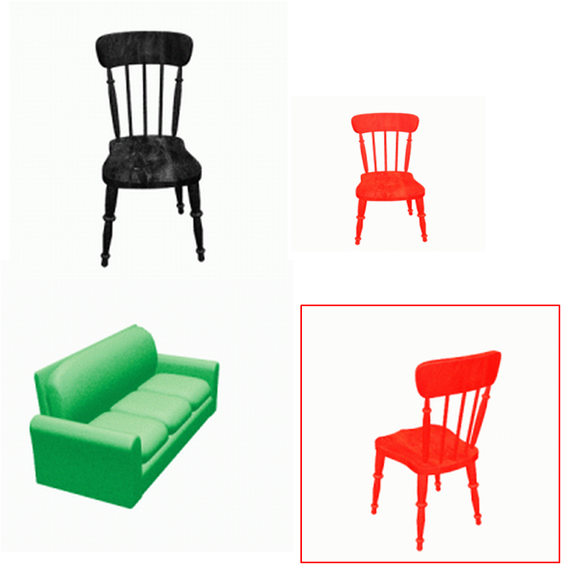
GRE Example
the red chair facing back
the large chair facing back
the red chair
the chair facing back
it
Domain + referent
Distinguishing descriptions

Slide 60
GRE and comparative evaluation
Generation Challenges
Series of shared tasks in areas of NLG
TUNA-REG Challenges organised as part of this, over three years (2007 – 2009)
Focus today: results from 2009
GRE considered a very good candidate for the first shared tasks.
Significant agreement on task definition.
Data available: TUNA Corpus

Slide 61
Data & task
TUNA Corpus
human-authored referring expressions of furniture or people;
collected via an online elicitation experiment;
human authors typed descriptions of referents in a visual context;
referents belonged to 2 domains: furniture or people.
Task definition
Submitted systems needed to:
select the content of referring expressions
realise it as a string

Slide 62
Corpus data
Input
<DOMAIN>
<ENTITY type=“target”>
<ATTRIBUTE NAME=“type” VALUE=“person”/>
<ATTRIBUTE NAME=“hasHair” VALUE=“0”/>
<ATTRIBUTE NAME=“hasBeard” VALUE=“1”/>
….
</ENTITY>
<ENTITY type=“distractor”> … </ENTITY>
….
</DOMAIN>
<WORD-STRING>
the bald man with a beard
</WORD-STRING>
Reference output
“the bald man with a beard”

Slide 63
Shared Task Setup
Original TUNA Corpus (singular section)
80% training data
20% development data
Test data
112 input DOMAINs
2 human outputs for each input DOMAIN
equal no. of people and furniture cases
Participants
6 different systems in the 2009 edition
many others in previous (2007-8) editions

Slide 64
Evaluation criteria in TUNA-REG
Humanlikeness
Adequacy/Clarity
Fluency
Referential Clarity
Intrinsic methods:
Assess properties of systems in their own right
Extrinsic method:
Assesses properties of systems in terms of its effect on human performance

Slide 65
Evaluation criteria
Humanlikeness
compares system outputs to human outputs
automatically computed

Slide 66
Measures of humanlikeness
String Edit (Levenshtein) Distance
number of insertions, deletions and substitutions to convert a peer description into the human description
BLEU-3
n-gram based string comparison
NIST-5
weighted version of BLEU, with more importance given to less frequent n-grams
Accuracy
proportion of outputs which are identical to the corresponding human description

Slide 67
Evaluation criteria
Humanlikeness
compares system outputs to human outputs
automatically computed
Adequacy
judgement of adequacy of a description for the referent in its domain
assessed by native speakers

Slide 68
Evaluation criteria
Humanlikeness
compares system outputs to human outputs
automatically computed
Adequacy
judgement of adequacy of a description for the referent in its domain
assessed by native speakers
Fluency
judgement of fluency of description
assessed by native speakers

Slide 69
Measures of adequacy and fluency
Experiment with 8 linguistically aware native speakers
all postgraduate students in Language/Linguistics
Participants shown:
system-generated or human-authored description
corresponding visual domain
Answered two questions:
How clear is this description? (Is it clear what object it refers to?)
How fluent is this description? (Does it read well?)
Ratings given using a slider (value between 1 and 100)
overcomes some of the objections to means comparison with interval scales

Slide 70
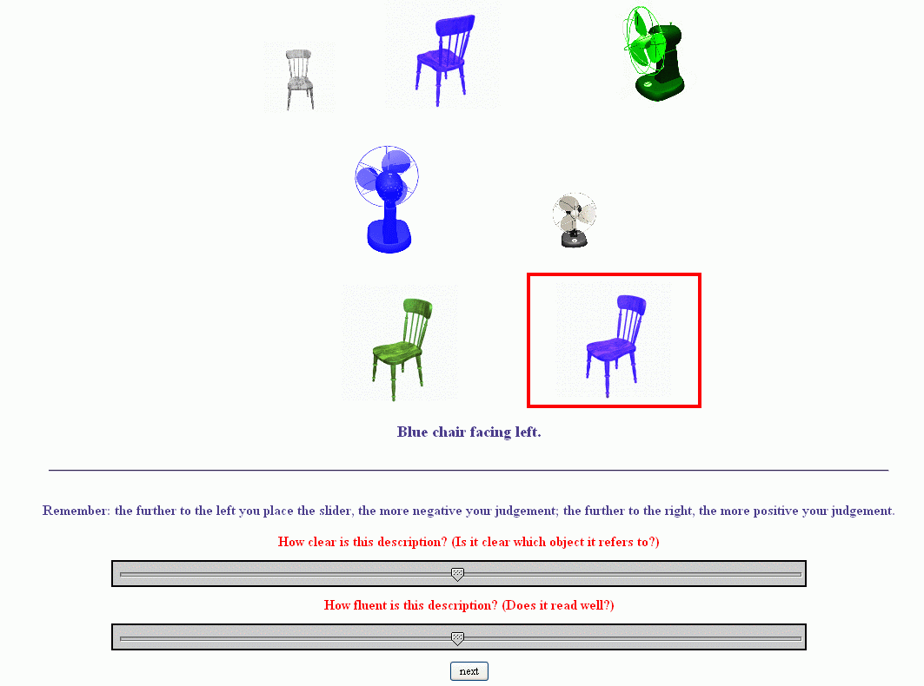
Experimental trial

Slide 71
Evaluation criteria
Humanlikeness
compares system outputs to human outputs
automatically computed
Adequacy
judgement of adequacy of a description for the referent in its domain
assessed by native speakers
Fluency
judgement of fluency of description
assessed by native speakers
Referential clarity (task-based)
speed and accuracy in an identification experiment
performance on task as index of output quality

Slide 72
Measuring referential clarity
Identification experiment with 16 participants
Procedure
participants shown a visual domain
heard a description over headset produced using a TTS system
clicked on the object identified
Measures
Identification speed (ms): how fast an object was identified
Identification accuracy (%): whether the correct (intended) object was identified

Slide 73
Referential clarity experimental setup
Identification speed = speed of identification based on description
Identification accuracy = error rate
System description:
blue chair facing left

Slide 74
Our main question
Are the different measures meaningfully related?
Do they tell us the same things about system quality?
Do they correlate?

Slide 75
Intrinsic human
 | Fluency | Adequacy | Acc. | SE | BLEU | NIST | ID Acc. | ID Speed
Fluency | 1 | 0.68
Adequacy | 0.68 | 1
Accuracy
SE
BLEU
NIST
ID Acc.
ID Speed

Slide 76
Intrinsic human + intrinsic automatic
 | Fluency | Adequacy | Acc. | SE | BLEU | NIST | ID Acc. | ID Speed
Fluency | 1 | 0.68 | 0.85 | -0.57 | 0.66 | 0.3
Adequacy | 0.68 | 1 | 0.83 | -0.29 | 0.6 | 0.48
Accuracy | 0.85 | 0.83 | 1 | -0.68 | .86 | 0.49
SE | -0.57 | -0.29 | -0.68 | 1 | -0.75 | -0.07
BLEU | 0.66 | 0.6 | .86 | -0.75 | 1 | 0.71
NIST | 0.3 | 0.48 | 0.49 | -0.07 | 0.71 | 1
ID Acc.
ID Speed

Slide 77
Intrinsic human + intrinsic automatic + extrinsic
 | Fluency | Adequacy | Acc. | SE | BLEU | NIST | ID Acc. | ID Speed
Fluency | 1 | 0.68 | 0.85 | -0.57 | 0.66 | 0.3 | 0.5 | -0.89
Adequacy | 0.68 | 1 | 0.83 | -0.29 | 0.6 | 0.48 | 0.95 | -0.65
Accuracy | 0.85 | 0.83 | 1 | -0.68 | .86 | 0.49 | 0.68 | -0.79
SE | -0.57 | -0.29 | -0.68 | 1 | -0.75 | -0.07 | -0.01 | 0.68
BLEU | 0.66 | 0.6 | .86 | -0.75 | 1 | 0.71 | 0.49 | -0.51
NIST | 0.3 | 0.48 | 0.49 | -0.07 | 0.71 | 1 | 0.6 | 0.06
ID Acc. | 0.5 | 0.95 | 0.68 | -0.01 | 0.49 | 0.6 | 1 | -0.39
ID Speed | -0.89 | -0.65 | -0.79 | 0.68 | -0.51 | 0.06 | -0.39 | 1

Slide 78
Results: summary
What is the relationship between evaluation methods?
no correlation between intrinsic automatic and extrinsic measures;
intrinsic, human measures correlate better with extrinsic measures;
intrinsic, automatic measures correlate only partially with intrinsic, human measures (Accuracy only)
Do these results generalise?
Similar results found in two previous Shared Tasks (2007, 2008).
These included many more systems.

Slide 79
Some possible explanations
Corpus contains a lot of individual variation (several authors).
Not all referring expressions are of “high quality” (e.g. some are very telegraphic).
BLEU/NIST more appropriate for long texts.
But still…
What people do need not reflect what people like.
We should not always expect intrinsic automatic measures to correlate with judgements.
What people do/like need not reflect what is effective.
We should not always expect intrinsic measures to correlate with task performance.

Slide 80
Some general conclusions
Our results suggest that the relationship between intrinsic/corpus-based and extrinsic evaluation is problematic.
Referring expressions generation: 3 different sets of evaluation studies, over 3 years.
In general, we should not rely on automatic techniques to make inferences about effectiveness of our NLG modules.

Slide 81
Data etc
Generation Challenges data archive (includes TUNA data, plus data from other shared tasks in NLG):
https://sites.google.com/site/genchalrepository/
TUNA Project (where the TUNA corpus was developed):
http://www.abdn.ac.uk/ncs/computing/research/nlg/projects/previous/tuna/

